Slide 1
The Road Vulnerability Sage
Frederico Pedroso
Transport Specialist, World Bank
Improvement of Road Network Resilience
“Strategies for Cost-Effective Climate Change Adaptation and Sustainable Development”
12-14 November 2025 / Maputo, Mozambique

Slide 2
Presentation Structure
  Disaster Risk Management Basics
  Nexus : DRM and Transport
  Road Asset Management : Lifecycle and Resilience
  Case Studies:
    Belize
    Samoa
    Brazil
  Conclusions

Slide 3






Why do we need to Assess Road Vulnerability?
  Disaster Risk Management Basics

Slide 4
Transport Planning and Design x Disaster Risk Management
Inadequate
Infrastructure Condition
and Maintenance
Vulnerability
Disaster
Risk
Climate
and
Natural
Hazards
Exposure
Climate
Change
Inadequate Infrastructure Planning and Design

Slide 5
Bringing all together…
Natural Hazards Assessment
Asset Condition Assessment
Vulnerability Curves

Slide 6
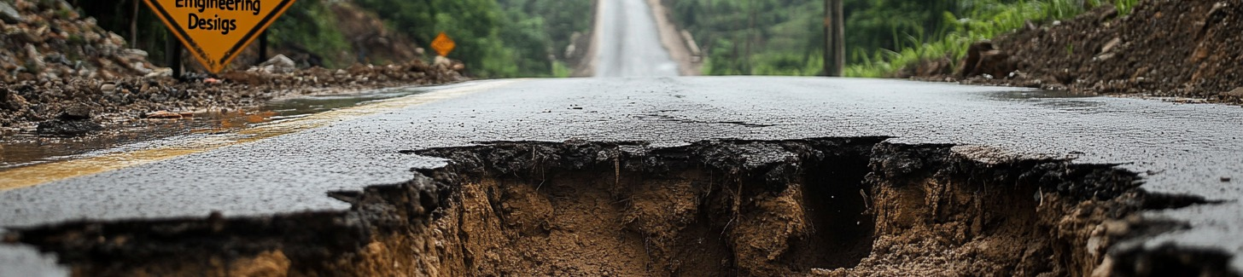
Resilient Asset Life-cycle
Vulnerability Assessment
Road Asset Management Systems
Resilient Asset Life-Cycle

Slide 7
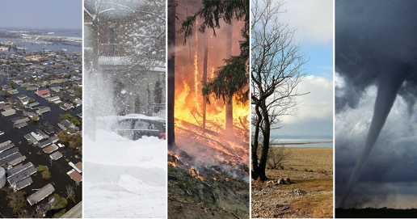
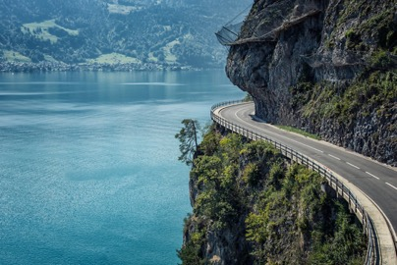

Resilient Asset Life-cycle
≈
Natural Hazard(s)
Risk = f (NH; E; V)
Exposure
Where:
V = f (Condition; Design STA; …)
Vulnerability

Slide 8

Case Studies

Slide 9
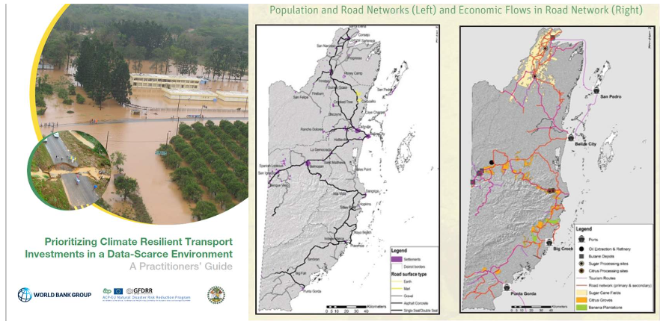
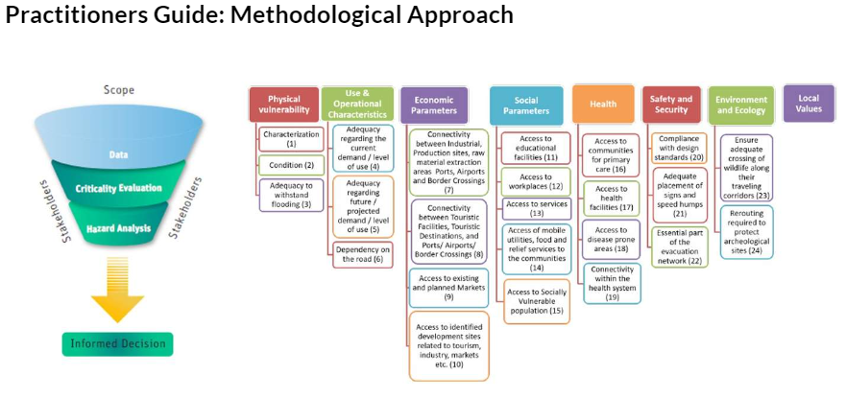
Belize: Engineering Designs (1/2)

Slide 10
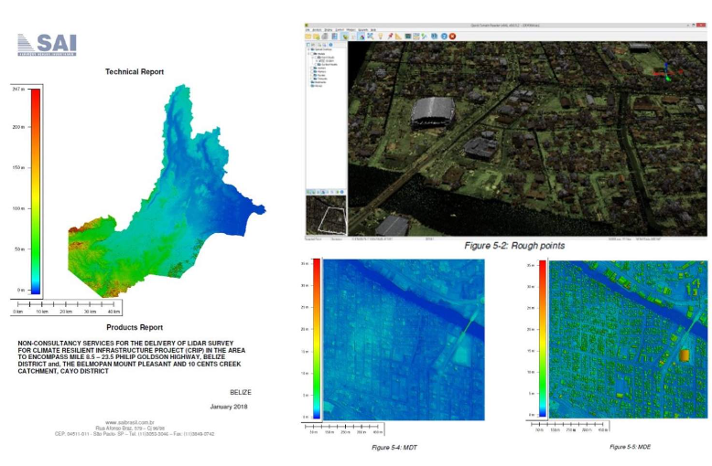
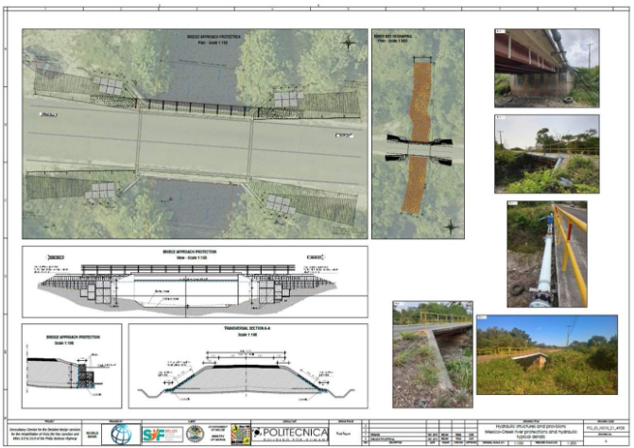
Belize: Engineering Designs (2/2)

Slide 11
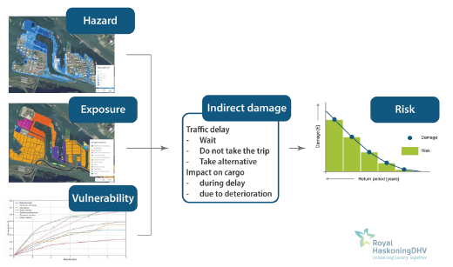
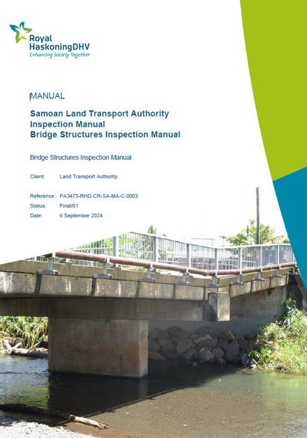
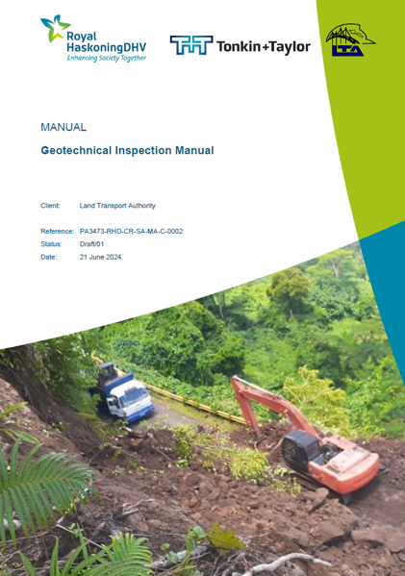
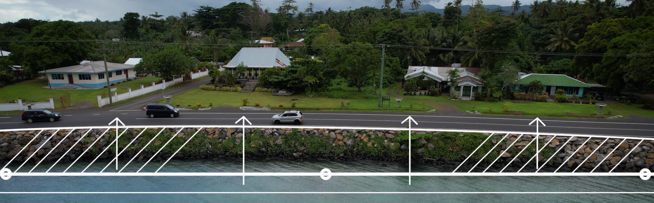
Samoa: Road Asset Management System (1/3)
11

Slide 12
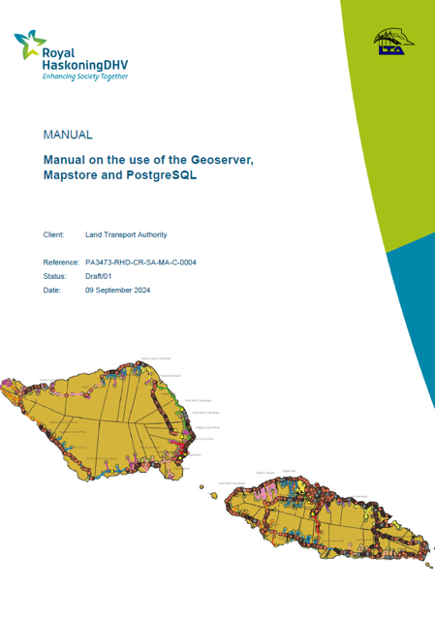
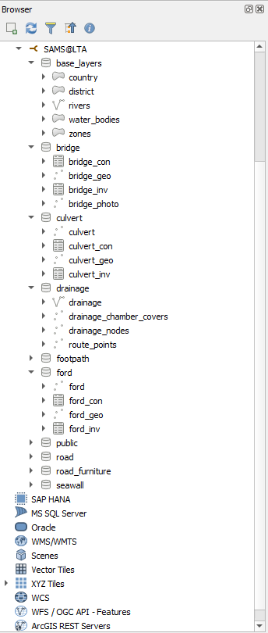
Samoa: Road Asset Management System (2/3)
Want to know more?
https://www.worldbank.org/en/news/immersive-story/2024/01/31/building-beyond-tomorrow

Slide 13
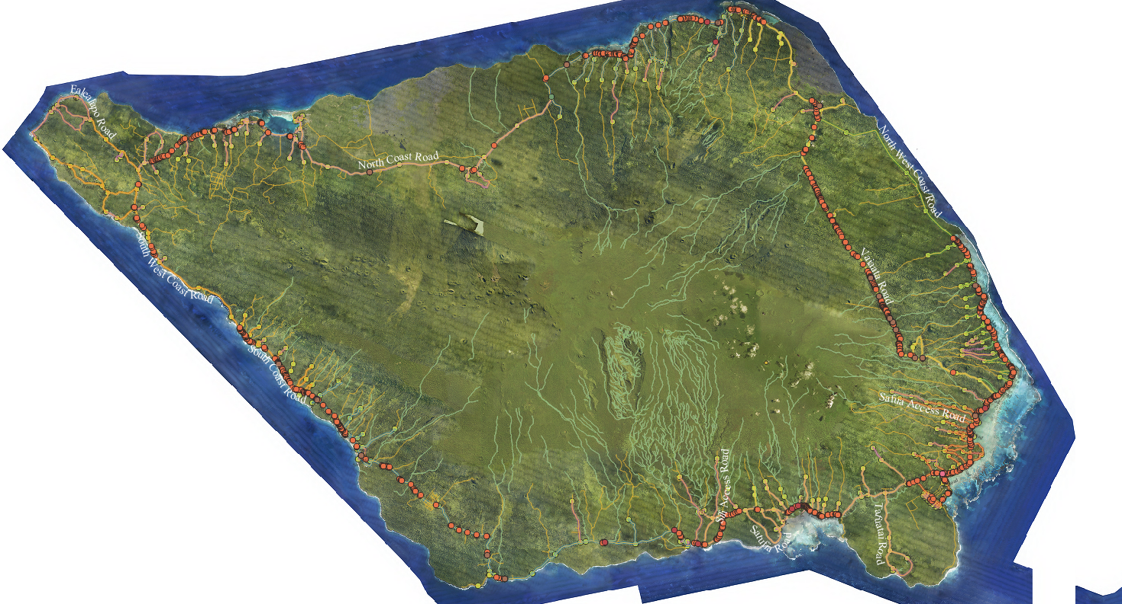
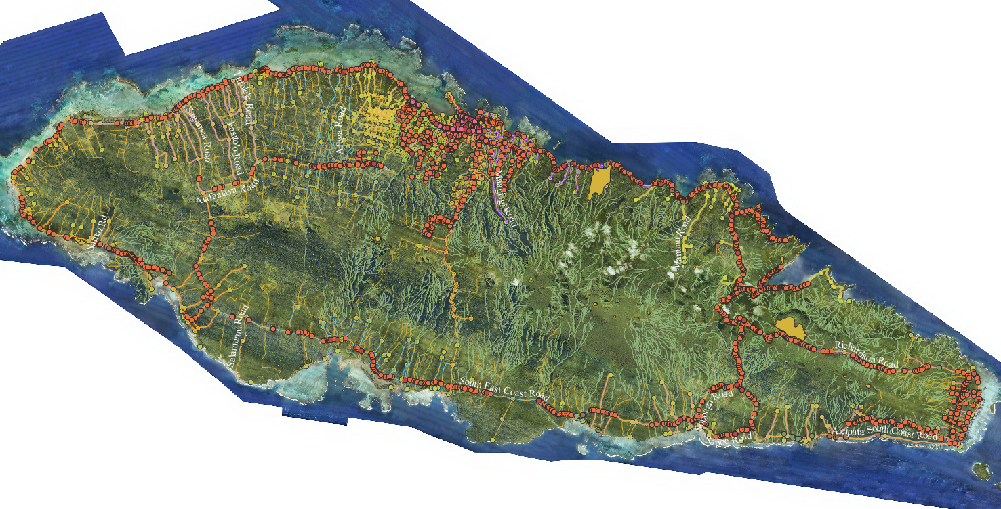
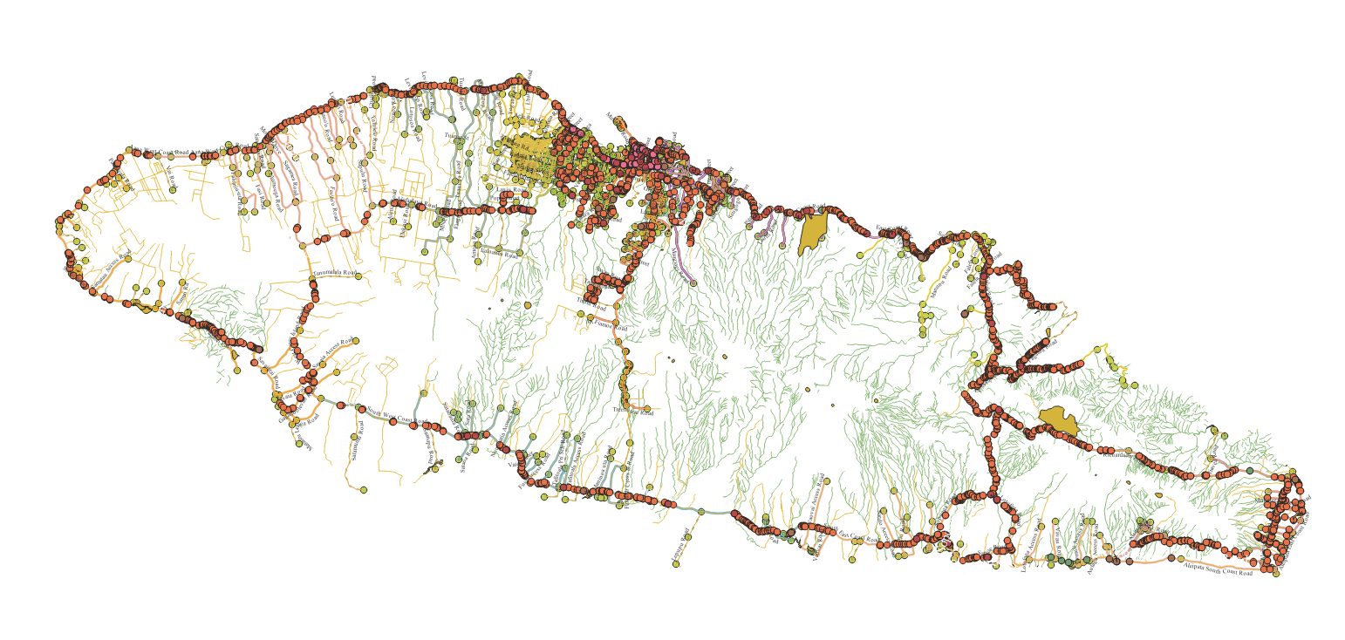
Samoa: Road Asset Management System (3/3)
Want to know more?
https://www.worldbank.org/en/news/immersive-story/2024/01/31/building-beyond-tomorrow

Slide 14
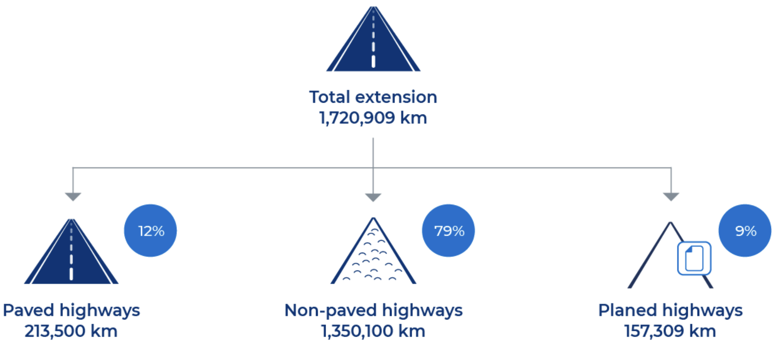
Brazil: Performance Based Contracts (1/3)
The Solution: AN Inspection Manual
Developed by World Bank for the Brazilian Pro-Roads Program
CREMA 2.0 contracts
Brazilian Pro-Roads Program
Integrates climate resilience into road infrastructure management
Roadmap for conducting resilience diagnosis
Identification of climate hazards threatening integrity and functionality of road networks.
Focus on key elements that can be impacted by climate hazards.
Anticipates potential structural and operational disruptions across road network.
Provides pro-active adaptation measures and strategies to enhance resilience and mitigate risks.

Slide 15
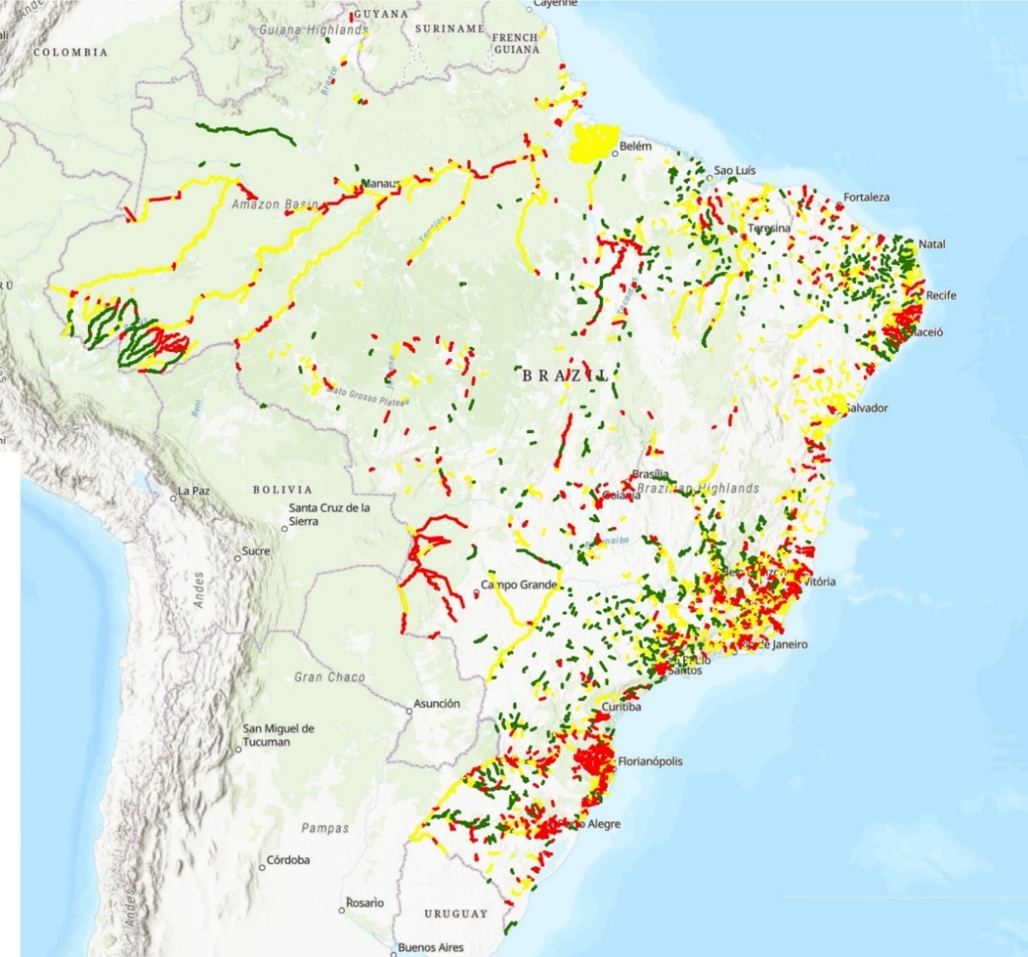
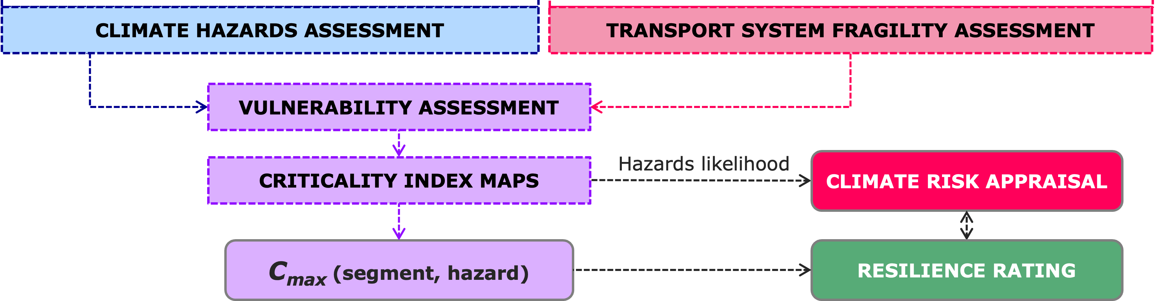
Brazil: Performance Based Contracts (2/3)
    Hazard Identification: Climate models (IPCC+ history) to identify climate risks (floods, landslides).
    Exposure Assessment: GIS tools to evaluate road exposure to identified hazards.
    Fragility Assessment: Assessment of road segments based on their condition status.
    Vulnerability and Criticality Assessment: Combine fragility + exposure to prioritize interventions.
    Resilience Strategies: Develop adaptation and maintenance measures to address issues.

Slide 16
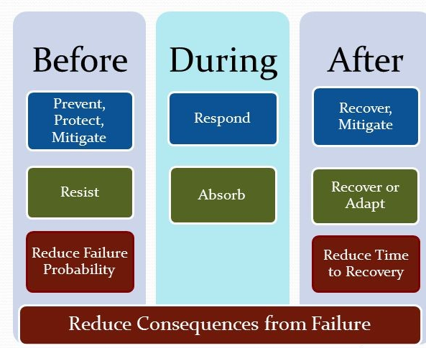
Brazil: Performance Based Contracts (3/3)
Guidelines for integrating climate resilience into road management
Highest standards of climate resilience and road safety.
Tools to assess and mitigate climate-related vulnerabilities.
Guidance on risk allocation between public and private sectors
Instrumental for resilience management plans (RMP).
Capacity building
Instrumental for continuous monitoring of road networks fragility and performance
Continuous monitoring
Long-term, performance-based contracts.
Enhance sustainability and safety factors
Resilience assessment
Risk mitigation & Investment prioritization

Slide 17
In Conclusion: THE ULTIMATE GOAL
Road Network Vulnerability Assessment
Road Asset Vulnerability Assessment
Road Asset Management Systems
Investment Plans

Slide 18
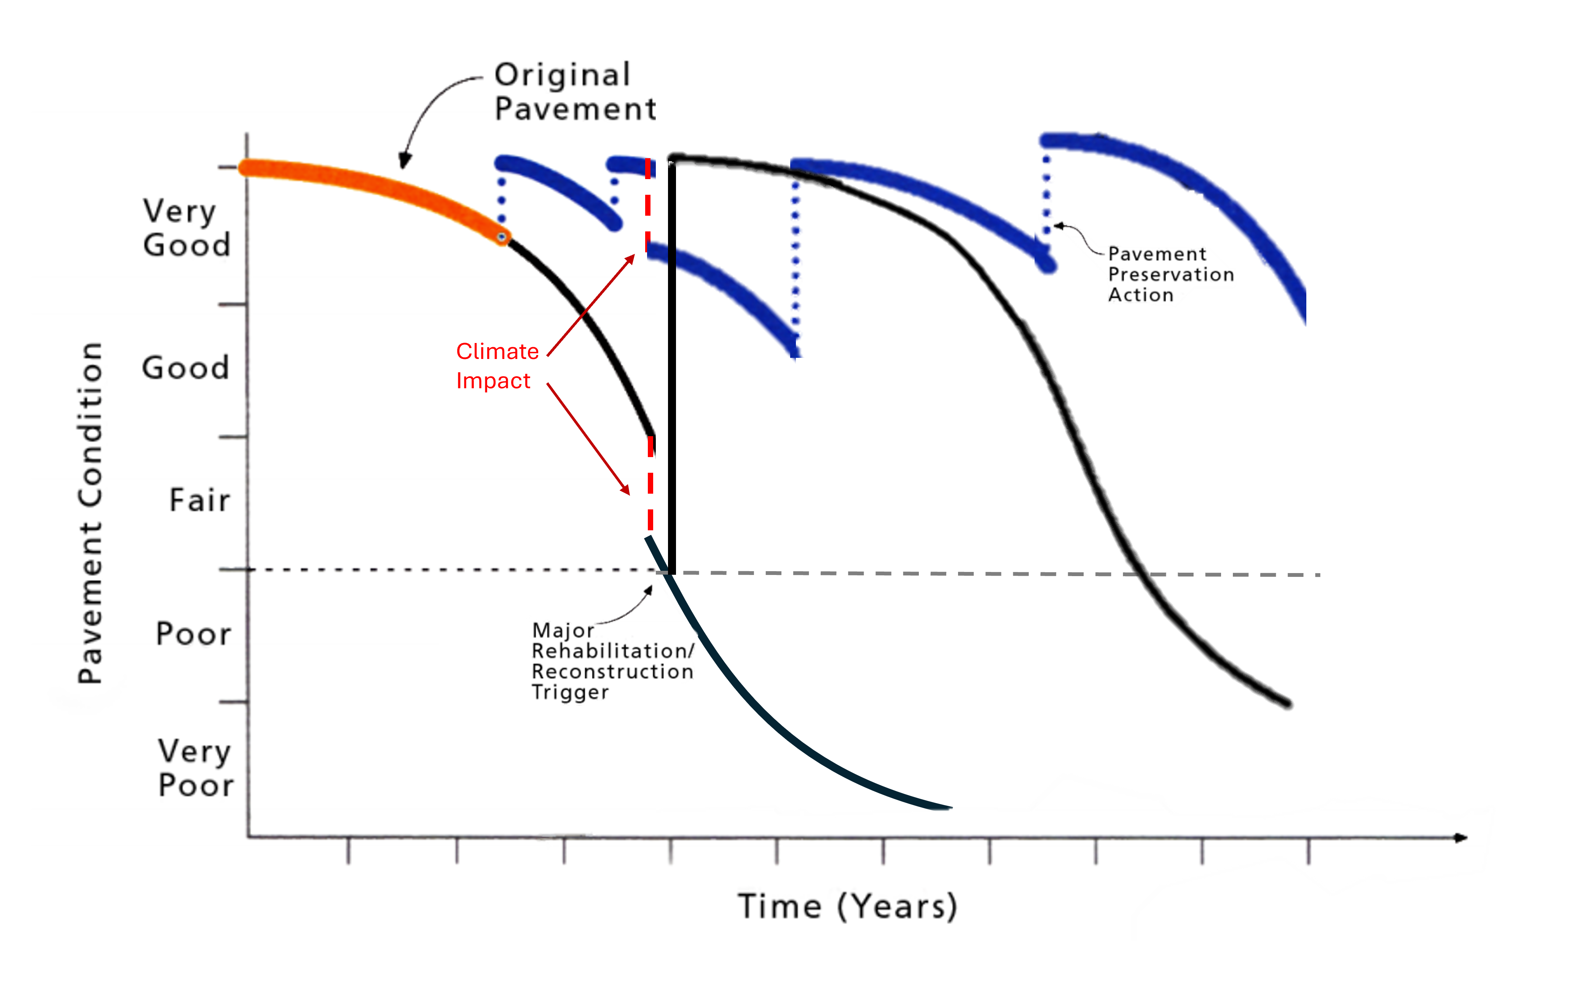
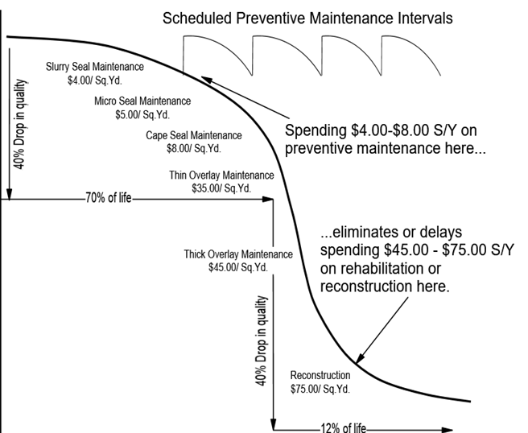
In Conclusion: THE ULTIMATE GOAL
Increased Accountability of private contractors for the ongoing condition through measurable KPIs.
Reduced Risk of Disruptions: Proactive maintenance reduces the risk of road closures from events
Cost Efficiency: Preventative measures minimize long-term repair costs by addressing issues early.
Sustainability: Enhanced resilience extends infrastructure life and reduces impacts over time.

Slide 19
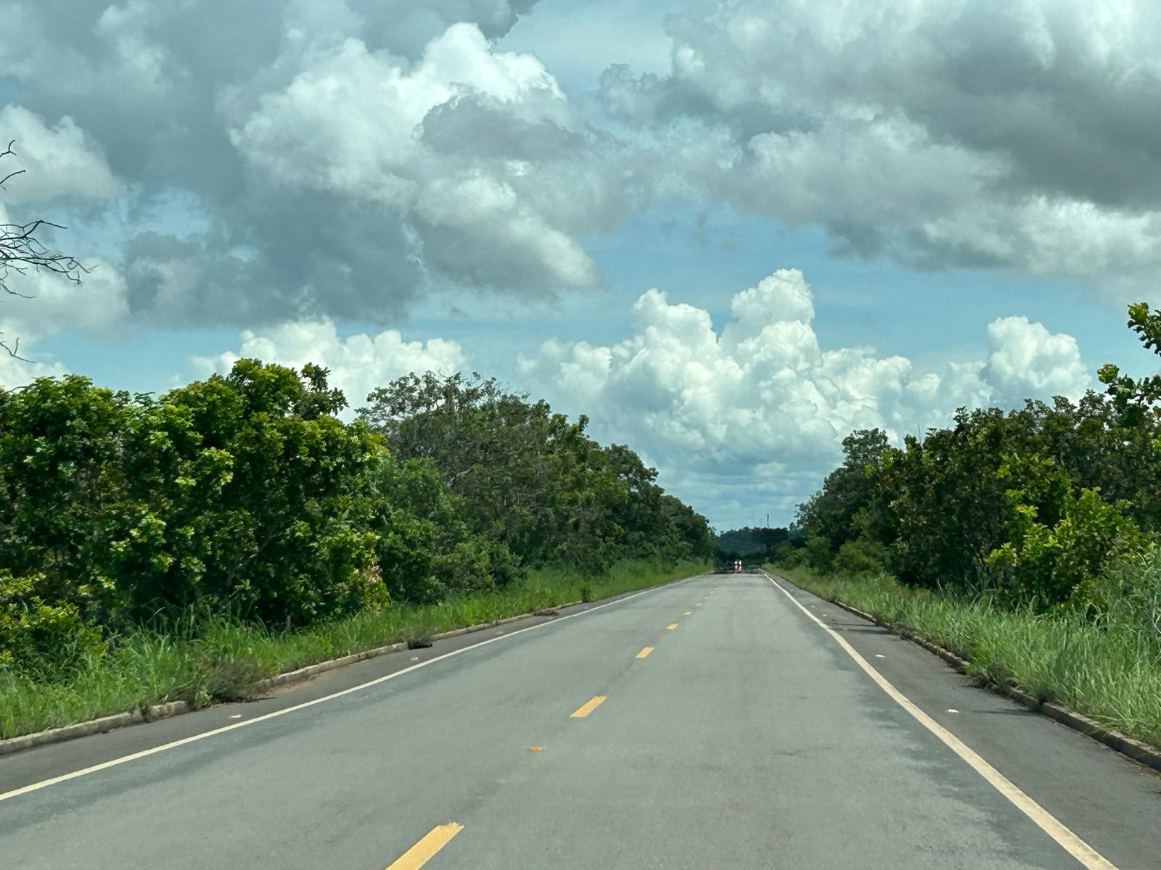
A last thought
If you are the decision maker, what to choose from?
Road Safety?
Drainage?
Road Marking?
Pavement conservation?
Climate change?
Vegetation control?
Maintenance?

Slide 20
Thank you for your attention!
Frederico Pedroso
Transport Specialist
fpedroso@worldbank.org
@twitter

