Slide 1
Governance and Sustainable Financing for Road Resilience in Southern Africa: Challenges and Opportunities for Mozambique
Hermen C. Dabo
Improvement of Road Network Resilience
“Strategies for Cost-Effective Climate Change Adaptation and Sustainable Development”
12-14 November 2025 / Maputo, Mozambique

Slide 2
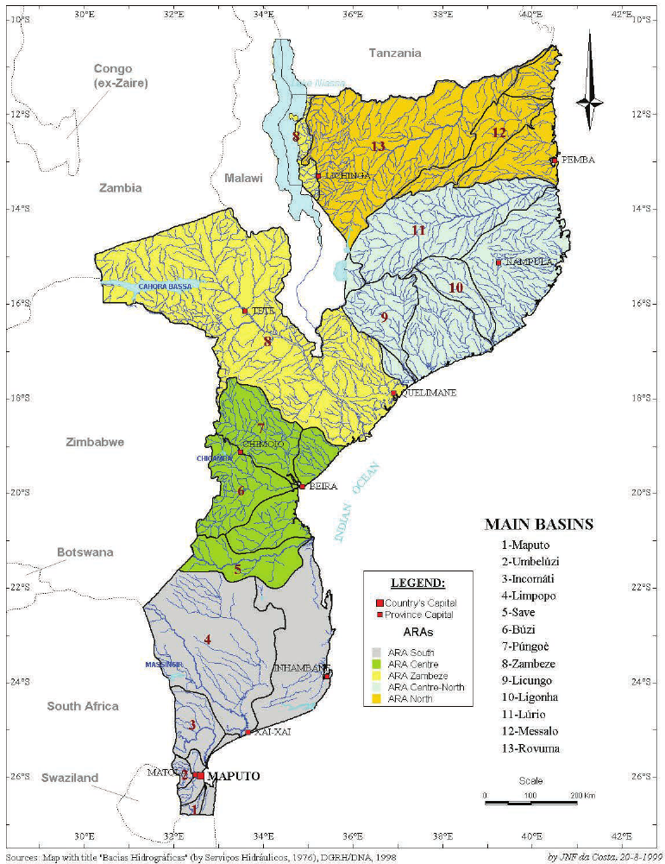
Why care for climate resillience?
  Climate change may add $130M–$1.5B to transport costs by 2050
  Recent cyclones already caused $3B+ in damage
  Climate Vulnerability
  Temperature increases of 1.4 to 3.0°C by 2060 and more intense, concentrated rainfall
  Droughts, cyclones, and floods
  Mozambique now averages 1.5 tropical cyclones annually
Notes:
Aqui fala da vulnerabilidade do país e depois da vulnerabilidade geografica e de custos... Então nos proximos vais falar mais da vulnerabilidade da rede de estradas
Aqui começar com o statement forte “WE DO NOT HAVE THE RESOURCES TO IGNORE CLIMATE RESILIENCE”
Dizer aqui que it pains you to say that we do not have the money to pay for post disaster reconstruction, but it relieves me to say that mozambique is not the only country dealing with funding problems... And we have examples of countries thriving in finding alternative solutions
Mozambique is a downstream country and is highly exposed to pressures resulting from upstream water-resources management decisions, especially during the rainy season.

Slide 3
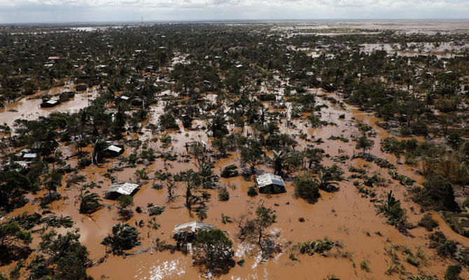
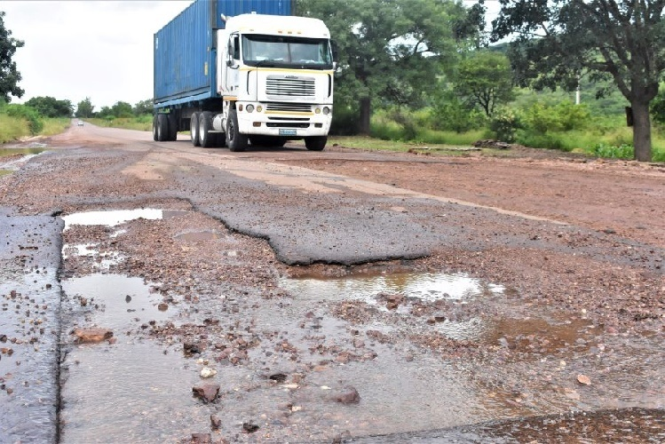
Why We Cannot Afford to Ignore Climate Resilience
High Vulnerability to climate changes
Flood & Climate Exposure
Maintenance & Degradation Pressures
Notes:
Fragile and Predominantly Unpaved Network (Only 21% of the road network is paved)
Deficient and Outdated Design Standards
Lack of network redundance
Around 60% of the road network crosses flood prone areas

Slide 4
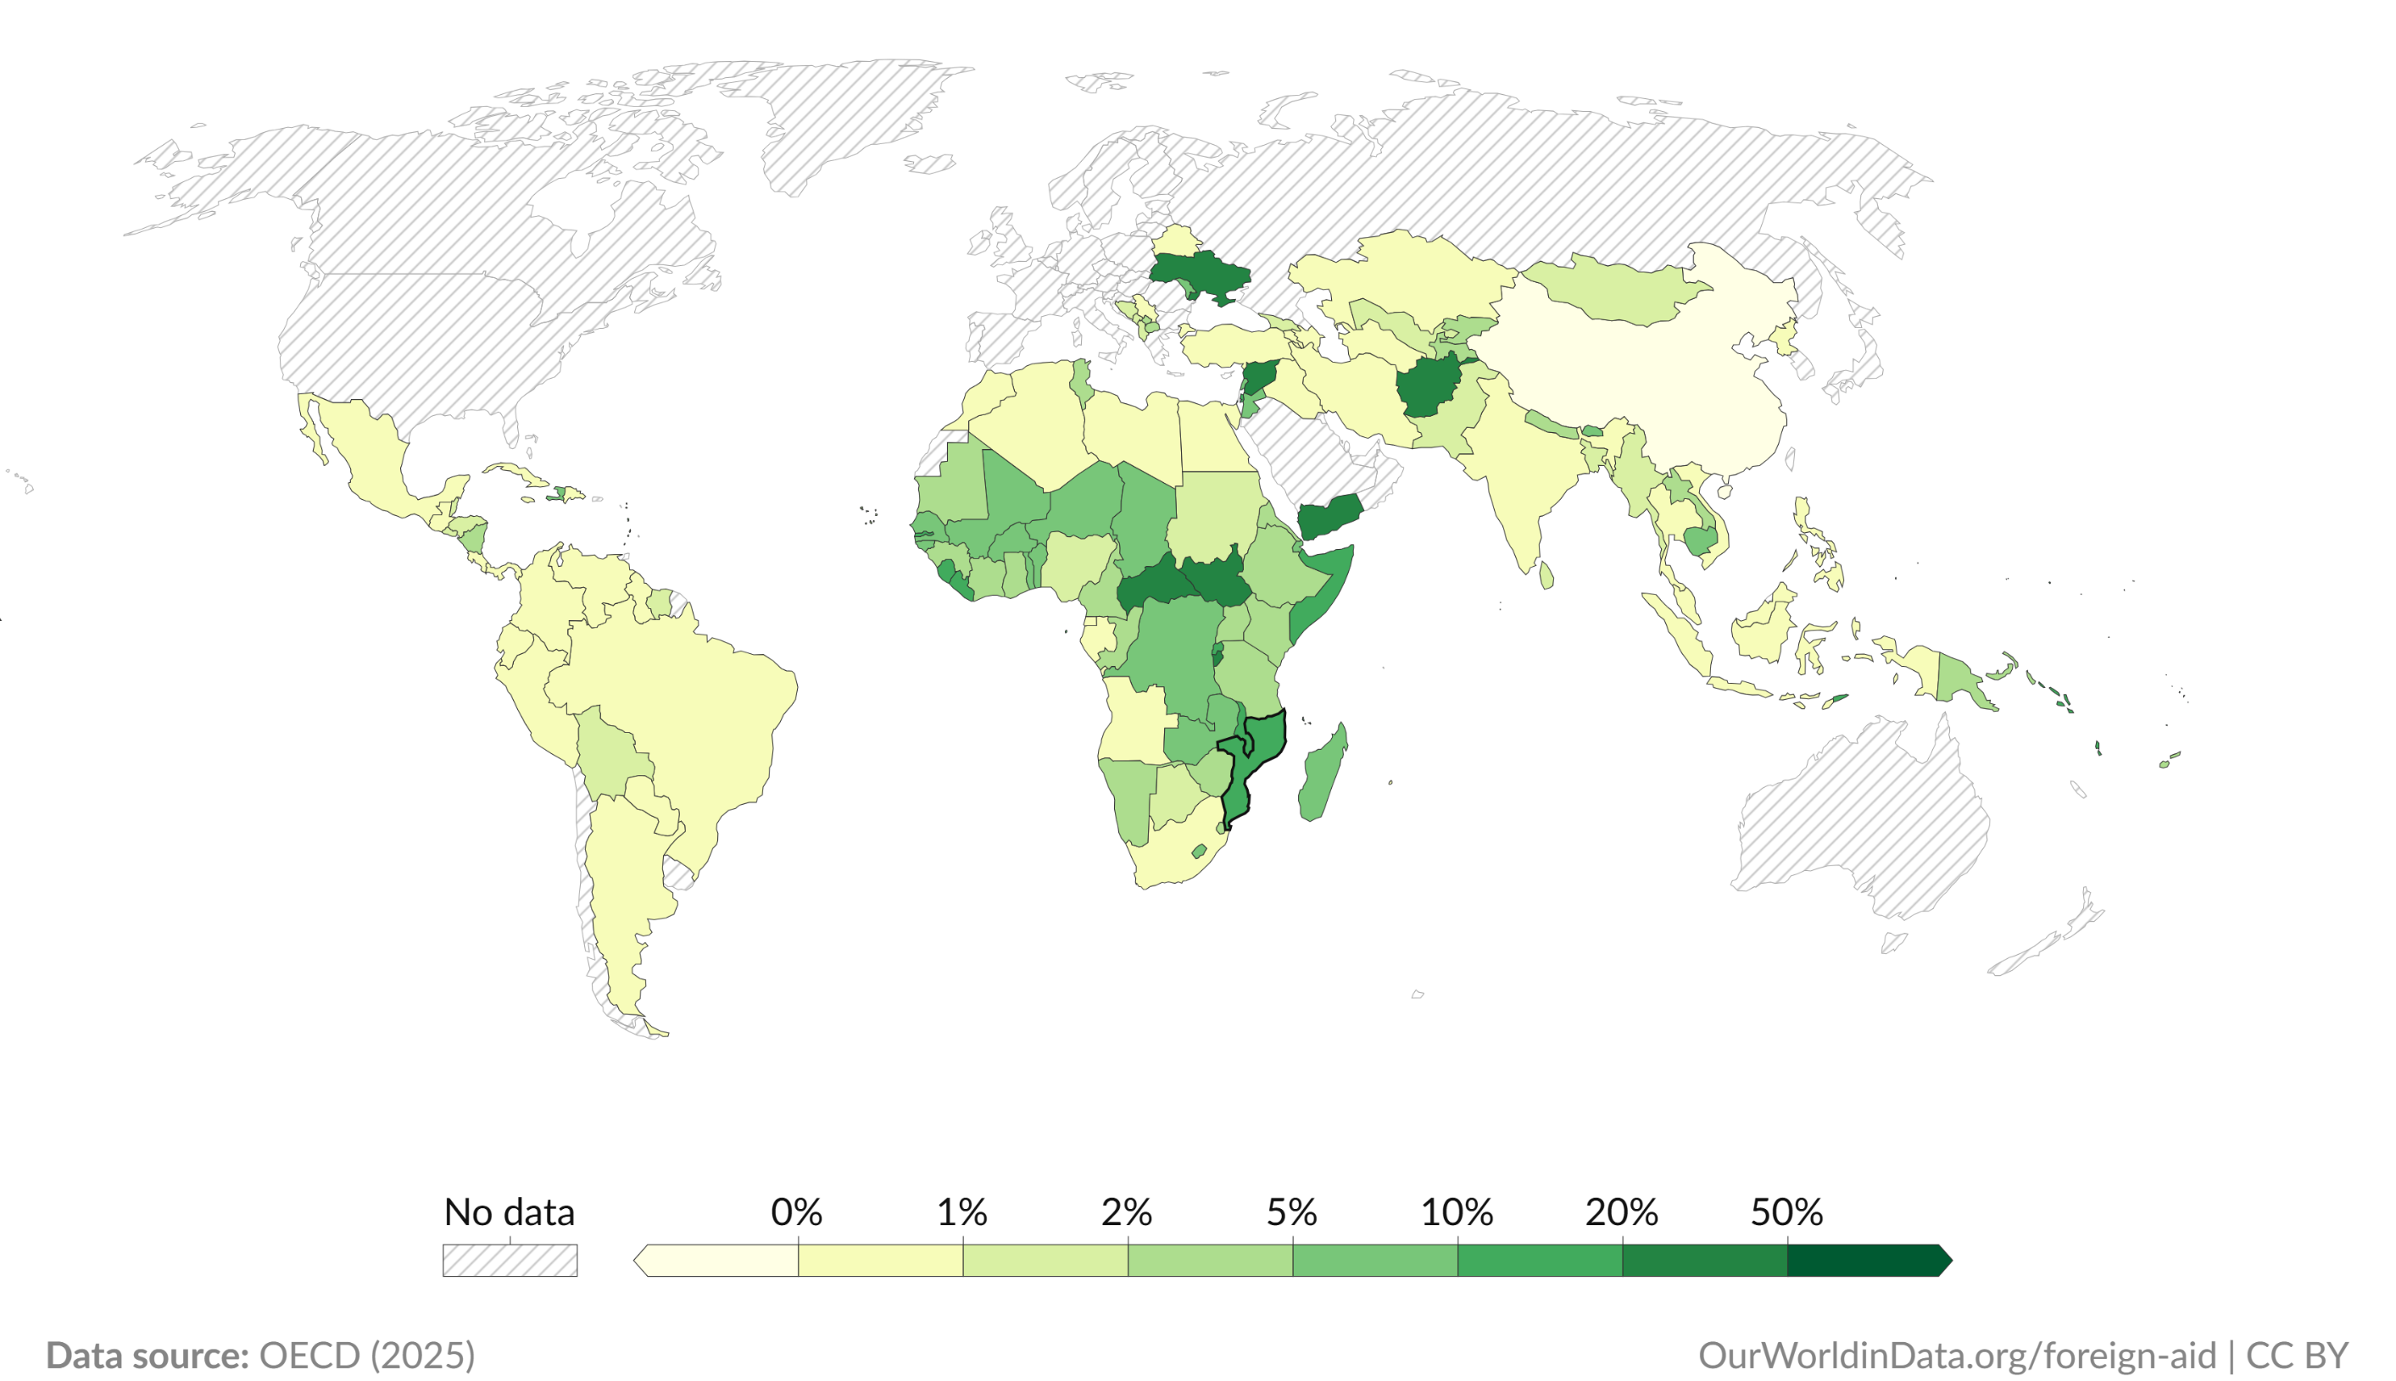
Interconnected Challenges
High Vulnerability to climate changes
Financial Constraints
Notes:
Road Fund revenue (~$180M) covers only 40–45% of annual maintenance needs.
65–70% of capital investment relies on external financing.
Large maintenance backlog: ~45% of paved network needs rehabilitation
Persistent “build–neglect–rebuild” cycle
Chronic Insufficiency of Domestic Revenue
Heavy Dependence on External Financing
Barriers to Accessing Climate Finance
High Costs of Inaction and Broader Fiscal Constraints

Slide 5
Where are we?
Governance
Infrastructure vulnerability
Financial
Weak decision-making frameworks
Outdated and inadequate national road policy
Fragmented institutional responsibilities
Predominantly reactive planning approaches
Insufficient and unreliable data systems
Limited integration of climate-risk analytics
Fragmented processes and lack of long-term continuity

Slide 6

Given these challenges, what would a realistic and effective path forward look like?

Slide 7
Strategic Pillars for Strengthening Road Resilience
Institutional Preparedness
Financial Preparedness
Technical Preparedness

Slide 8
Institutional Preparedness (Governance and Coordination)
Reinforcing institutional governance and coordination
Strengthening Institutional Capacity and Technical Expertise
Decentralization of Decision-Making and Activities with Central Support
Improving Transparency and Accountability
Notes:
*Provide central technical and financial support to provincial authorities
Performance-Based Contracts (PBMCs)
Resilience-specific requirements in projects and contracts
Develop targeted training programs in asset management

Slide 9
Technical Preparedness (Policies and Planning)
Integrating resilience into road Policies and Planning
Update the National Road Policy to include explicit resilience objectives
Performance-based asset risk management approach incorporating asset inventory, risk registries, GIS reference systems, Key Performance Indicators (KPIs), and a Climate Impact Vulnerability Score to prioritize climate-adaptive investments
Create Data Foundation: Infrastructure Climate Resilience Assessment Data Starter Kit
Enhance Pavement Management Systems (PMS) to incorporate flooding impacts to support budget-constrained optimization models to minimize recovery costs

Slide 10
Financial Preparedness (Diversification and Sustainability)
Diversifying financing sources
Strengthen Domestic Revenue
Create and access Climate Finance
Parametric Climate Risk Insurance
Target PPPs for high-traffic corridors (integrate explicit climate risk provisions)
Notes:
Para parámetros de risco de mudança climática associam exposição e capacidade de resposta e esta ultima depende fundamentalmente de um Quadro sólido institucional e político

Slide 11
Key Priority Actions for Climate Preparedness
Short term
Institutional and systems foundatiom
Medium term
Scaling and Integration
Long term
Policies and RAMS development
Pilot Studies
Road Network Inventory
Diversify financing, leveraging PPPs
Pilot parametric insurance
Transformation and Sustainability
Ensure predictible income and investments
Reduction of long-term costs

Slide 12
Key take-away notes
Road resilience is a complex challenge combining climate vulnerability, governance capacity, and financial gaps
Continued reliance on reactive approaches would only deepen backlogs and costs
Digital tools enable low-cost asset monitoring.
Climate finance and parametric insurance help close funding gaps.
Regional examples (Tanzania, South Africa) show that reforms can deliver results.
Technical Integration, Institutional Governance, and Financial Sustainability.
Proactive and strategic planning, performs significantly better than reactive responses.

Slide 13
We don’t build resilience on individuals; we build it on institutions and long-term policy. Political cycles are temporary, resilience is not.

Slide 14
Thank you for your attention!
Hermen C. Dabo
Lecturer & Researcher – ISUTC, Mozambique
hermencdabo@gmail.com

