Slide 1
Resilient Road Asset Management : SSATP DP4 Fourth Pillar
Mustapha BENMAAMAR
Program Manager, SSATP
Improvement of Road Network Resilience
“Strategies for Cost-Effective Climate Change Adaptation and Sustainable Development”
12-14 November 2025 / Maputo, Mozambique

Slide 2
Fourth Development Plan (DP4): 2022-2026
Africa Transport Sector Digitalisation and Decarbonizing

Slide 3
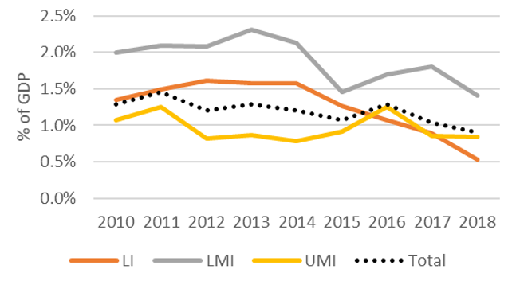
Understanding public spending trends for infrastructure in developing countries
Question: What factors drive infrastructure spending? spending trend? Is spending efficient?
Results:
  On-budget infrastructure expenditure has been low, declining over time, and procyclical
  There is a very pronounced capital bias in infrastructure spending (particularly for roads) – although countries with Road Funds seem to do better
  Budget execution ratios are very low (particularly for power and in LICs)
  No evidence that road sector spending has increased in efficiency over time
  A large share of infrastructure spending takes place off-budget (via SOEs and PPPs)
Implications: Spending envelopes are well below needs, but there is also huge scope to increase spending efficiency
Source: A Study on Fiscal Costs and Risks from Infrastructure, World Bank, 2023
Public expenditure on infrastructure

Slide 4
There is evidence of a pronounced capital bias in road expenditure, which leads to growing investment liabilities due to asset deterioration
Evidence suggests that road sector expenditure has become less productive and more inefficient over the 2006-2018 period in many developing countries
  with almost all the 46 countries with available data spending more on capital than on maintenance
  Capital bias is so marked that countries spend around six times as much on investment as maintenance
  Countries with road funds do spend more on maintenance than their peers. Yet, they still seem to dedicate more resources to investment than maintenance overall
  Evidence suggests that road sector expenditure has become less productive (km of roads build/$1.0 spent) and more inefficient over the 2006-2018 period in many developing countries
  half of the countries analyzed experienced an increase in the inefficiency of road expenditure

Slide 5
SSA Road Sector Financing: Findings I
A large number of countries are deviating from the road sector commercialization reform agenda, a few 2GRFs have lost their autonomy/effectiveness and became 1stGRFs
Government contribution generally unreliable (time/size) - Fuel levy represents 80% of revenues is hardly adjusted, is currently US$ 9c/l on average, not directly transferred to RFs, and well below to meet routine maintenance needs
Absorption capacity is weak, disbursement rates of RAs ranges from 60% to 90%, due to cumbersome procurement process and road works delays tied to weak local contractors’ industry
Independent Technical audits are hardly carried out, undermining RFs credibility

Slide 6
SSA Road Sector Financing: Findings II
5- Road maintenance funding has exceptionally increased in few countries (i.e. Kenya Annuity Road Program, KARP) but not always through a sustainable mechanism
6- With the KARP, Kenya pioneered an innovative approach similar the Restoration and 3GRF Concepts
7- However, the KARP did not ramp-up as anticipated due to a host of reasons related to the structuring of the program, its funding and financing as well as the selection and preparation of annuity projects
8- Few countries (Chad, Kenya, Tanzania and Zambia) have gained experience in Performance-Based Contracts,. But progress is still modest due to the capacity limitations of the Administration and the local contracting industry.

Slide 7
Making infrastructure more climate change resilient is critical
Making infrastructure more resilient is critical
  To avoid costly repairs
  To minimize the wide-ranging consequences to the livelihoods and well-being of people
The lack of resilient infrastructure in LMIC harms people and firms more than previously understood
  Direct costs of natural disaster is $18 billion a year
  Disruptions caused by natural hazards, as well as poor maintenance and mismanagement of infrastructure, costs household and firms at least $290 billion a year
Net Benefit of Investing in More Resilient Infrastructure in LMIC would be $4.2 trillion, with $4 in benefit for each $1 invested

Slide 8
Africa and South Asia bear the highest losses from unreliable infrastructure
In Kampala, Uganda, even just moderate floods block enough streets to make it impossible for over a third of Kampalans to reach a hospital during the critical window of time following a medical emergency
In Tanzania, almost half of transport disruptions in the country are due to floods, and flood-related transport disruptions cost more than $100 million per year

Slide 9
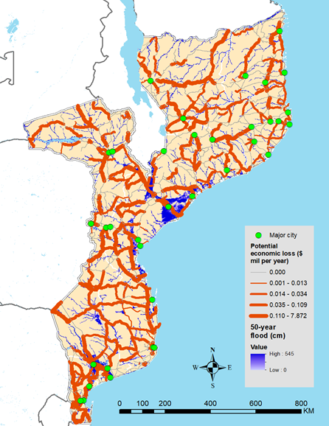
Potential economic cost of road disruption due to flooding in Mozambique

Slide 10
Make road network climate resilient
Individual Roads
Engineering designs: Drainage structure improvements, adequate pavement design
Local Materials/Technics and technology
Timely routine maintenance: clean culvert...
Roads Policy
Update country’s road design standards to incorporate climate risks
Integrate and streamline climate change into country’s Road Asset Management System
Adequate budget and resource goes to maintenance

Slide 11
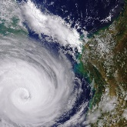
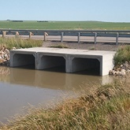
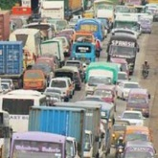
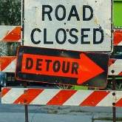

Make road network climate resilient and stay the course on 2GRF
Technical Assistance: Vulnerability Assessment of Road network
Reassert the importance of road maintenance
Climate exposure
Resilience of infrastructure
Economic risk to transport infrastructure
Stay the course on Second Road Generation Funds
Improve 2GRF Effectiveness
Damage functions
Resilience as a network
Criticality analysis

Slide 12
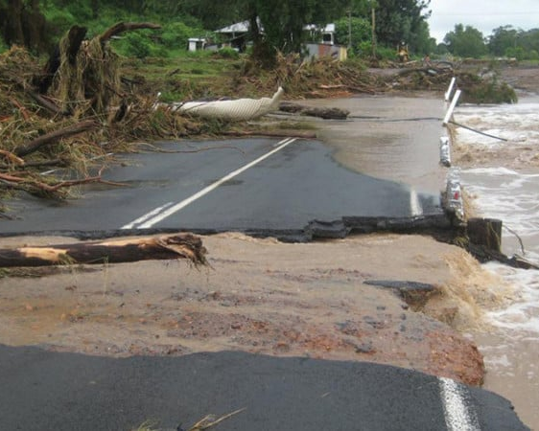
SSATP-DP4 Thematic Area 4 - Resilient Road Asset Management Systems
Objective
Reasserting the importance of road maintenance and mainstreaming climate resilient practices into road asset management systems
Conduct climate vulnerability assessments and mainstreaming climate resilient practices into road asset management systems;
Reassert the importance of road maintenance in developing climate resilient road asset management systems;
Support second-generation road funds effectiveness and efficient roads management practices .
Notes:
4- Climate Resilient Road Asset Management
Conduct climate vulnerability assessments and mainstreaming climate resilient practices into road asset management.

Slide 13
Thank you for your attention!
Mustapha BENMAAMAR
SSATP Program Manager
mbenmaamar@worldbank.org
@twitter

