Slide 1
Examples of best practices in improving road resilience in Belgium
Eva Van den Bossche
CEO of Belgian Road Research Centre
Improvement of Road Network Resilience
“Strategies for Cost-Effective Climate Change Adaptation and Sustainable Development”
12-14 November 2025 / Maputo, Mozambique

Slide 2
Index
Belgium and Belgian Road Network
Examples of best practices in improving road resilience in Belgium

Slide 3
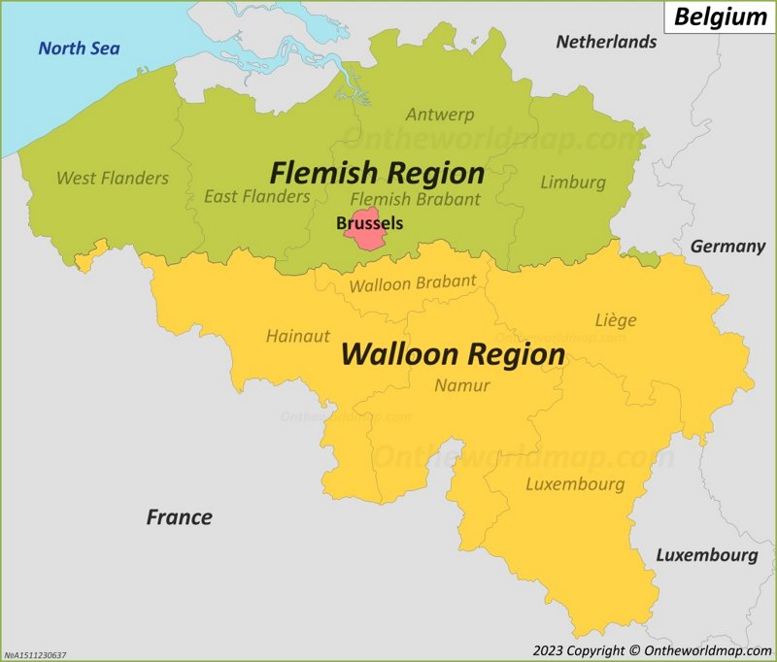
Belgium

Slide 4
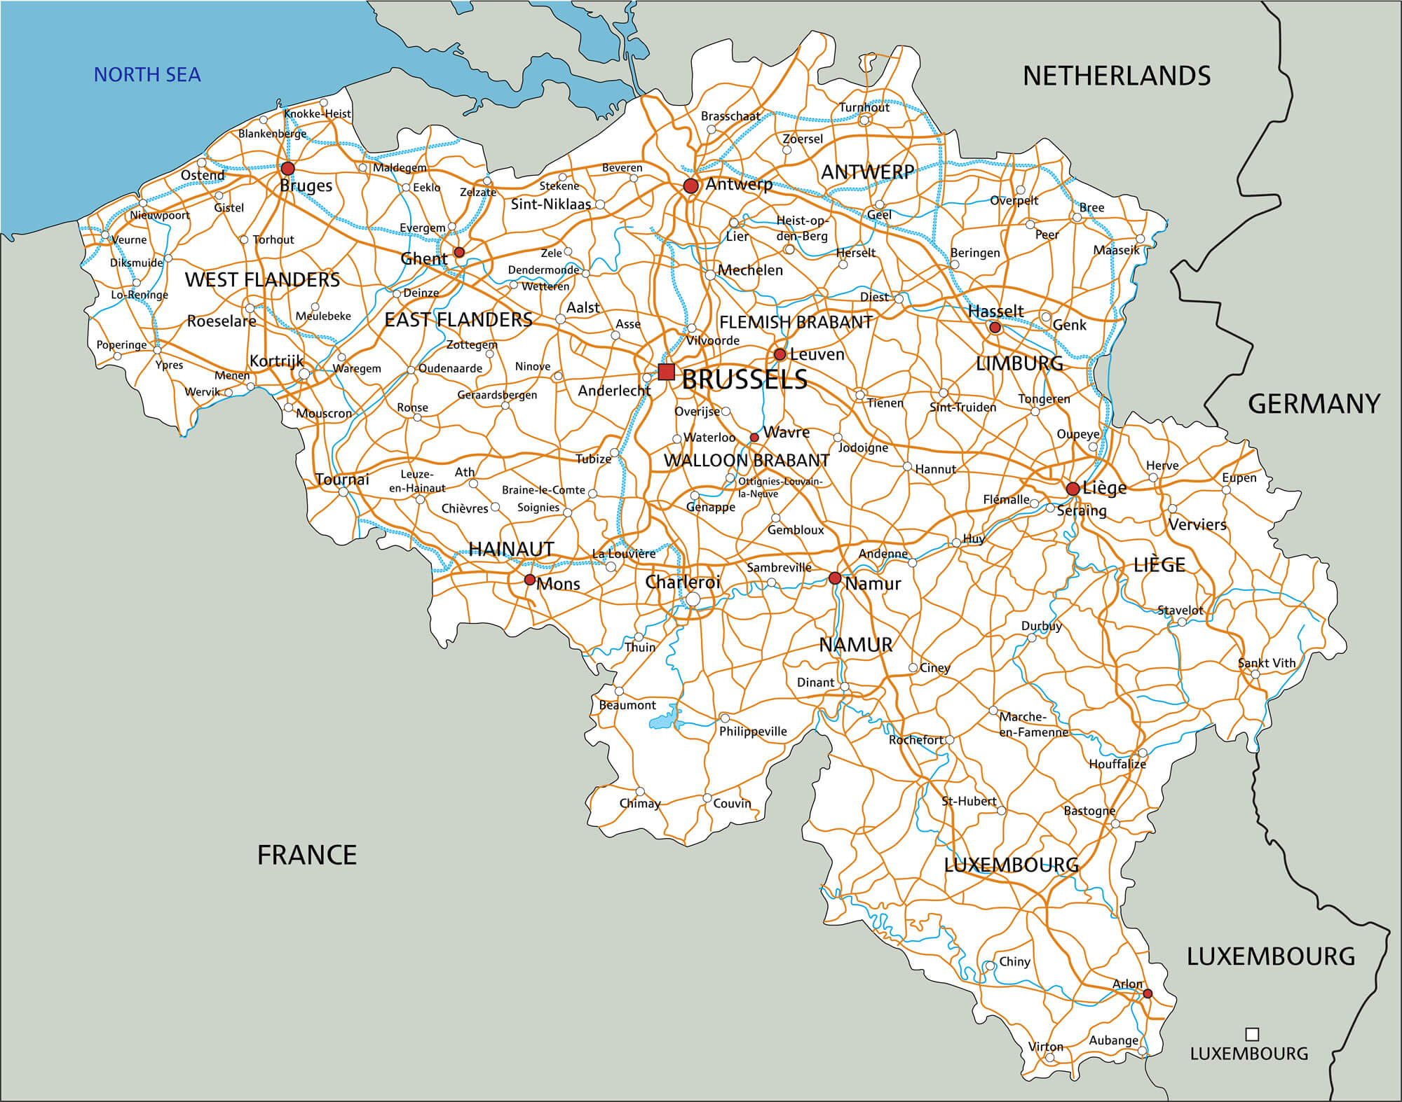
Belgian Road Network

Slide 5
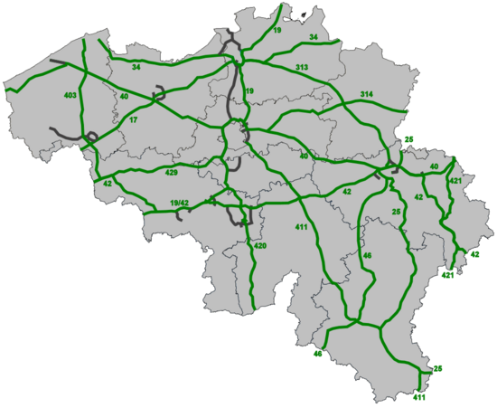
Belgian Road Network
Most of the highways were build in the ‘60 and ‘70
Including the bridges and tunnels
Urgently in need of structural maintenance – rebuilding – re-engineering

Slide 6
Belgium: road authorities
Flemish Region:
Agency for Roads and Traffic
Brussels region:
Brussels Mobility
Walloon Region:
Service Public Wallonie Mobility
and Infrastructure & SOFICO

Slide 7
Belgium: road authorities
  Impact of climate change for our road network
  Main concern: WATER!
    Flooding of rivers
    Waterbombs

Slide 8
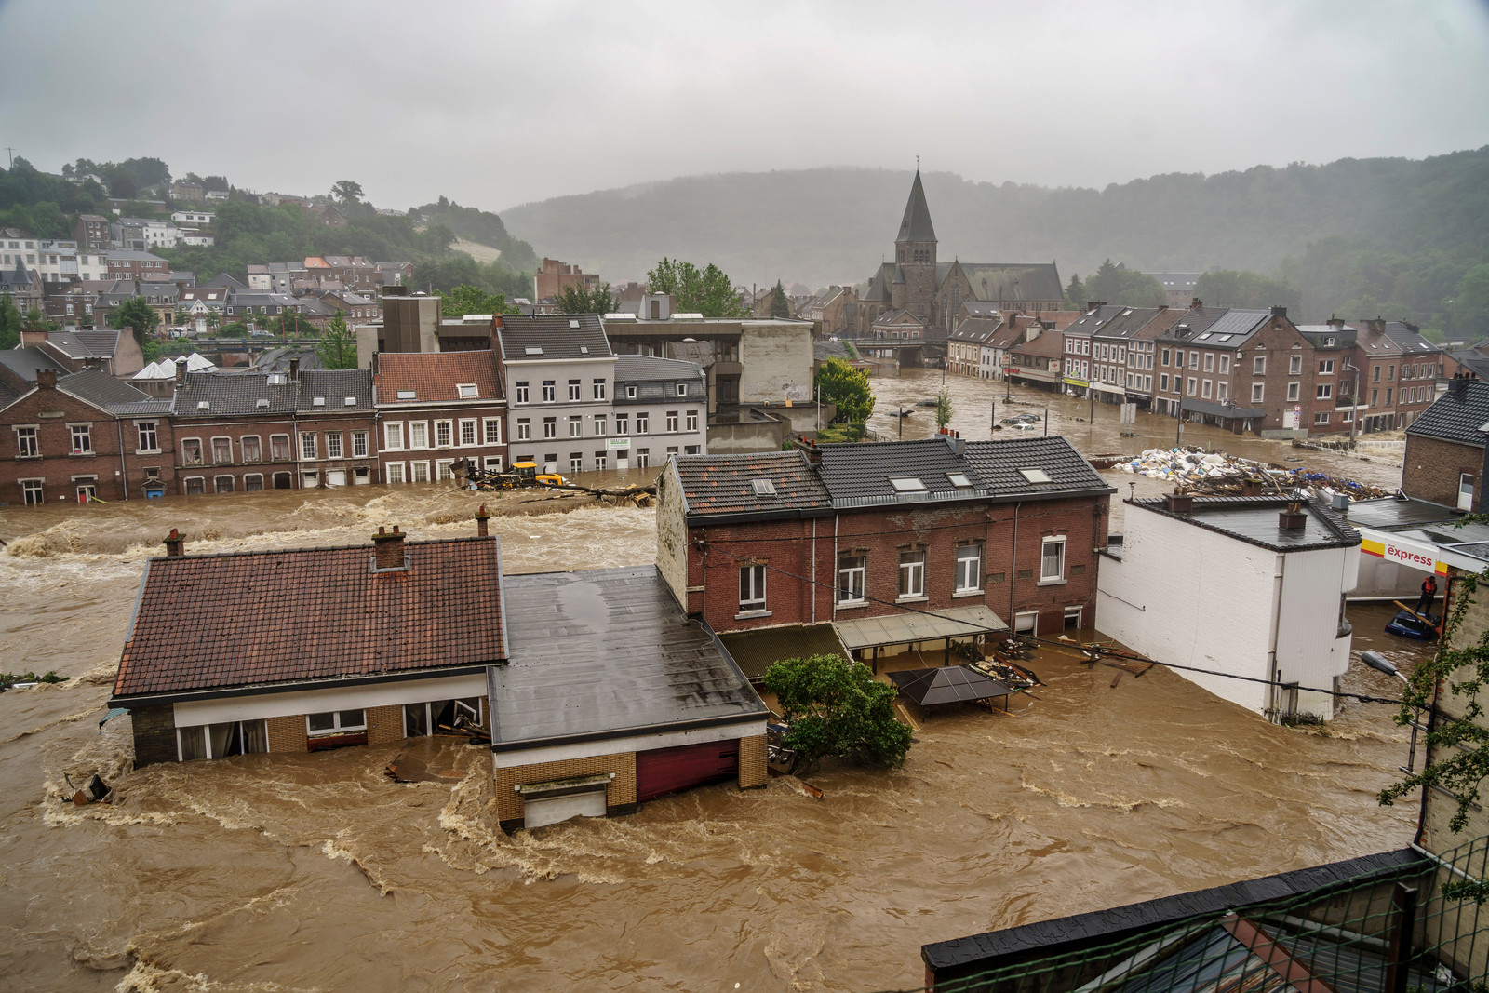
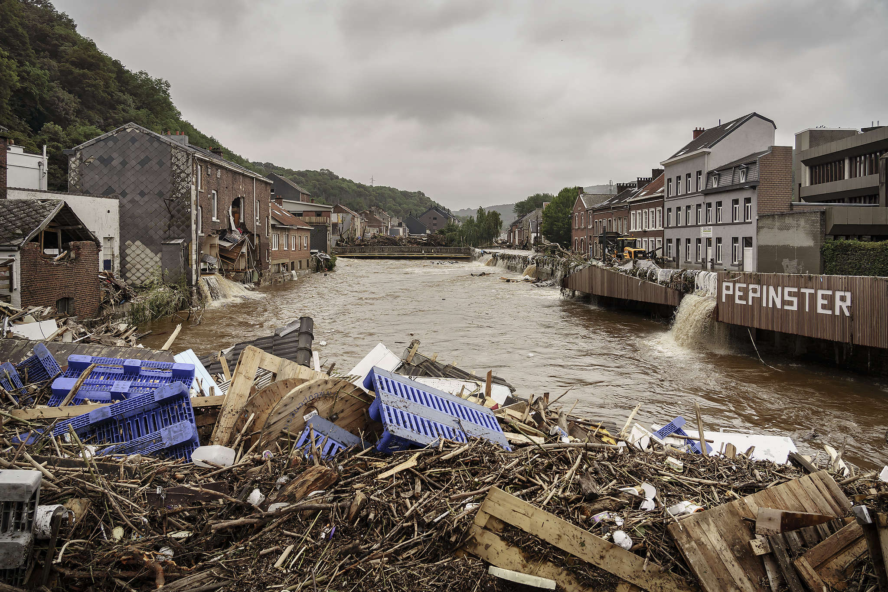
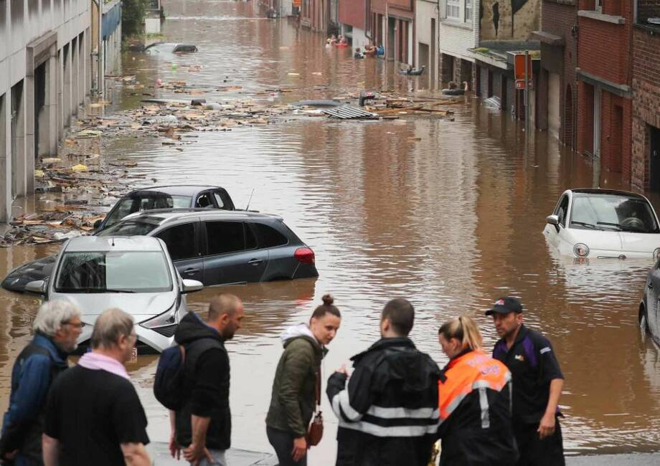
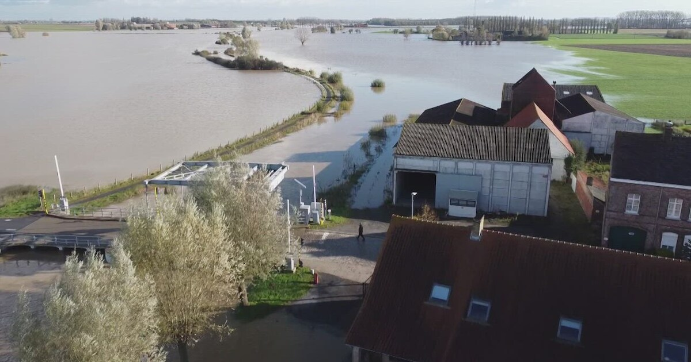
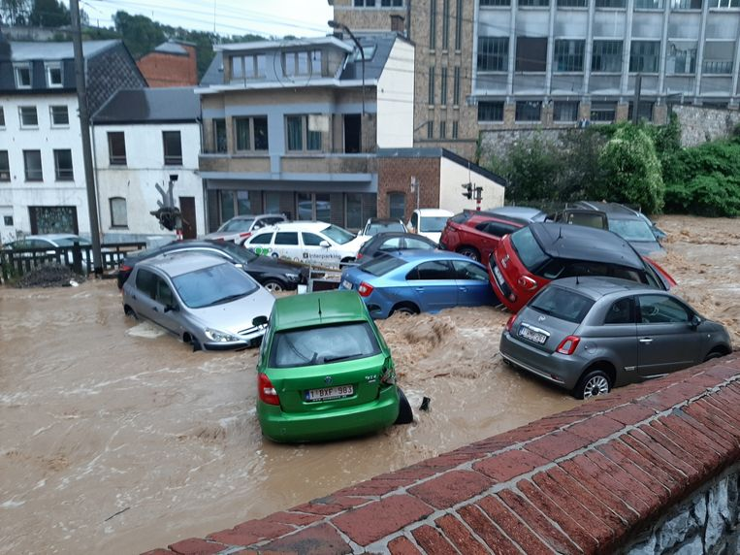

Belgium
  July 2021

Slide 9

Agency for Roads and Traffic & SPW Mobility and Infrastructure
  Asset Management Plan
    Risk based
    Condition of the assets = driver for investment and maintenance needs
    Always: needs >>> available budget
    Also about resilience to climate change
    European recommendation
    Prioritizing fairly straightforward within a family of assets, more difficult when taking into account all assets

Slide 10
Flemish Region – Agency for Roads and Traffic
  Crisis Management Plan
    New version summer 2025
    Disasters, incidents or unexpected events with impact on road operation: chain of commands
    Risk based
    Covers all activities of the agency
    3 topics top of mind now:
      Cybersecurity
      Military preparedness
      Climate change
    “Passe partout”, as few as possible specific response plans
      More detailed BCP for Flanders Traffic Management Centre: people, logistics, switch-off plan

Slide 11

Flemish Region – Agency for Roads and Traffic
  Crisis Management Plan
    Floods
    Extreme rainfall / Waterbombs
      Legislation with adapted guidelines for infiltration and buffering of rain
      Driven by new climate models
      Not fully adapted to worst case scenario’s, still a trade-off with policy makers
      Simulations of waterbombs on Ghent and Brussels
      Guidelines for tunnels were adapted: water storage in tunnels is being redesigned
      Design guidelines need to be strictly respected or no building permit! (p.e. drainage)

Slide 12
Flemish Region – Agency for Roads and Traffic
  Crisis Management Plan
    Extreme heat
      Failure of pavements
      Not yet adapted guidelines
    Freezing
      Design guidelines have been adapted because risk is now lower because of changing weather
    Drought
      Drying of verges → fire hazards
        Natural vegetation
        Trees chosen for being less sensitive to drought

Slide 13

Flemish Region – Agency for Roads and Traffic
  Climate Plan
    Actions related to the buildings, equipment, vehicles, … of the agency
    Actions related to (investment) projects for the road network
    Not the choice of the projects but the decisions related to tendering, contractors and methodology (CO₂ reduction, materials, recycling or reuse, machinery, …)

Slide 14

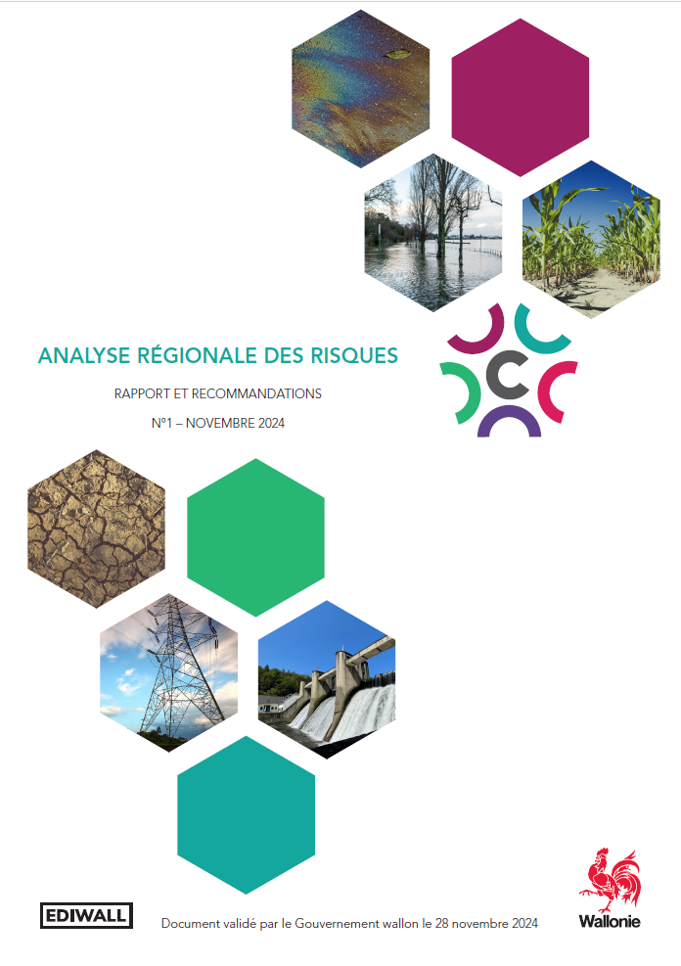
Walloon Region – SPW Mobility and Infrastructure
  Crisis Management Plan
  Global plan for the Walloon region, across all agencies and topics
  Based on risk assessment

Slide 15
Walloon Region – SPW Mobility and Infrastructure
  Crisis Management Plan for the agency
  Waterways and roads
  Mapping of risks
  Sensibilisation and training

Slide 16
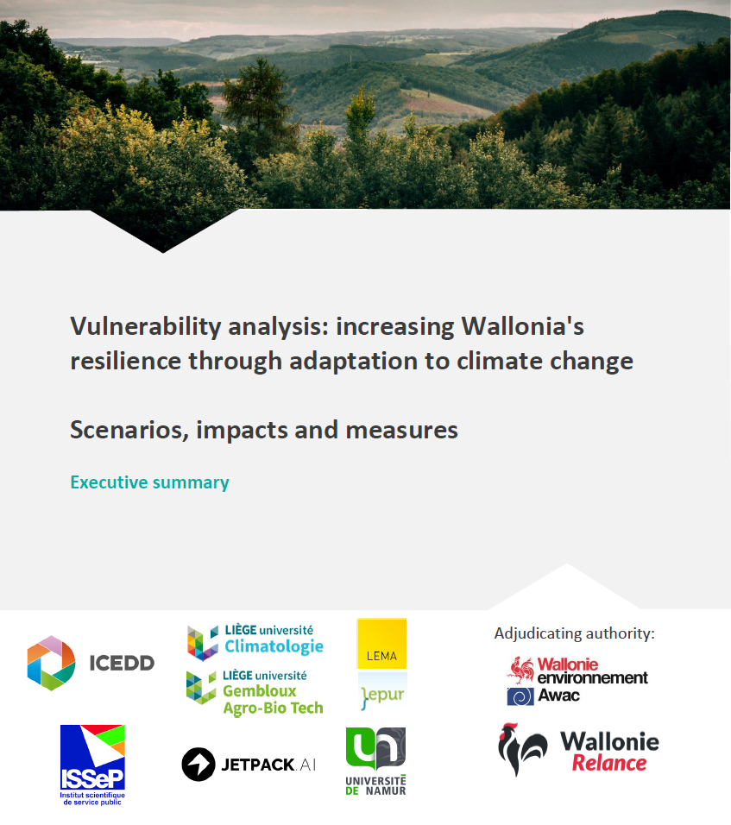
Walloon Region – SPW Mobility and Infrastructure
  Vulnerability analysis
    Flooding
    Storms
    Heatwaves
    Extreme cold
  Infiltration of water: guidelines and recommendations
  Bridges: adapted guidelines

Slide 17
Walloon Region – SPW Mobility and Infrastructure
  Investment plan
    Storm basins
    Prioritizing based on risk mapping
      Families of assets
      Future: condition of the asset + criticality of the asset + network hierarchy
    All assets need more budget…

Slide 18

Agency for Roads and Traffic & SPW Mobility and Infrastructure
  Data
    Meteorological and hydrology live data: very important for operations and decision making
    One tool to collect and assess all data sources
    Historical data: for adapting design guidelines and modelling
  Barriers and challenges
    € and
    Competition with other issues (ageing infrastructure, cybersecurity and military awareness)
    Resilience for climate change = long term effects, multidisciplinary
    Not always top of mind with policy makers
    Legislation about public tenders does not easily facilitate new practices or innovation

Slide 19
Agency for Roads and Traffic & SPW Mobility and Infrastructure
  Future developments
    TOTEM infra: Tool for calculating environmental impact of infrastructure for the full life cycle, including climate change adaptation measures
    In development for the three regions of Belgium
  Impact of innovation or new technology
    Electrification of building equipment, machinery and worksites, CO₂ impact
    Data collection, modelling, AI tools

Slide 20
Thank you for your attention!
Eva Van den Bossche
CEO of Belgian Road Research Centre
e.vandenbossche@brrc.be

