Slide 1
Resilience of Road Networks
Cecilia Briceño Garmendia
Lead Economist World Bank Group
Improvement of Road Network Resilience
“Strategies for Cost-Effective Climate Change Adaptation and Sustainable Development”
12-14 November 2025 / Maputo, Mozambique

Slide 2
The problem and methodological approach

Slide 3
The Starting Point
Reliable access to and connectivity among markets, populations, and regions are essential elements of economic development
  Transport infrastructure connect people with centers of economic and social opportunities
  Ensuring that these connections are maintained –or quickly restored—, in event of shocks, is associated to poverty reduction poverty and economic development

Slide 4
Objetives
Determine data and methodological decisions
Evaluate criticality
Prioritize interventions under tight budgets to increase the resilience of transport networks
  Identifying cost-efficient options to increase network resilience
Estimate budget envelops to upgrade a network to predefined resilience standards

Slide 5
Criticality, Reliability and Resilience - They all look alike
Term | Definition
Criticality | The relative importance of a road network link for the overall efficiency of the network.
Reliability | The degree of operability of a road network link under any circumstances.
Resilience | The ability of a link to return to its normal state after a shock
Exposure to Extreme Shocks
Vulnerability | The lack of reliability when exposed to exogenous hazards
Note
Criticality is defined by the context’- Vulnerability can be altered with interventions
Metrics:
Reliability: probability that two locations remain connected under any circumstance,
Vulnerability: consequences of link failure, irrespective of the probability of failure.
Can be measured as the increase in cost/accessibility when a link is disrupted

Slide 6
An Empirical Approach to Assess Critical Links
Identify a subset of the most critical links
  Use traffic as a proxy for importance and extract relevant segments
Use Interdiction to “rank” or measure criticality
  Estimate average aggregate accessibility index as a baseline (no link closures)
  Individual links of the “important” segments are disrupted one-by-one and new least-cost routes are computed along with a new aggregate accessibility index → All traffic is re-assigned to the new least-cost route
  The links with the largest decreases in accessibility are considered critical links
Identify vulnerable links using flood data
  Flood data is overlaid on the critical links to identify which are exposed to floods

Slide 7
  Tradeoffs between reliability and the cost of interventions
The policymaker’s decision problem
  How to prioritize certain links in the network for investment
  Adapt to climate change and other shocks
Sources of uncertainty
  Potential disruptions (natural, demand-driven, structural)
  The severity of these disruptions
Proposed metrics
  Infrastructure-based accessibility: Vehicle Operating Costs (or RUCs)
  Location-based accessibility: costs weighted by population
Options
  Menu of potential interventions

Slide 8
The policy maker dilemma: vulnerability, reliability and resilience

Slide 9
The Case of Perú: Assessing interventions

Slide 10
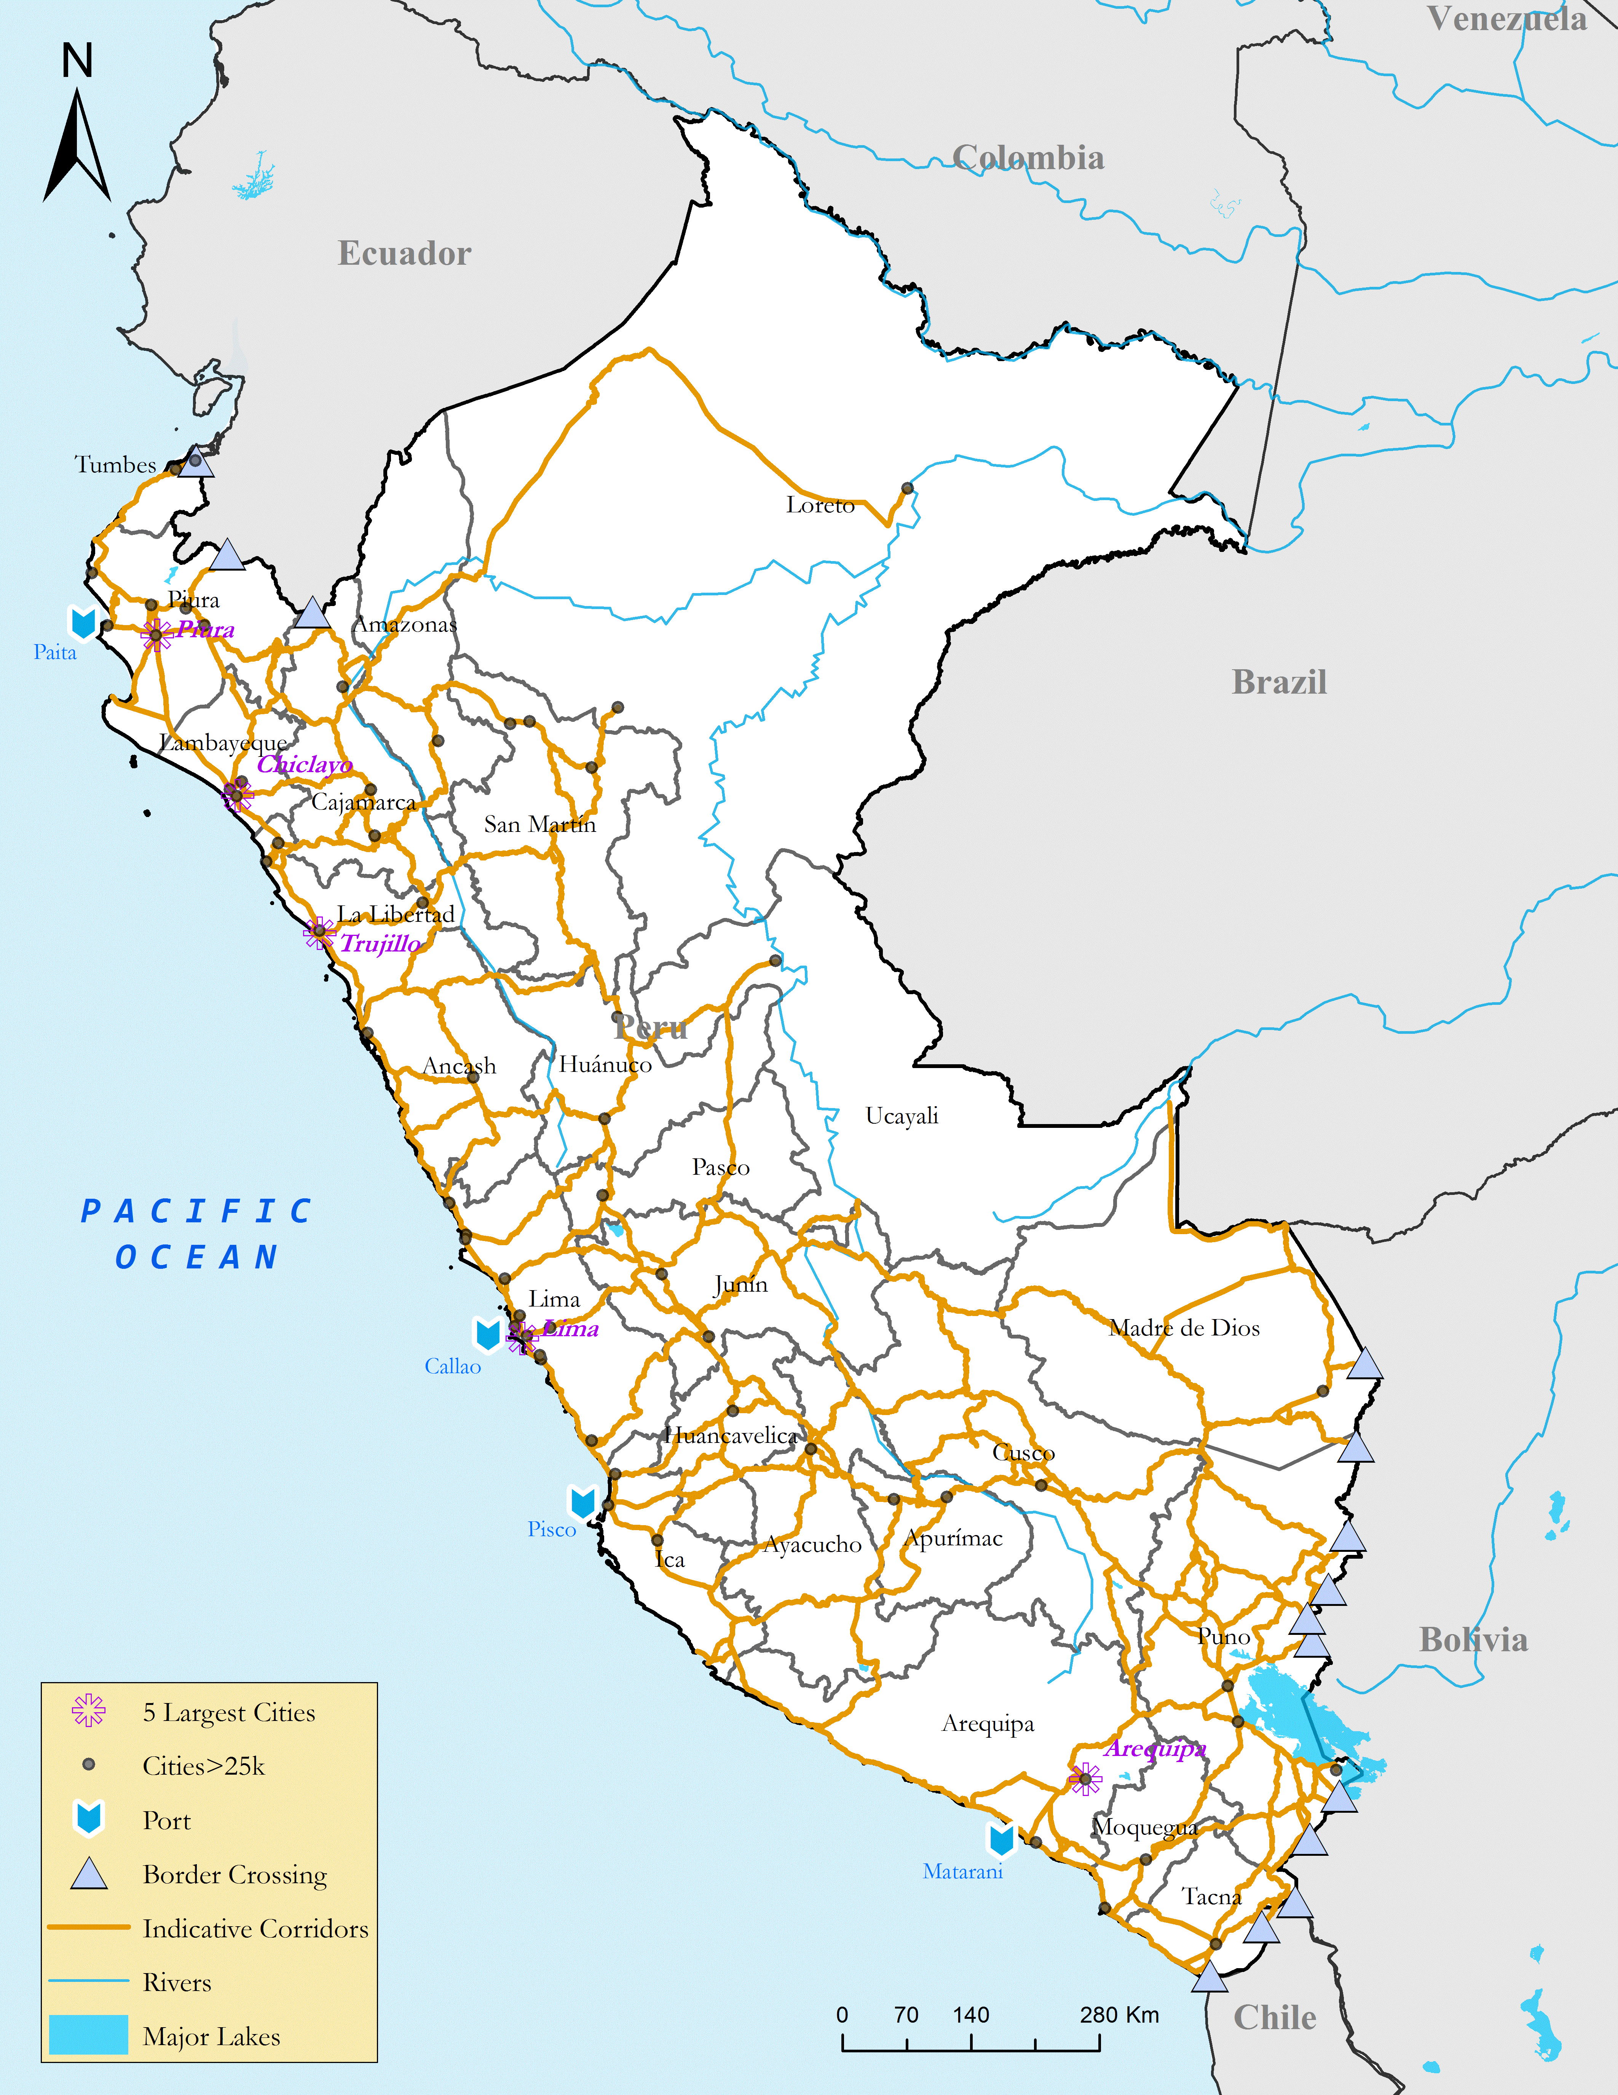
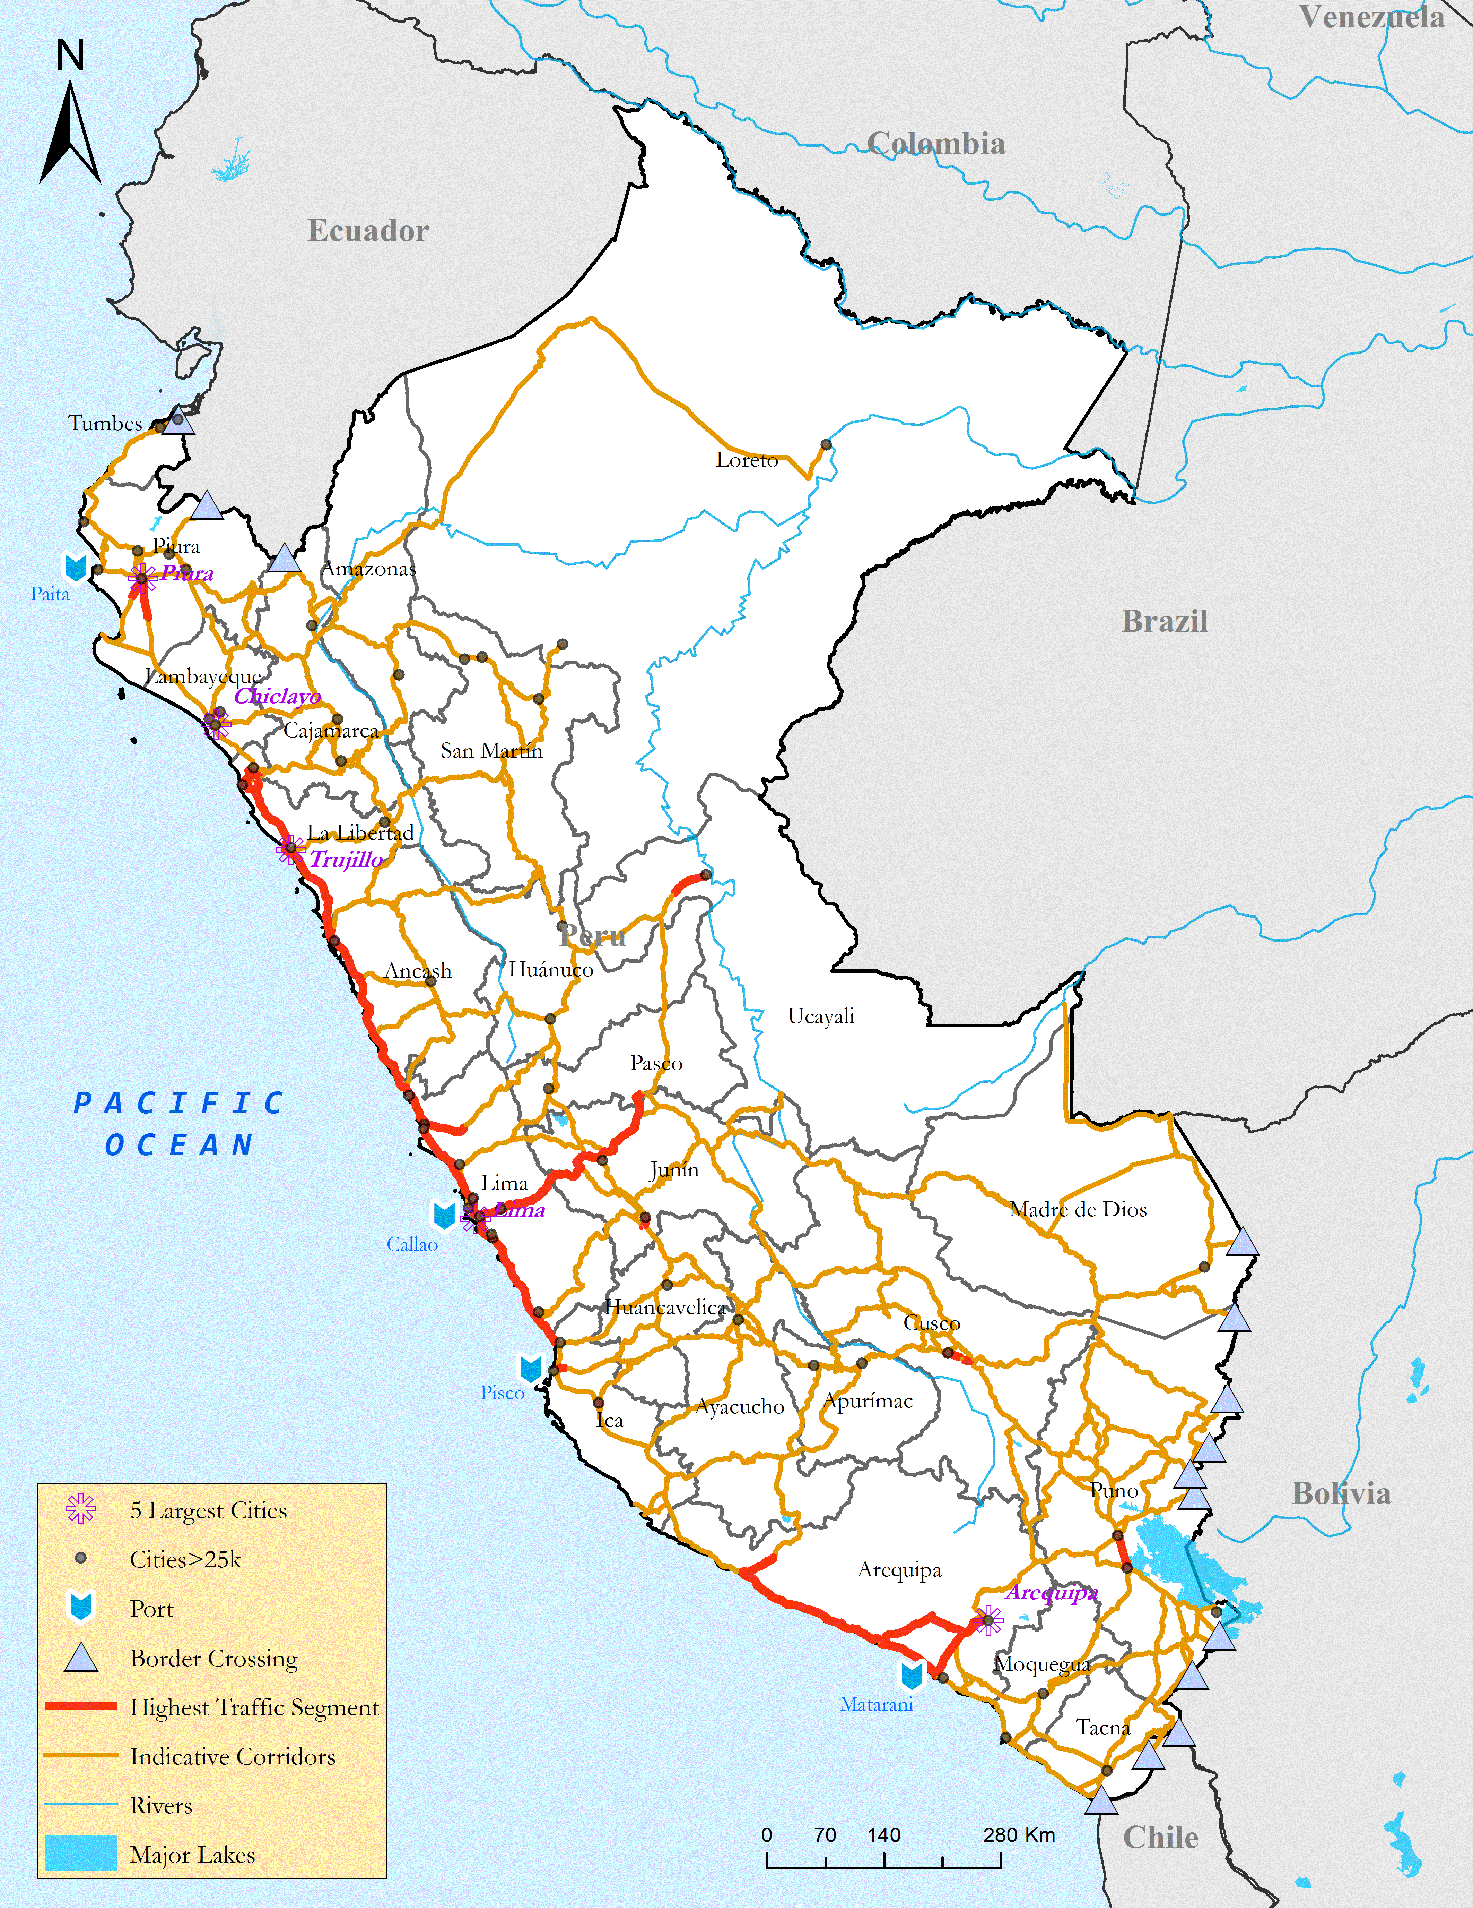
Critical corridors – A Subset of the Network: Case Perú
Least-Cost (Sub)Network (Indicative Corridors)
High-Traffic Links

Slide 11
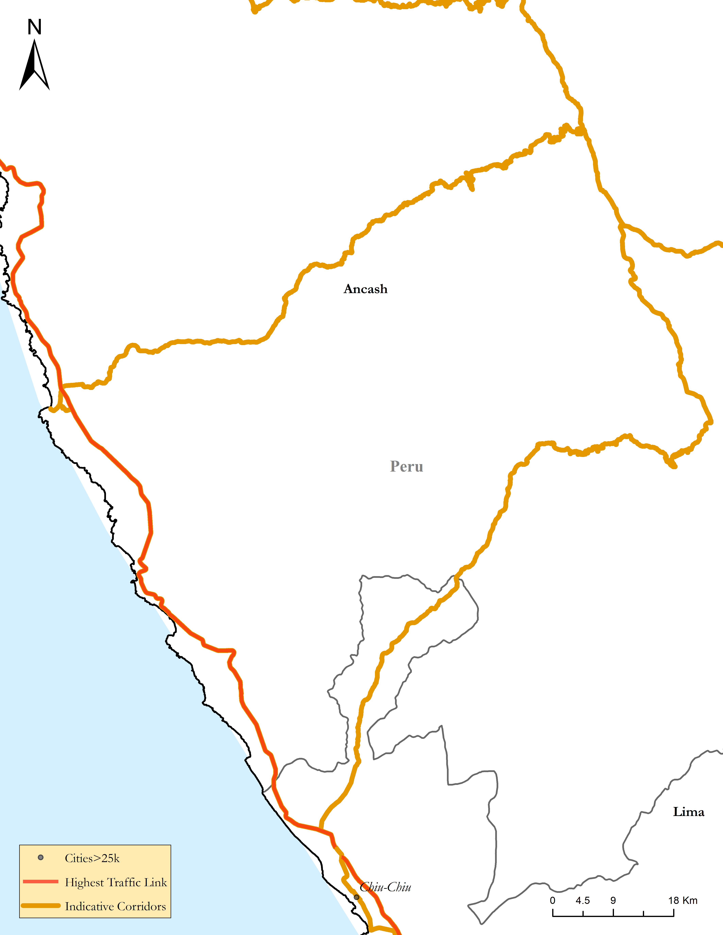
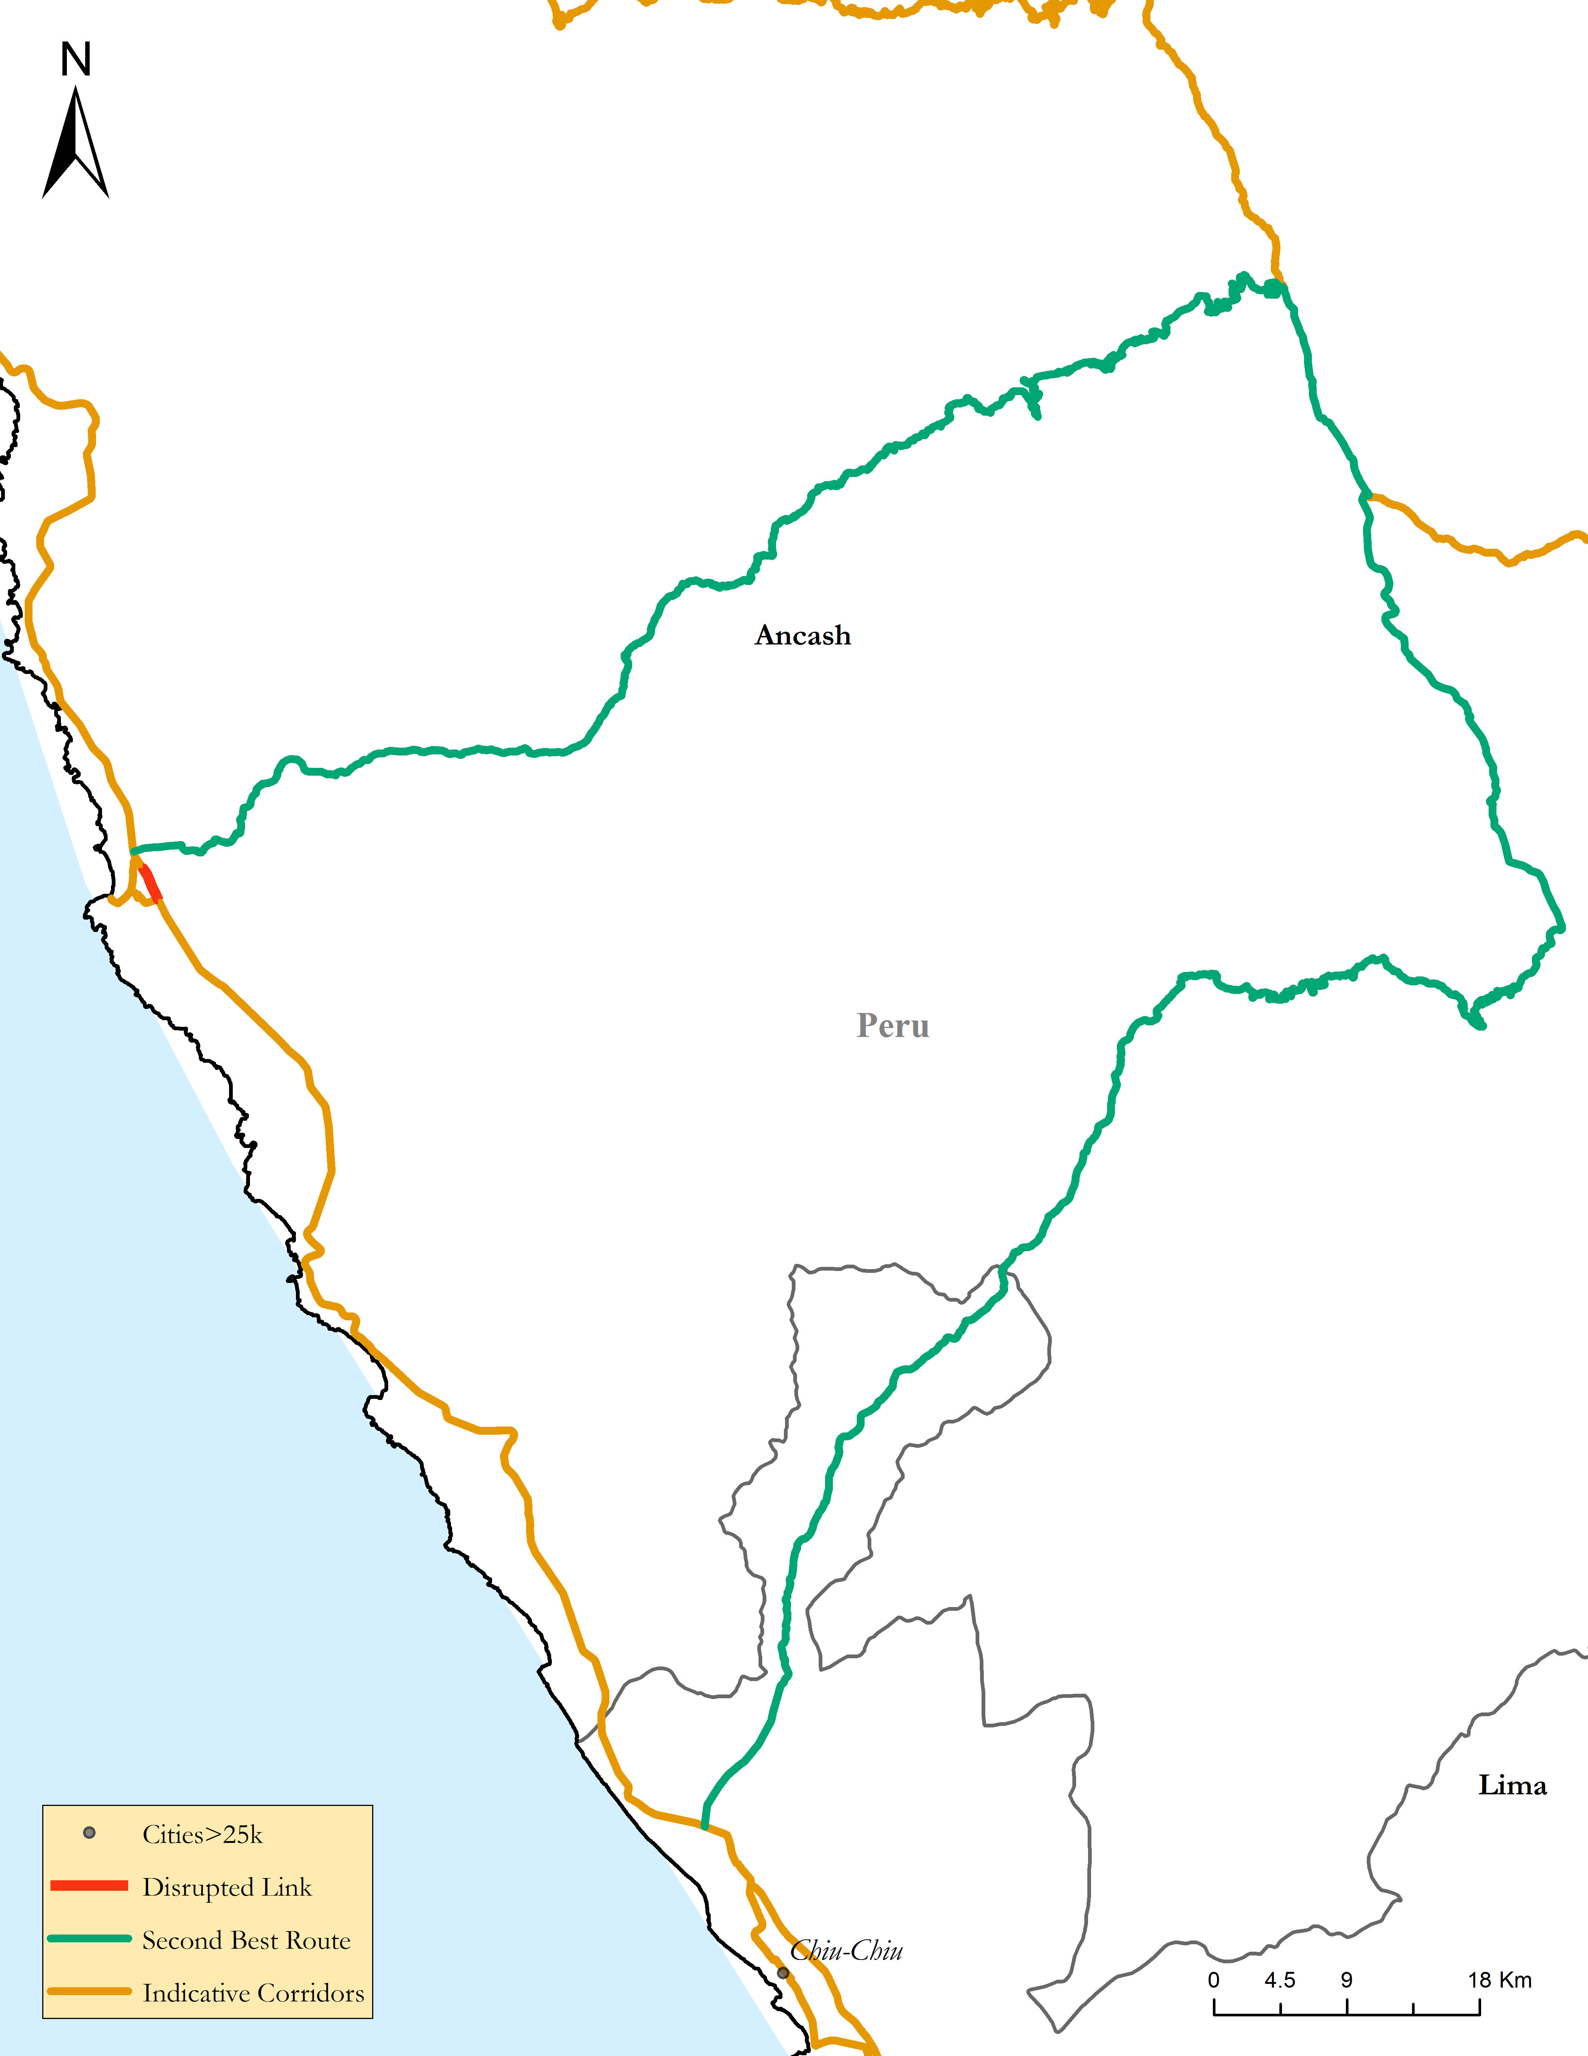
Measuring Criticality
Optimal Route
2nd-Best Route

Slide 12
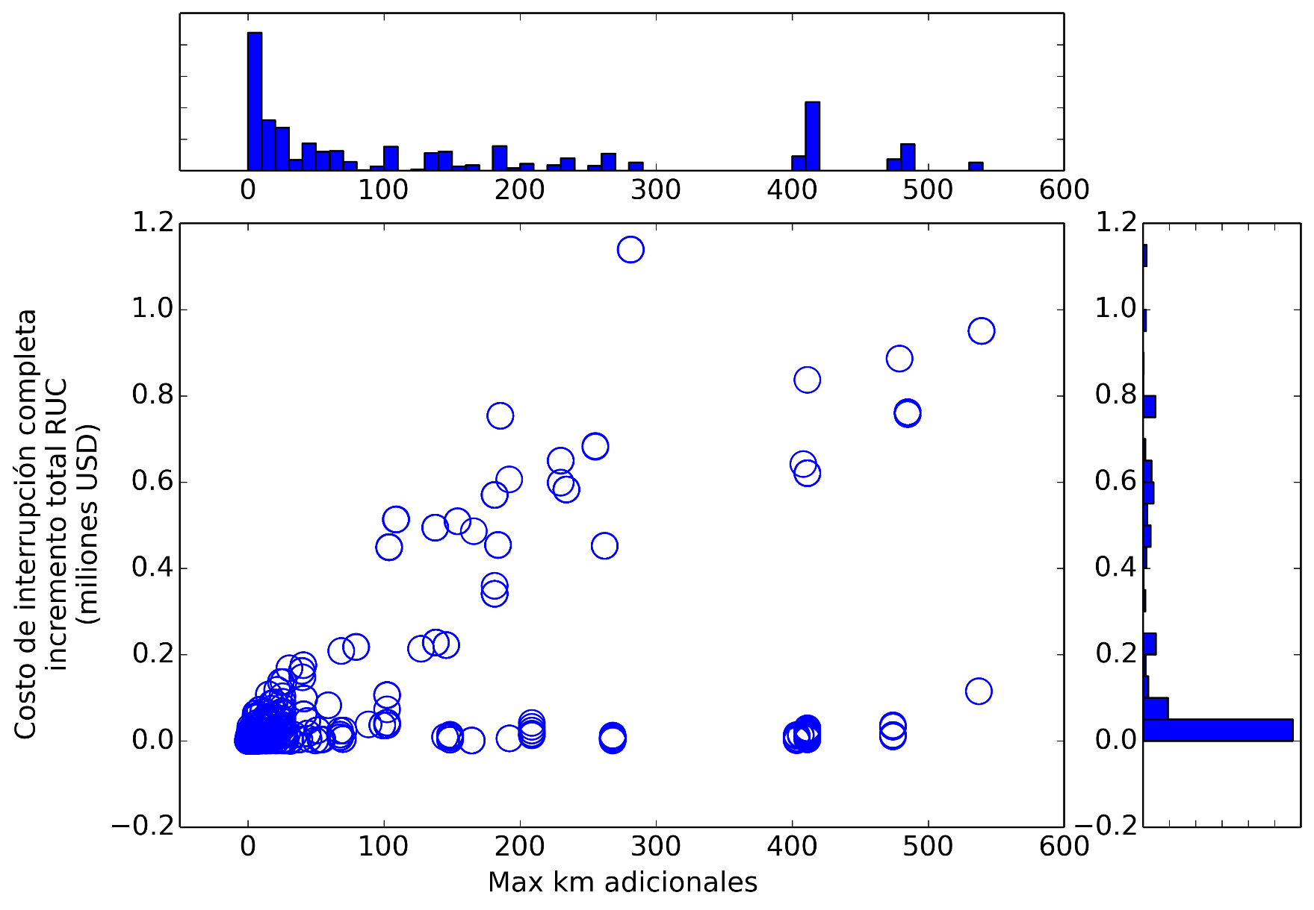
Increase in distance (x-axis) and cost (y-axis) due to disrupted links
A
B
C
Notes:
The figure shows ALL disrupted links

Slide 13
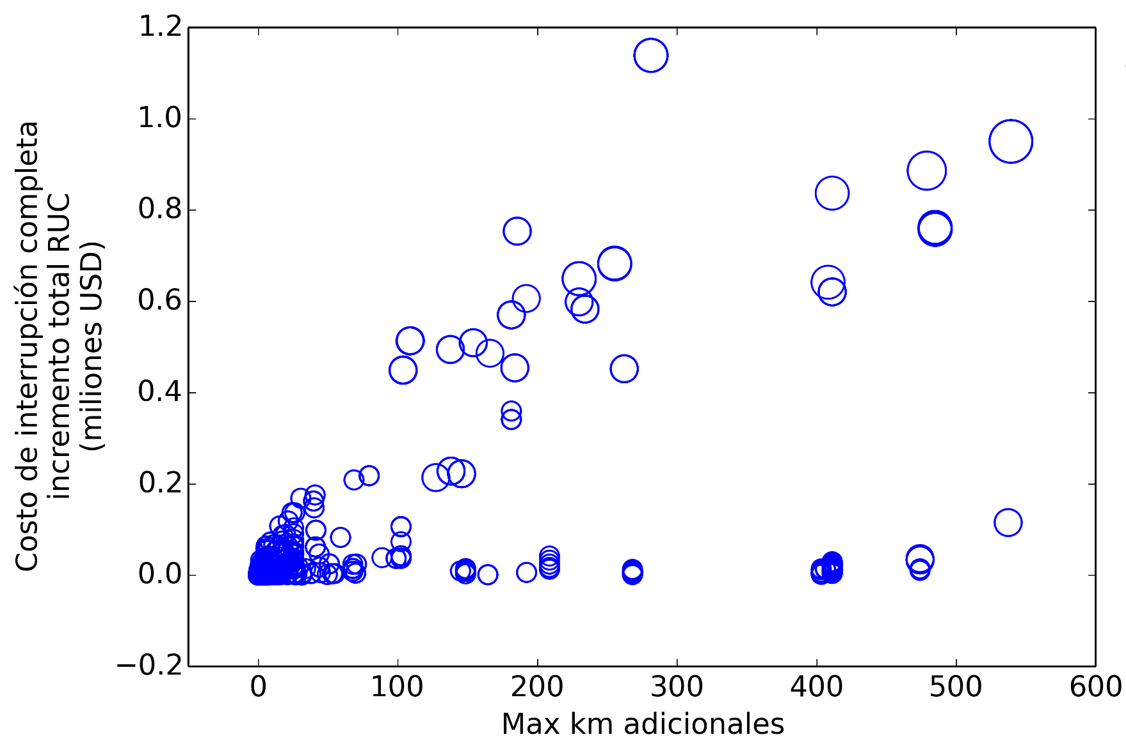

The size of the circle represents the economic cost of disruption
B.
5.6M $US
A.
4M $US
C.
2M $US

Slide 14
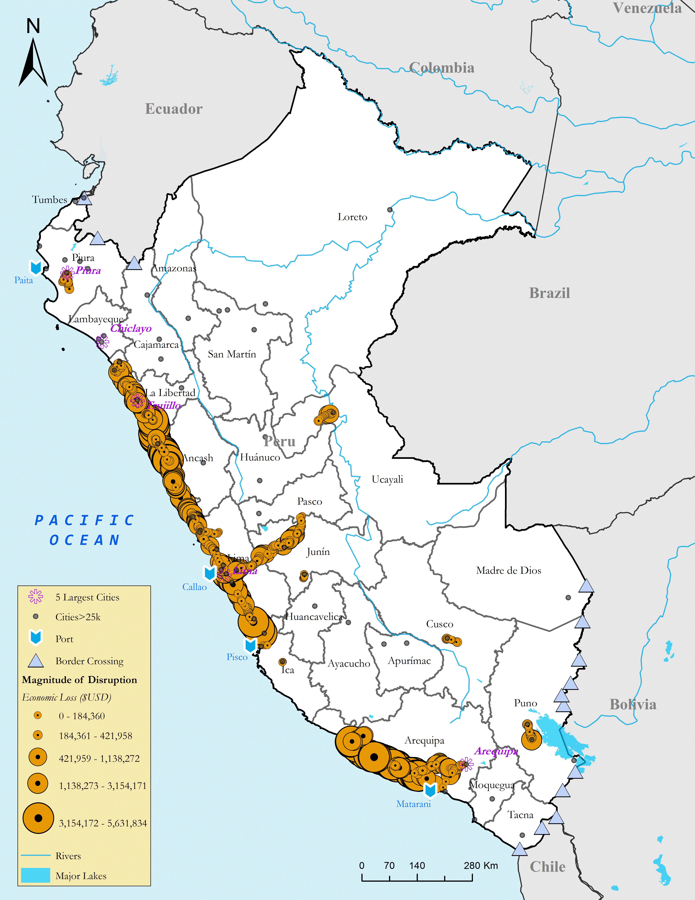
Bringing home the problem:
Ranking and measuring criticality
Critical Links and Their Losses
A
B
C

Slide 15
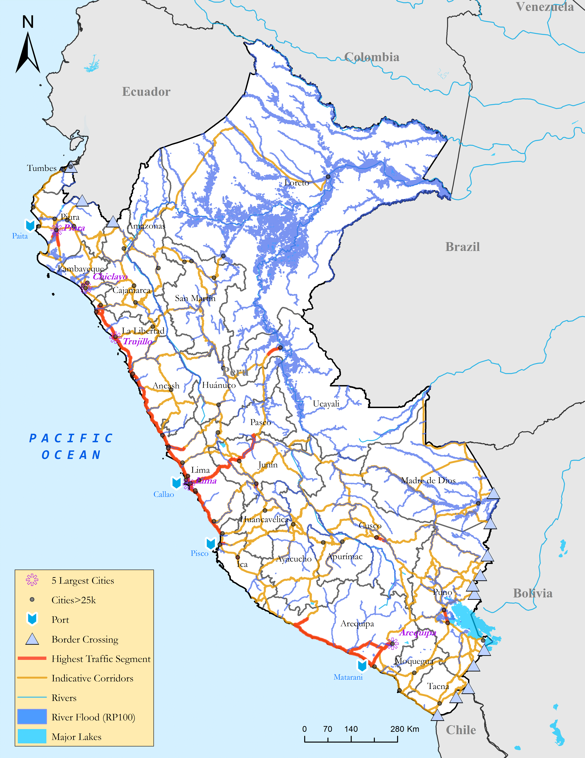
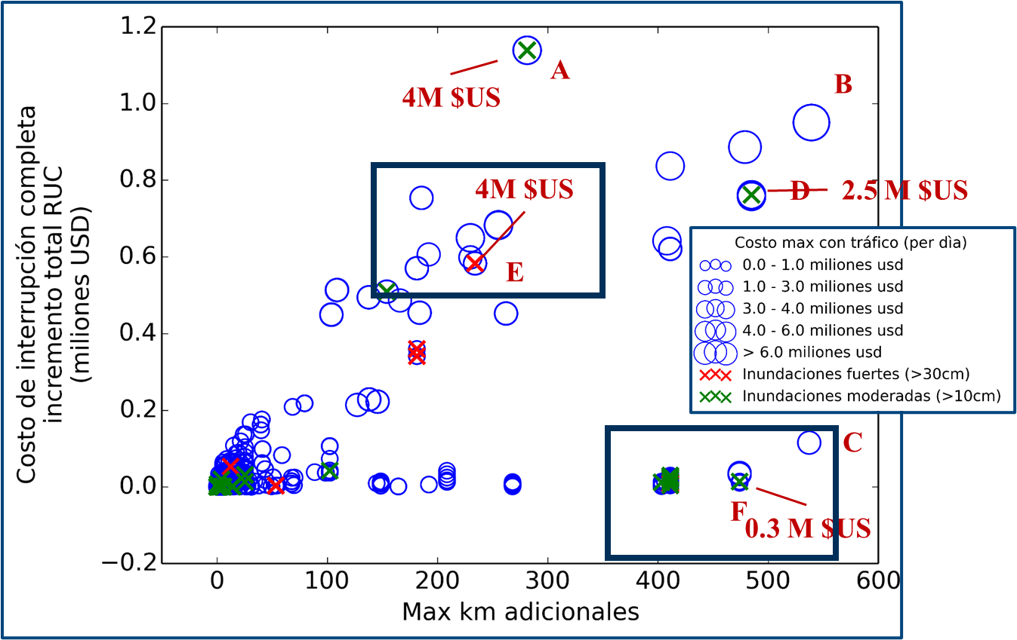
Critical links and exposure to climate events
Flood Risk in Peru

Slide 16
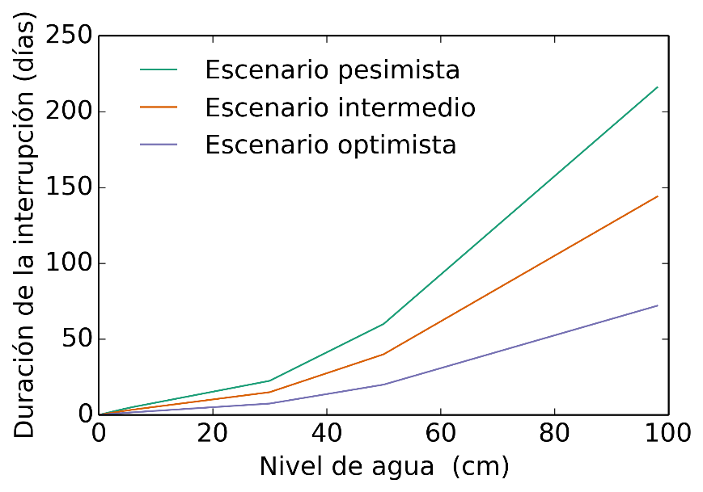
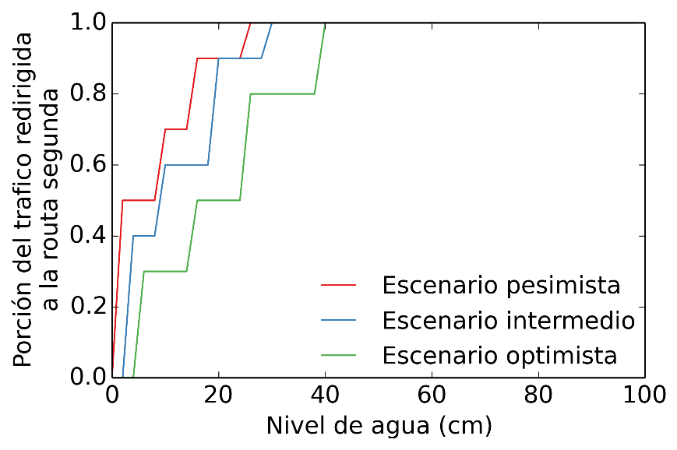
  Flooding: Four Uncertainties
Duration
Frequency of floods
  4 scenarios: one historical and three incorporating climate change
Duration of disruption caused by flooding
Share of traffic which can travel on the flooded road
Increased costs for traffic which can travel on the flooded road
Traffic

Slide 17
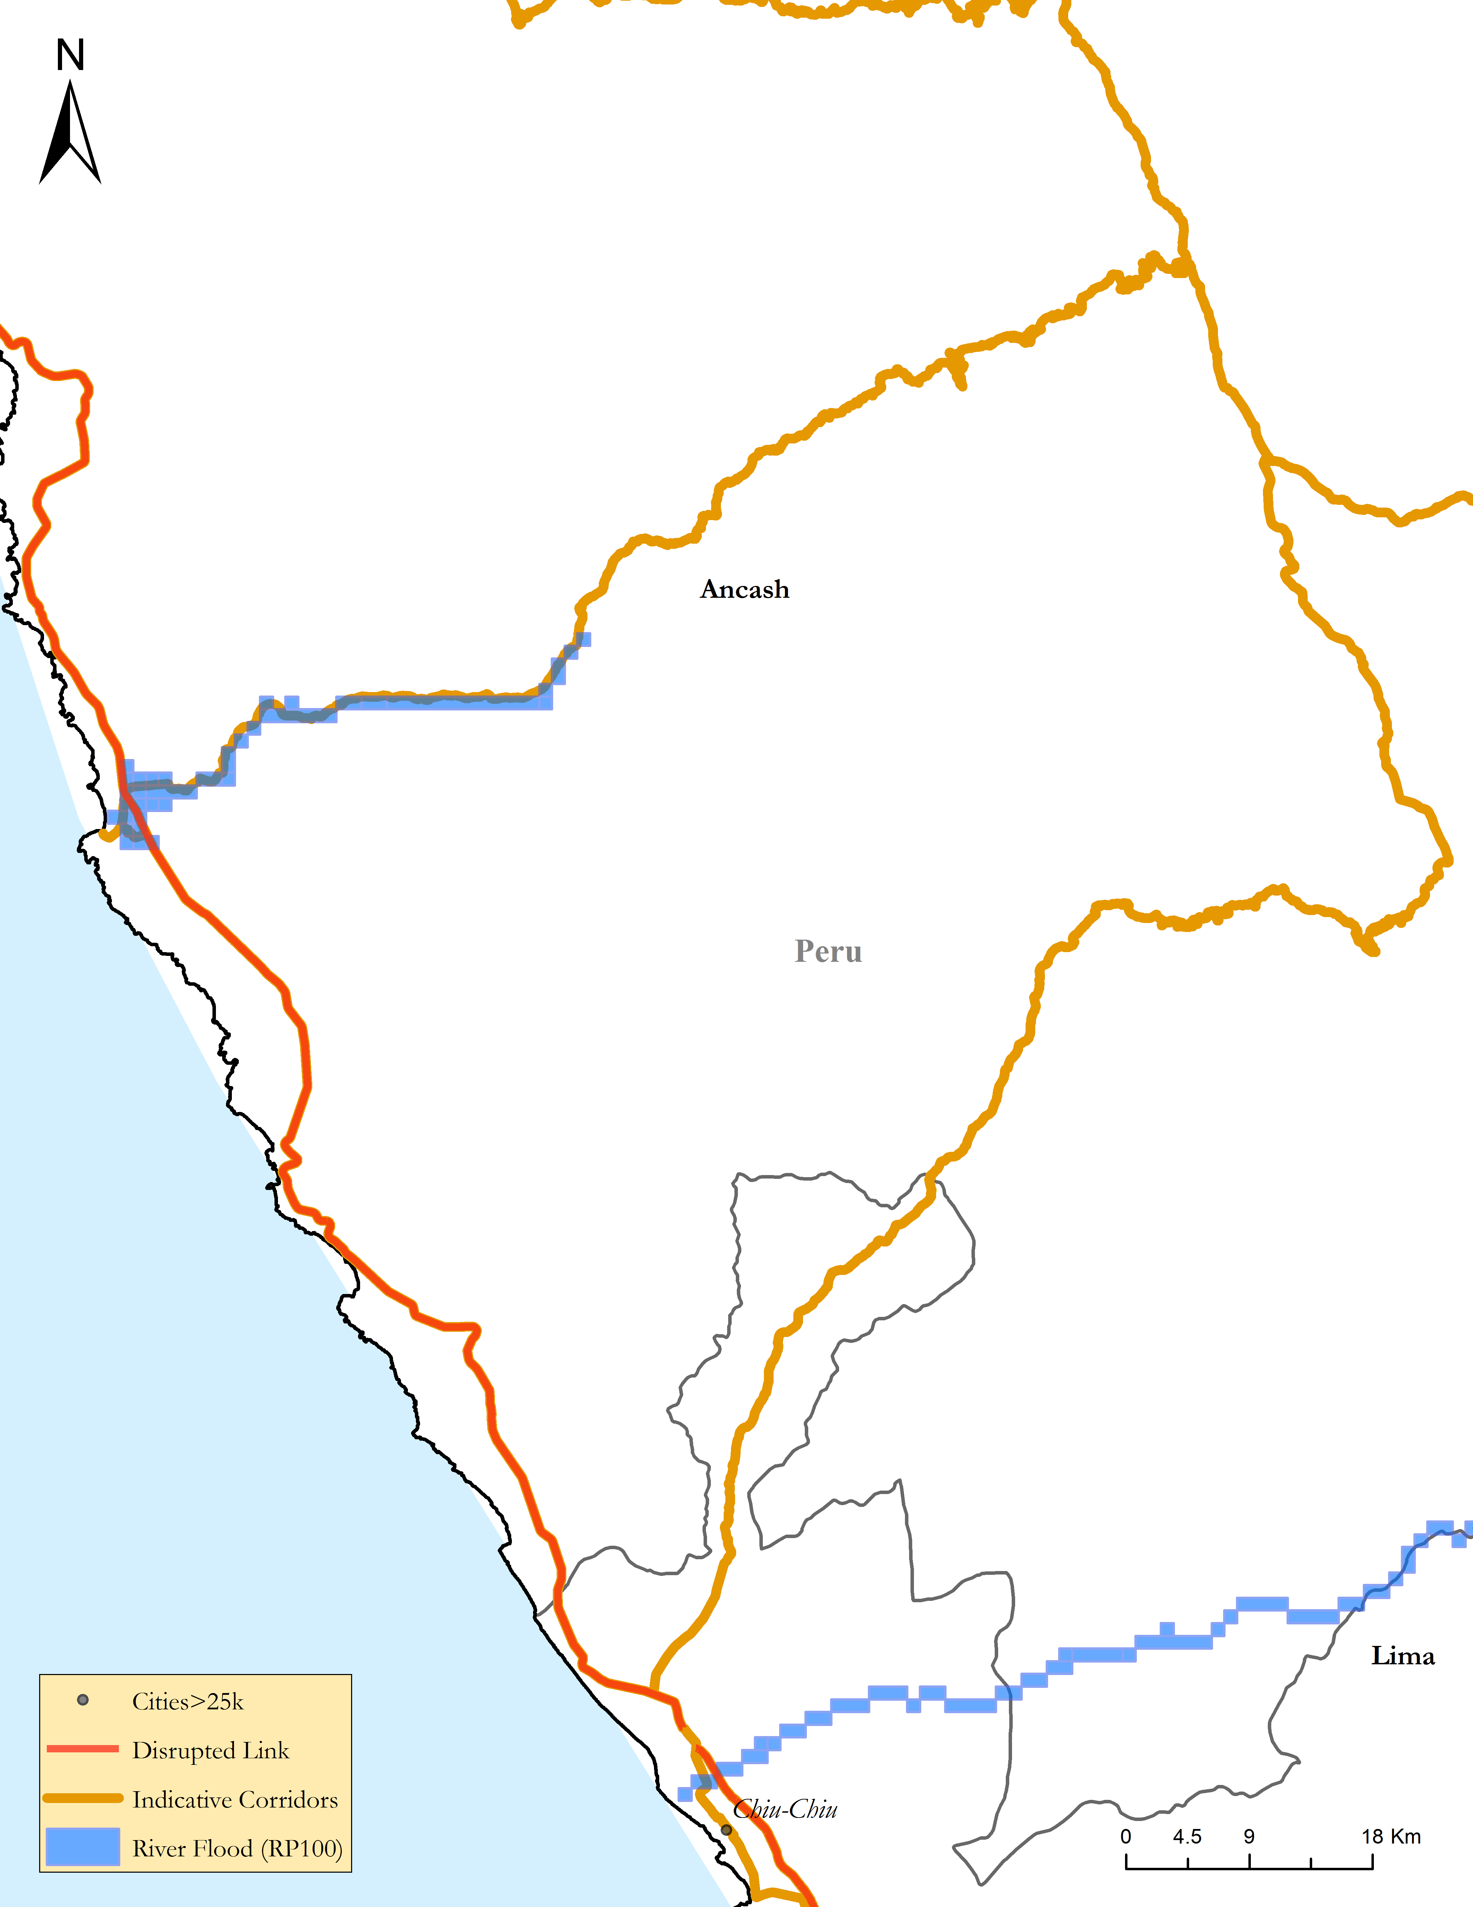
Critical links exposed and vulnerable to floods
Flood Risk in Peru
Link 418: Carretera Panamerica

Slide 18
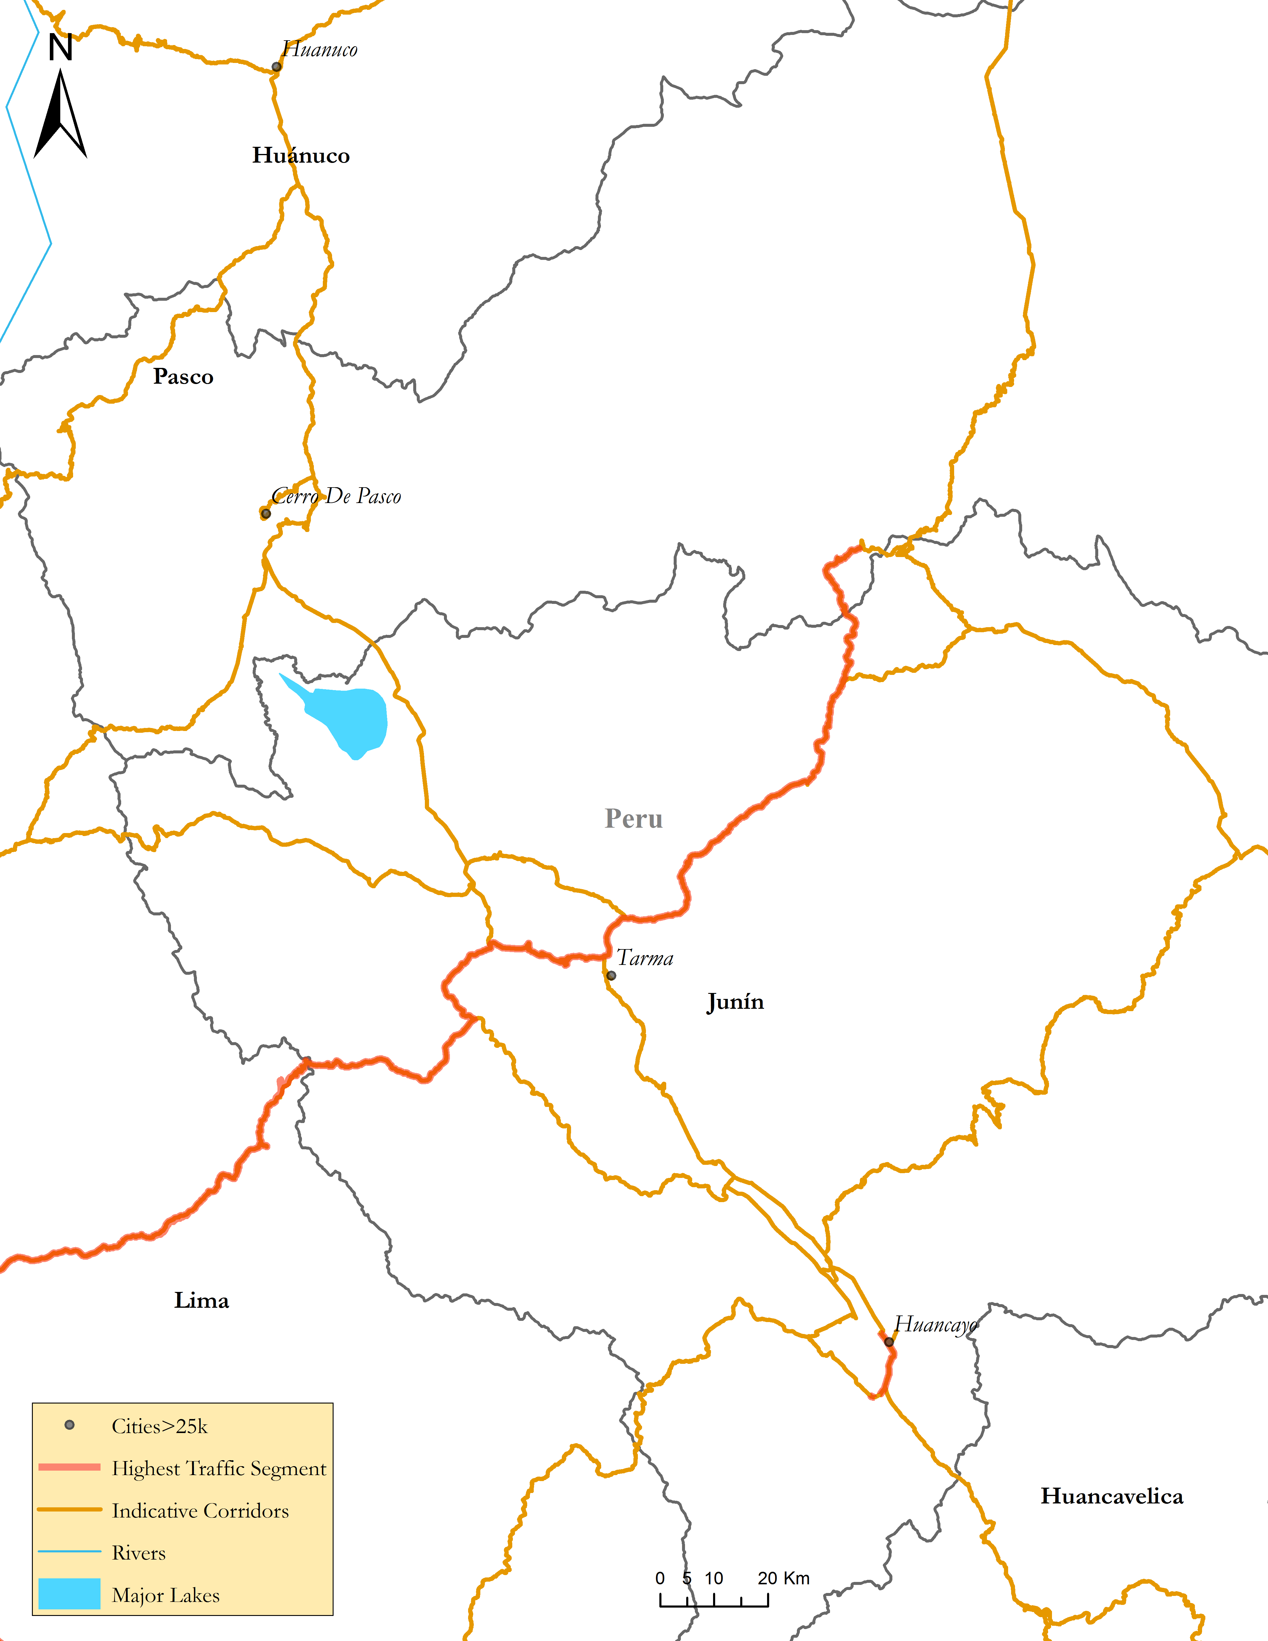
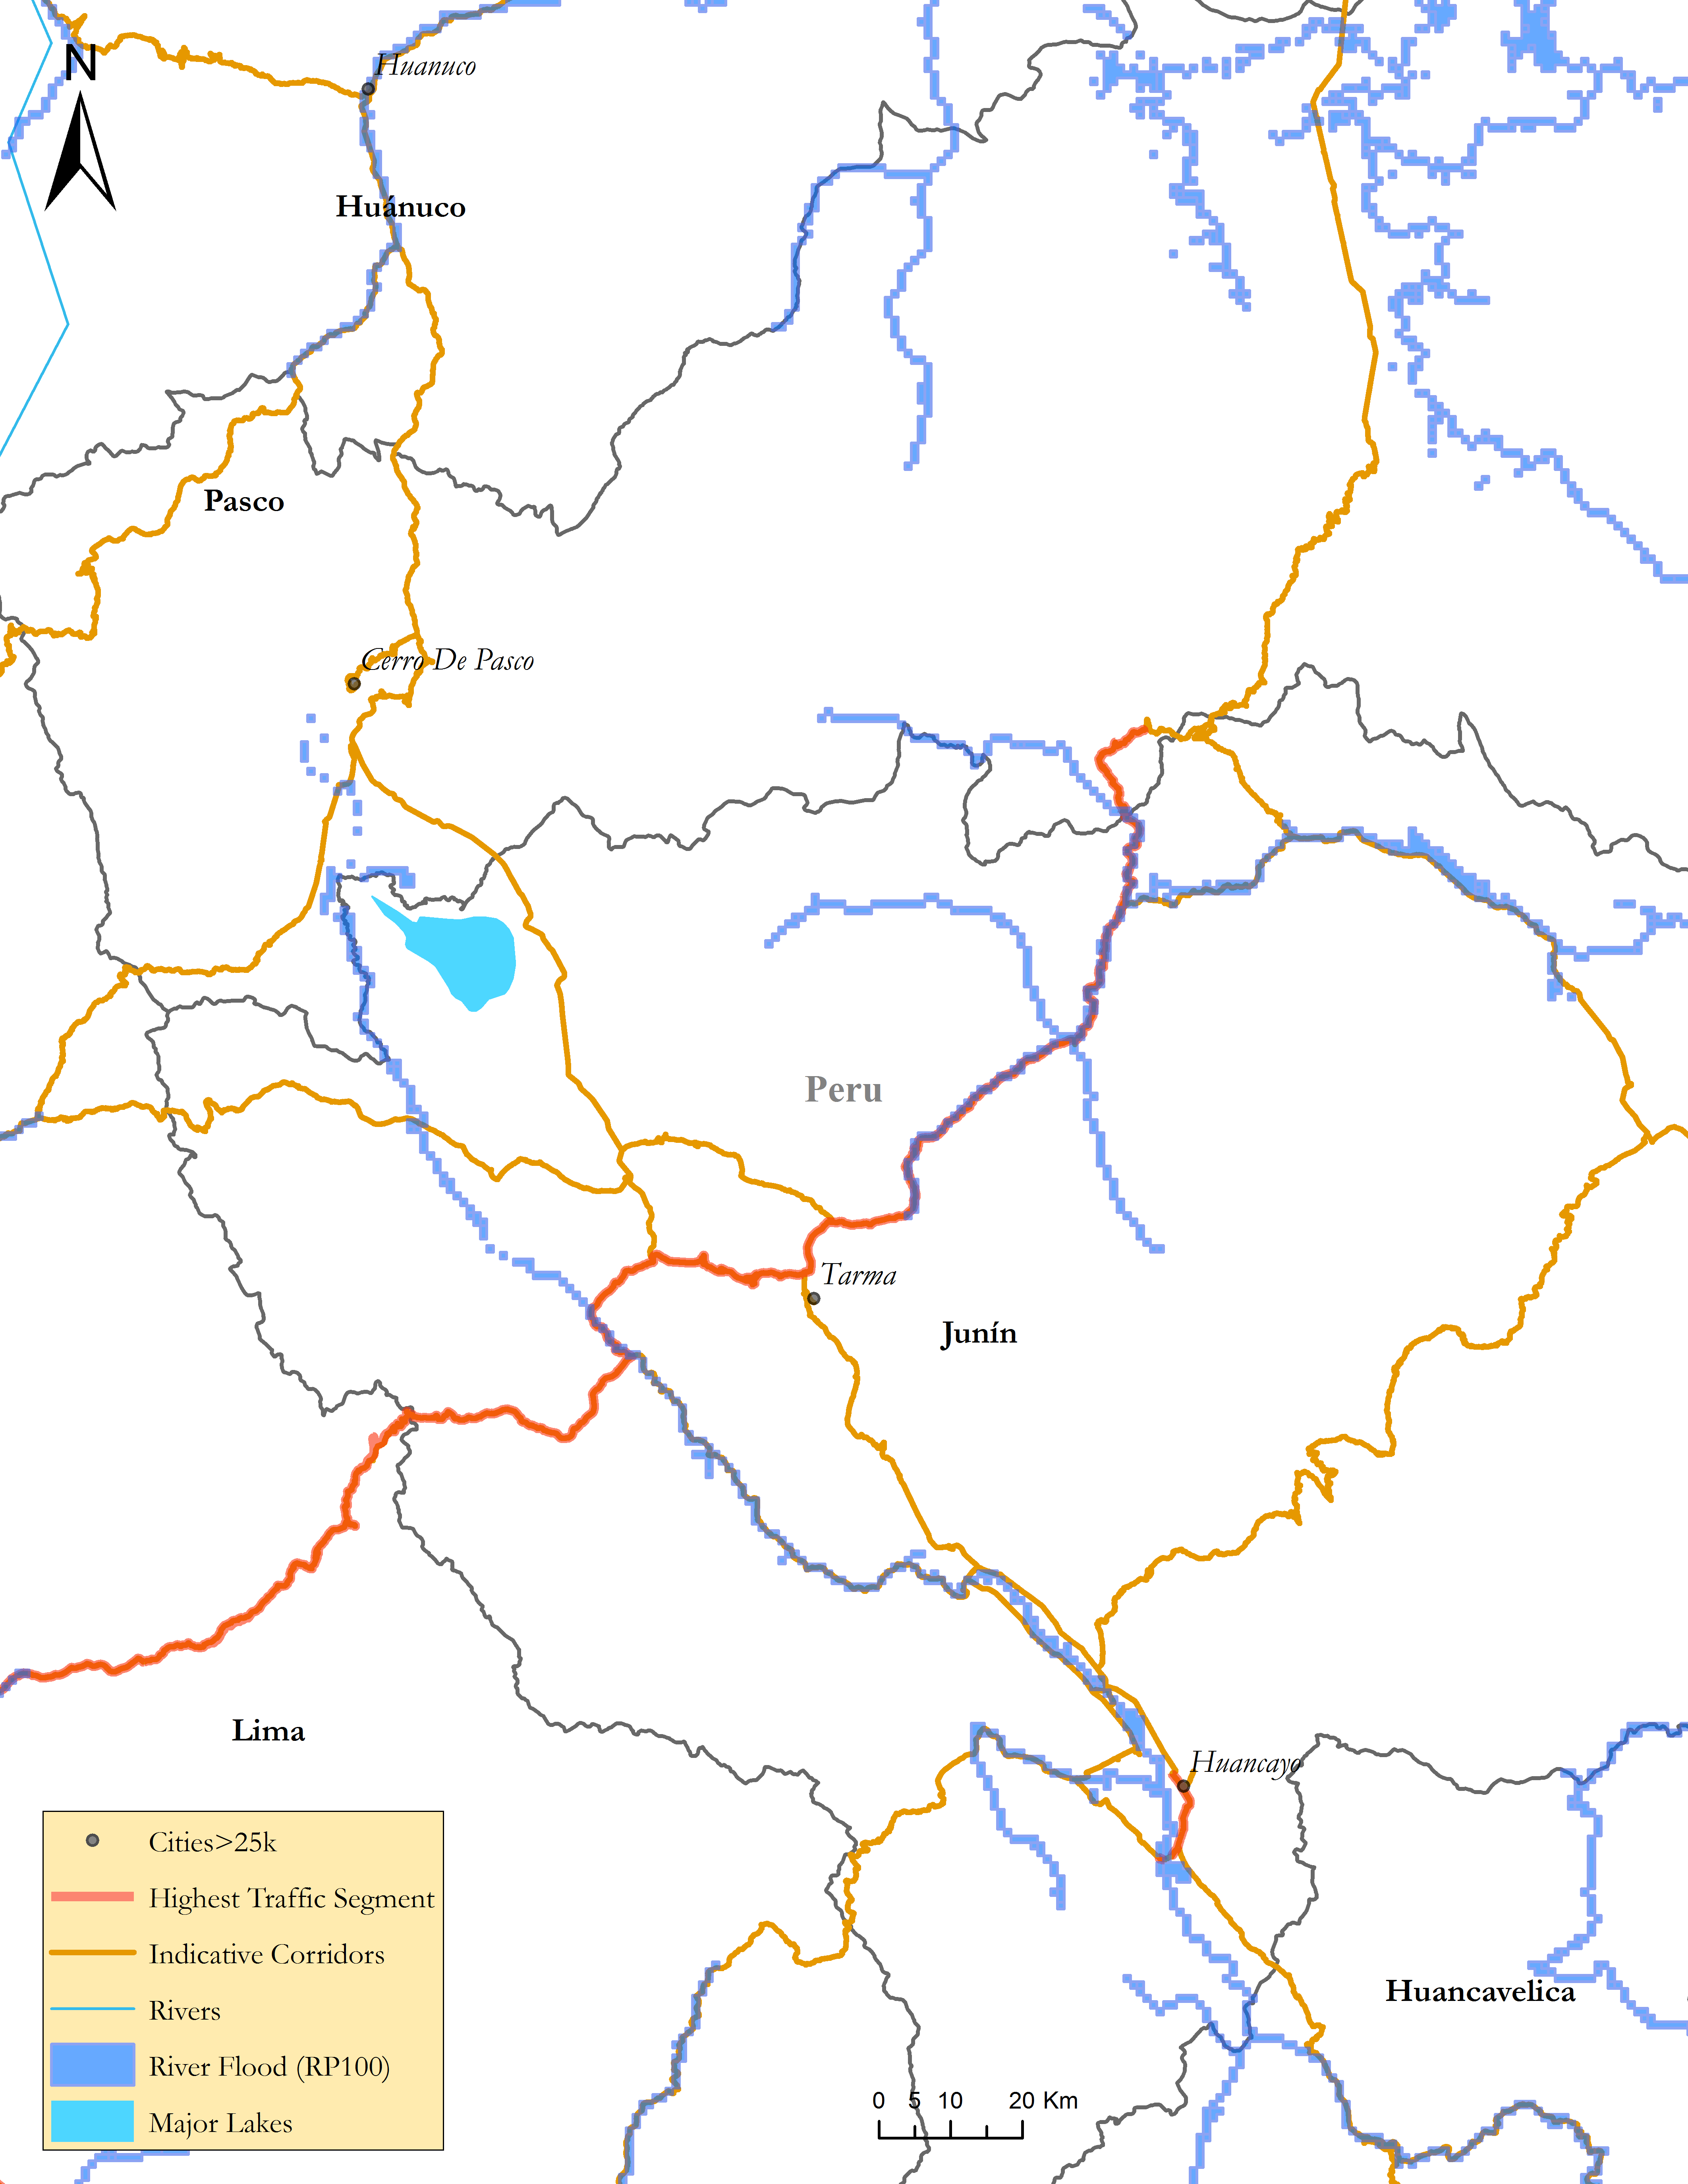
Critical links exposed and vulnerable to floods
Flood Risk in Peru
Link 124: Carretera Central

Slide 19
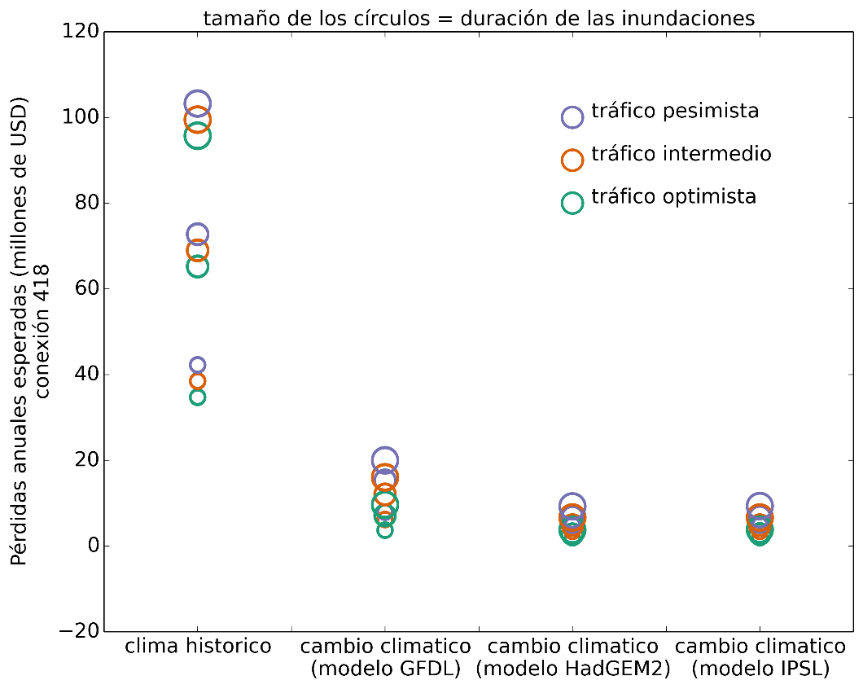
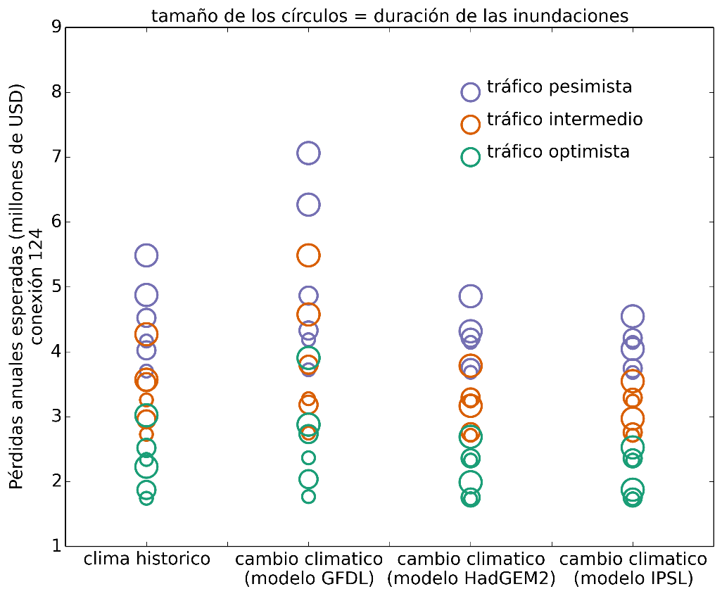
Expected annual losses can be calculated for multiple scenarios
Link 418: climate change leads to reduced precipitation and so less flooding
Link 124: losses are higher under climate scenarios, but flood levels are low; losses depend on the traffic which can continue to use the flooded road
Link 418: Carretera Panamericana
Link 124: Carretera Central
$$Expected Losses=Duration∗\left({Traffic}_{1stBest}∗{Cost}_{1stBest}+{Traffic}_{2ndBest}∗{Cost}_{2ndBest}\right)$$
$$+ \left\{\begin{matrix}Cost of reconstruction if disruption>7 days \\ Cost of rehabilitation if disruption ≤7 days\end{matrix}\right.$$

Slide 20
How can we increase reliability?
Option | Description | Benefit | Cost per km
 |  |  | Link 418 Panameric. | Link 124 Central
Do nothing ex ante | Inaction
Frequent maintenance | Frequent controls and maintenance of the road; clean drainage; reinforce slopes | Reduction in flood duration | 70,089 | 70,089
Improve 2nd-best road | Pave an unpaved road; improve structures and drainage | 2nd-best road has the same RUC as the 1st-best road (all flood losses disappear) | 500,608 | 500,608
Flood-proof road | Relocate the optimal route; enlarge the drainage | The road never gets flooded (all flood losses disappear) | 1,283,833 | 1,283,833

Slide 21
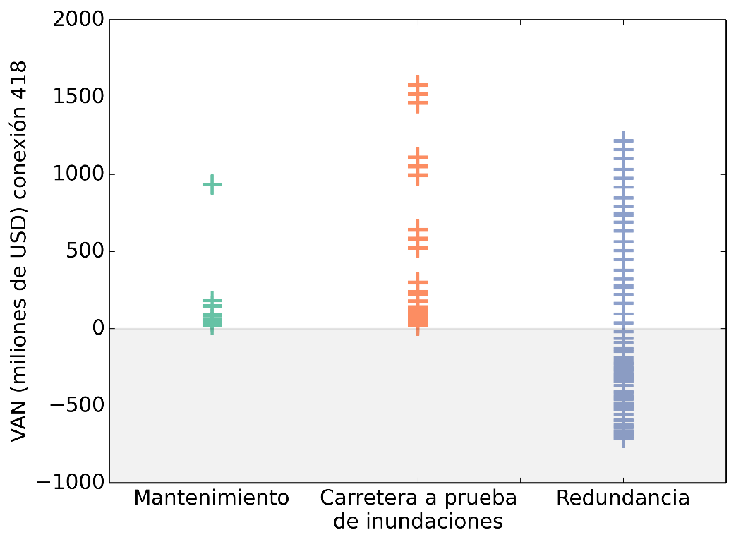
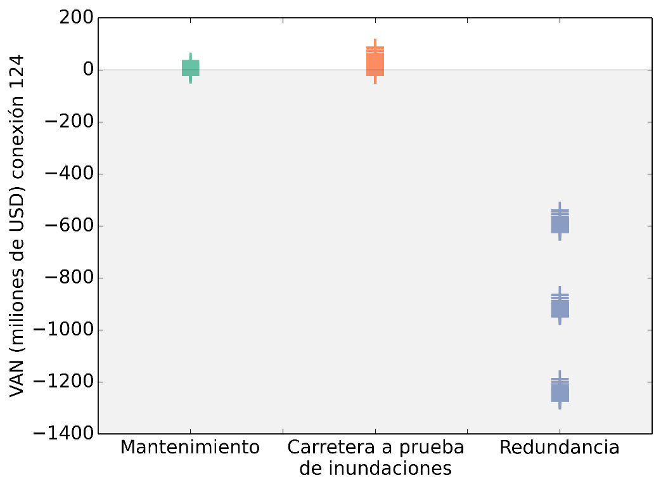
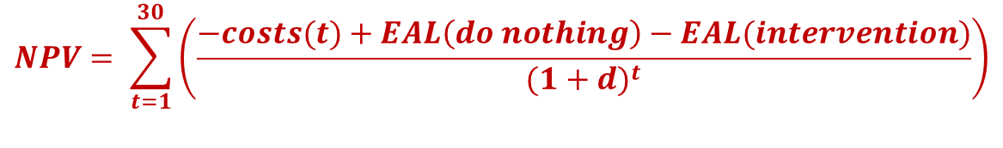
The benefit of an intervention is the difference between the expected annual losses when nothing is done and with the intervention
Link 418: maintenance and flood-proof road are “no-regret” options
Link 124: improving the second-best route does not seem a good option
Link 418
Panamericana
Link 124
Central
$$NPV= \sum_{t=1}^{30}{\left(\frac{−costs(t)+EAL\left(do nothing\right)−EAL(intervention)}{{(1+d)}^{t}}\right)}$$

Slide 22
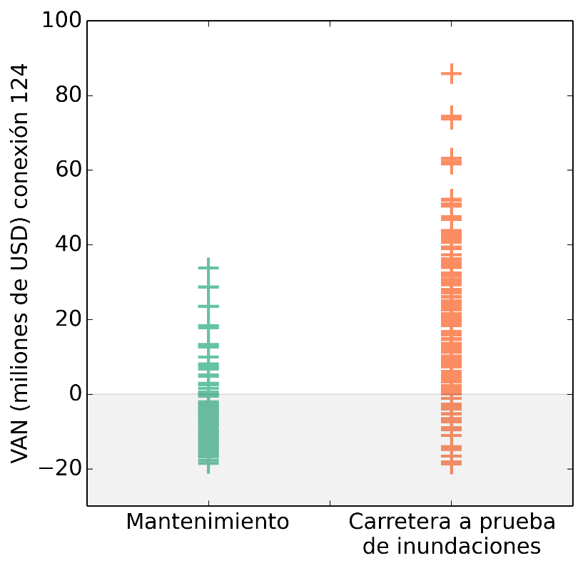
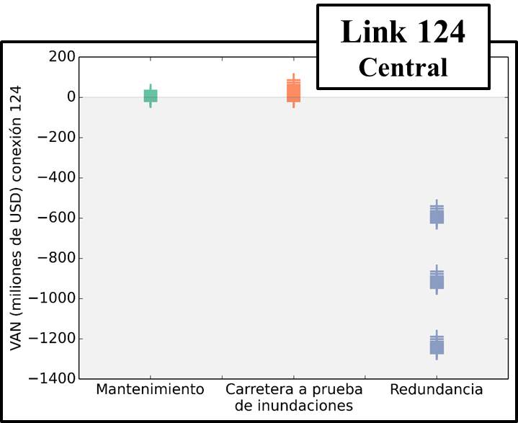
The benefit of an intervention is the difference between the expected annual losses when nothing is done and with the intervention
Link 124
  Improving the second-best route is never a good option
  Maintenance and a flood-proof road both have negative NPV in some cases but the flood-proof road leads to a higher NPV on average
Link 124
Central

Slide 23
The Case of Mozambique: Upgrading a Network

Slide 24
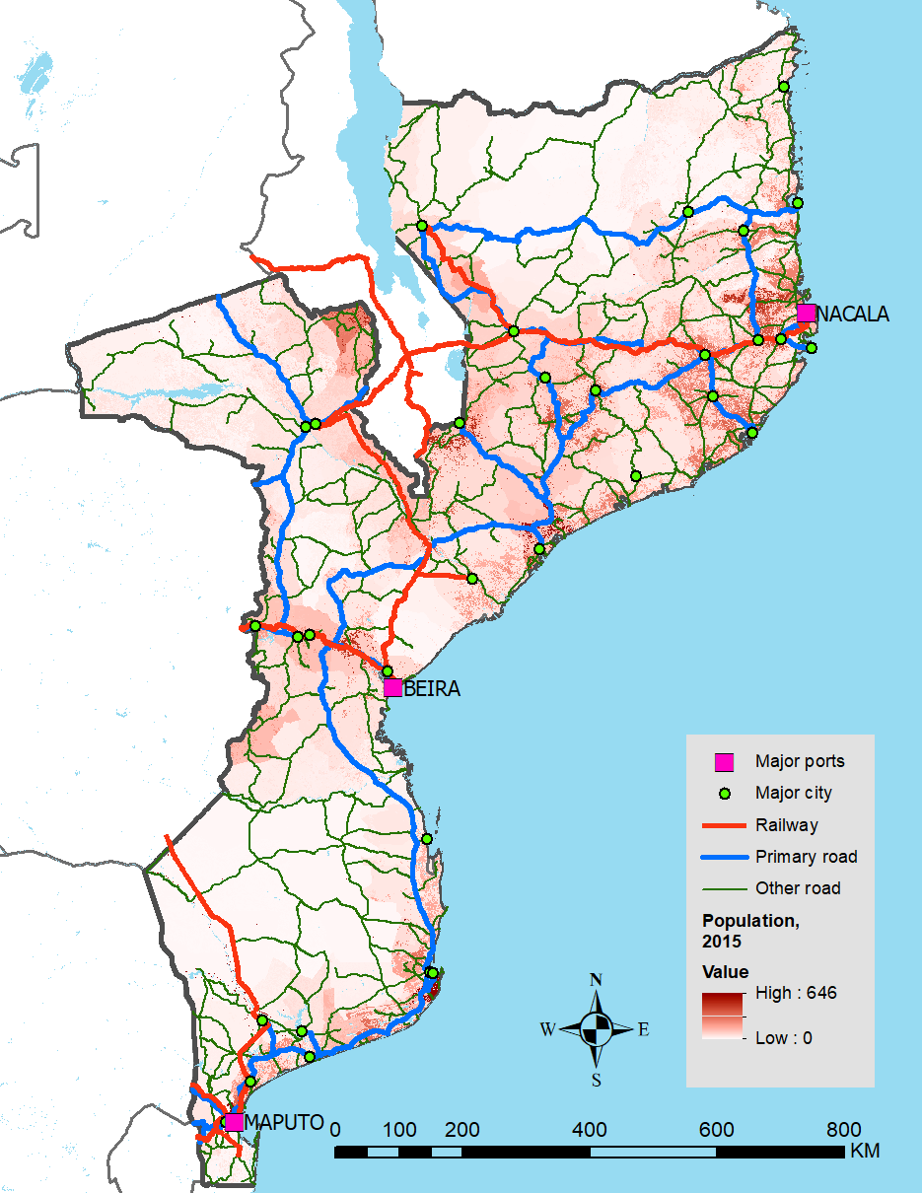
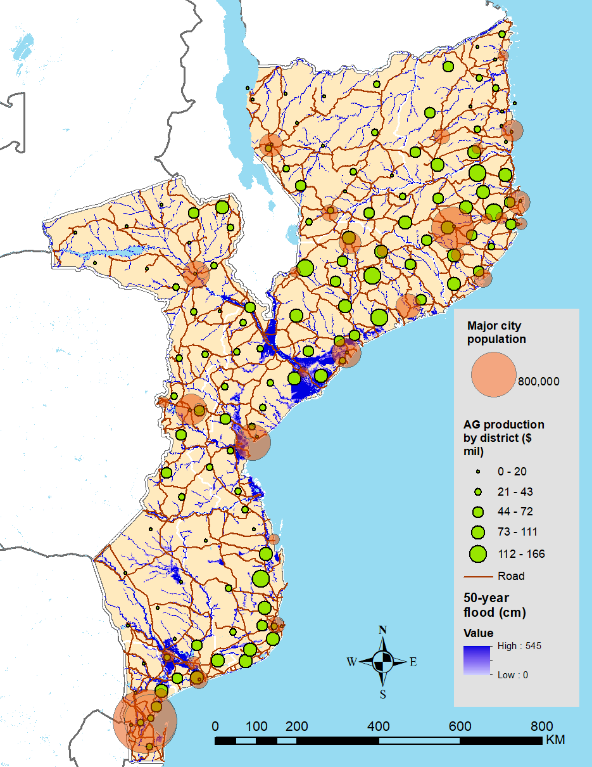
Critical corridors – Starting point
Transport Network (Indicative Corridors)
Main Population and Agriculture Centers

Slide 25
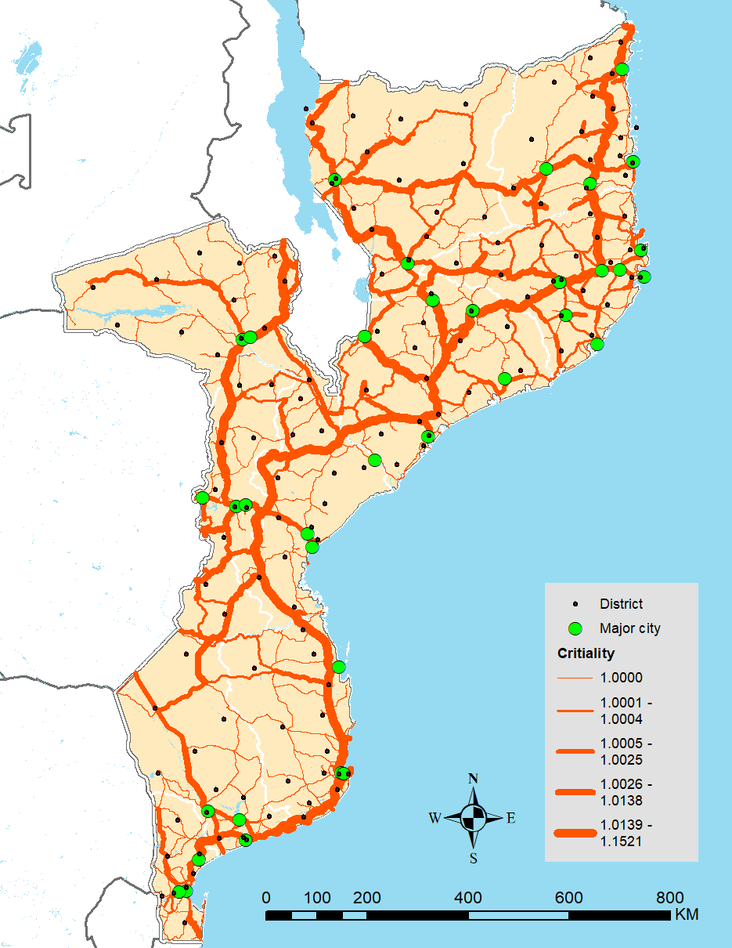

Critical corridors – A subset of the network
For a given link k
$${Criticality}_{k}=\frac{\sum_{i}{\sum_{j}{t_{ij}^{k}}}}{\sum_{i}{\sum_{j}{t_{ij}^{∗}}}}$$
Where t* is the shortest travel time between node i and j.
Criticality Map
Estimated Network Criticality
Estimated Deterrence

Slide 26
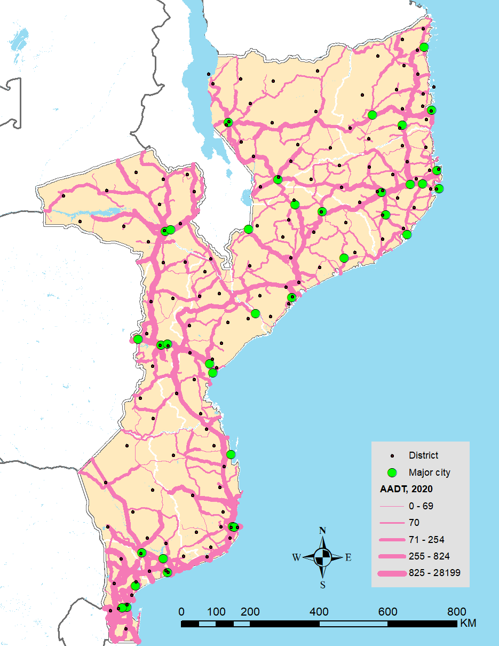

Critical corridors – A subset of the network
Road High-Traffic Links
For a given link k
$${Economic Criticality}_{k}=\frac{\sum_{i}{\sum_{j}{g_{ij}t_{ij}^{k}}}}{\sum_{i}{\sum_{j}{g_{ij}t_{ij}^{∗}}}}$$
Where t* is the shortest travel time between node i and j,
and g_{ij}. is a measure of economic activity (eg traffic)
Estimated Network Economic Criticality

Slide 27
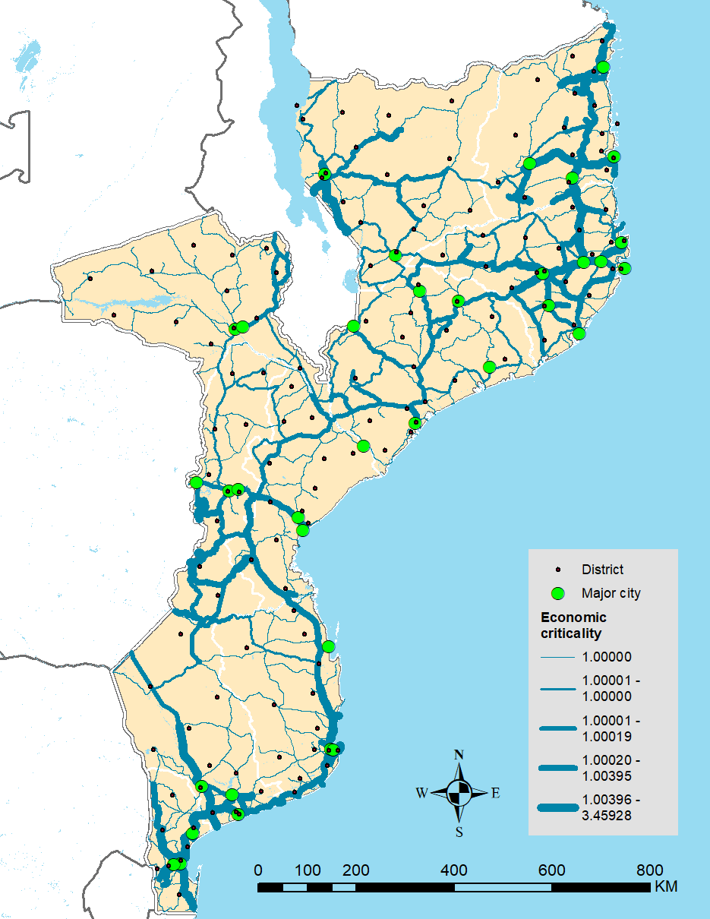
Critical corridors – The criteria is a policy decision
Criticality Map
Economic Criticality Map

Slide 28
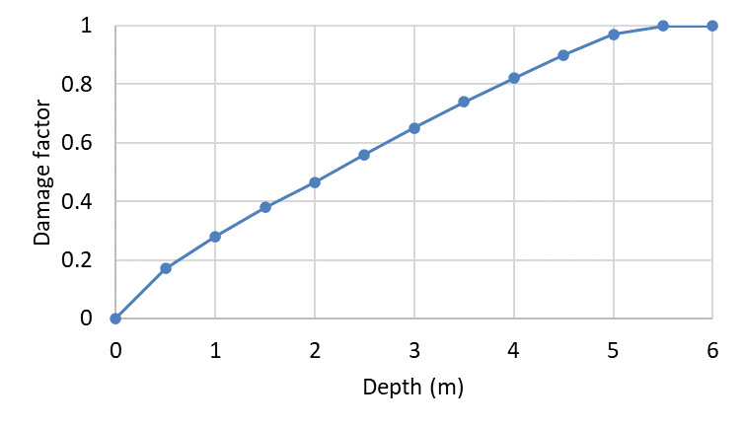
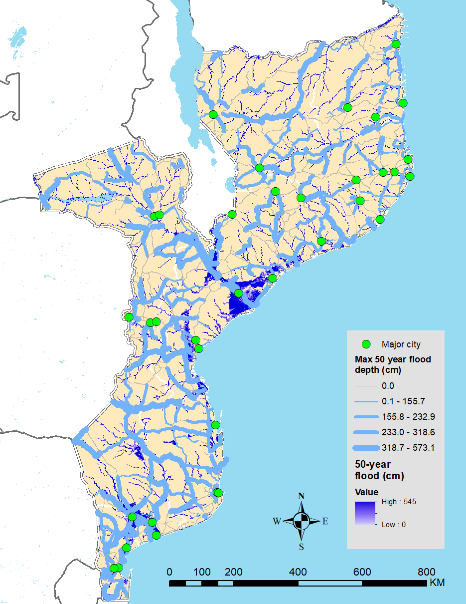
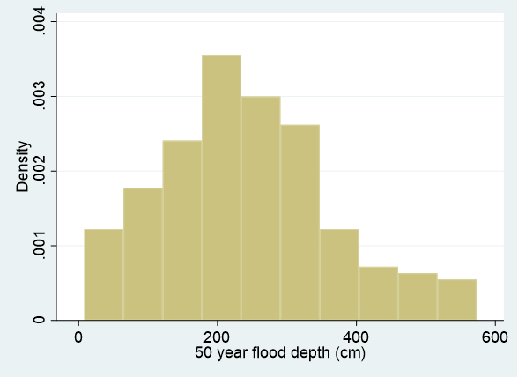
Exposure to Climate Events
50-year Flood Map

Slide 29
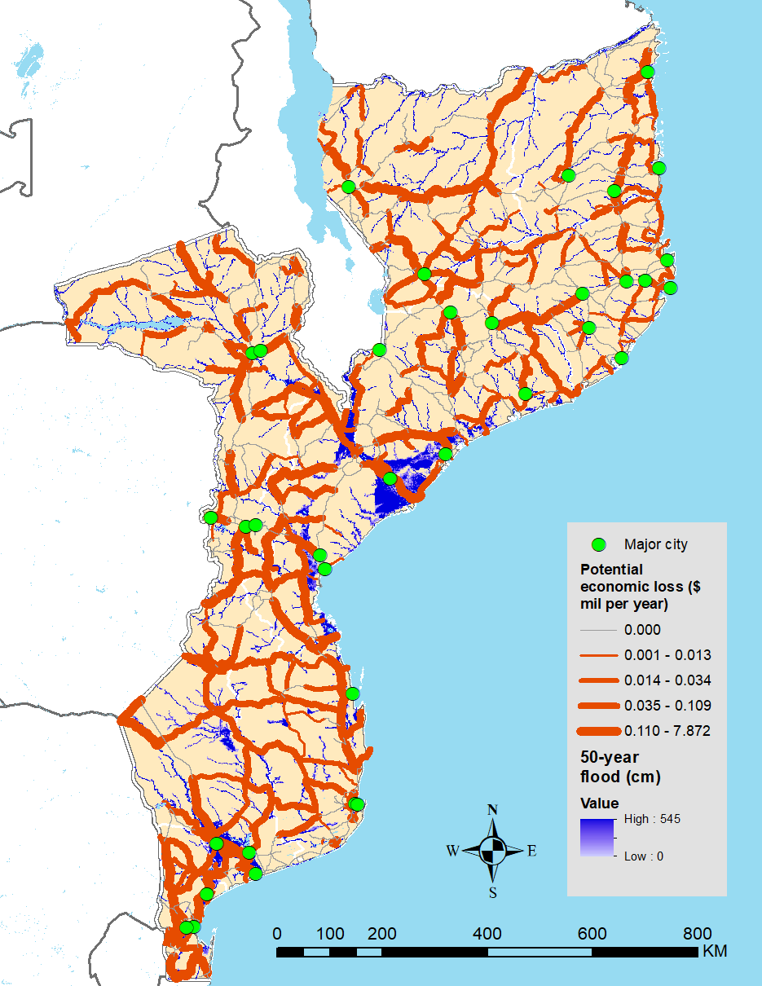
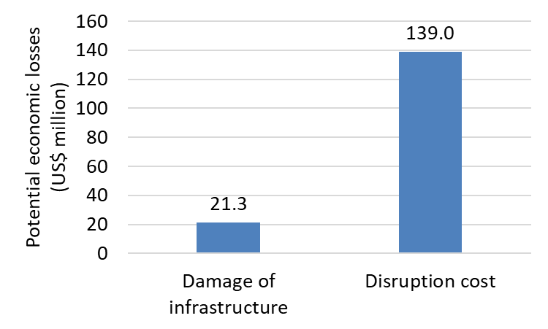
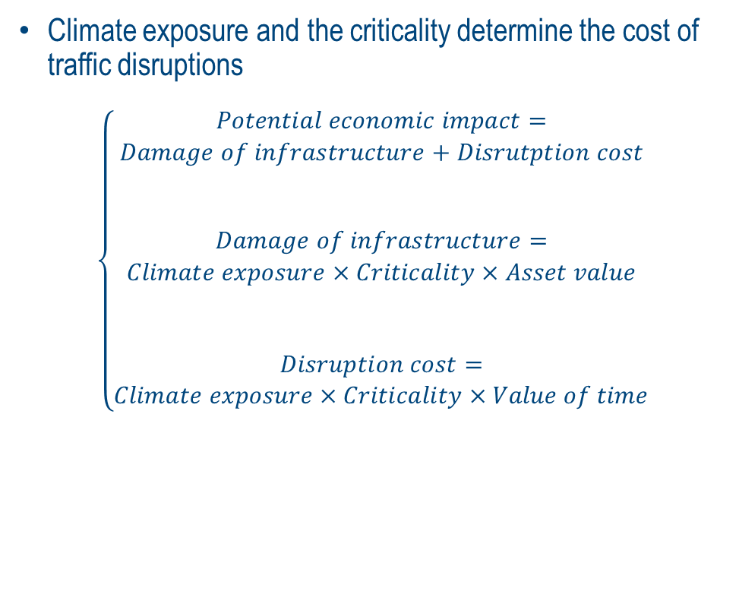
Potential economic cost of climate disruptions
Potential Economic Losses – Upper Bound
Climate exposure and the criticality determine the cost of traffic disruptions
$$\left\{\begin{matrix}\begin{aligned}\begin{aligned}Potential economic impact= \\ Damage of infrastructure+Disrutption cost\end{aligned} \\ \\ \end{aligned} \\ \begin{aligned}Damage of infrastructure= \\ Climate exposure×Criticality×Asset value\end{aligned} \\ \begin{aligned} \\ \\ Disruption cost= \\ Climate exposure×Criticality×Value of time\end{aligned}\end{matrix}\right.$$

Slide 30
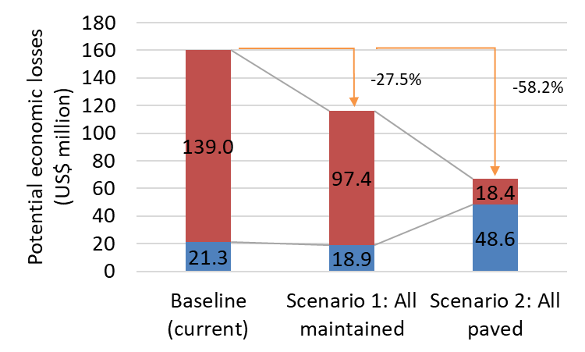
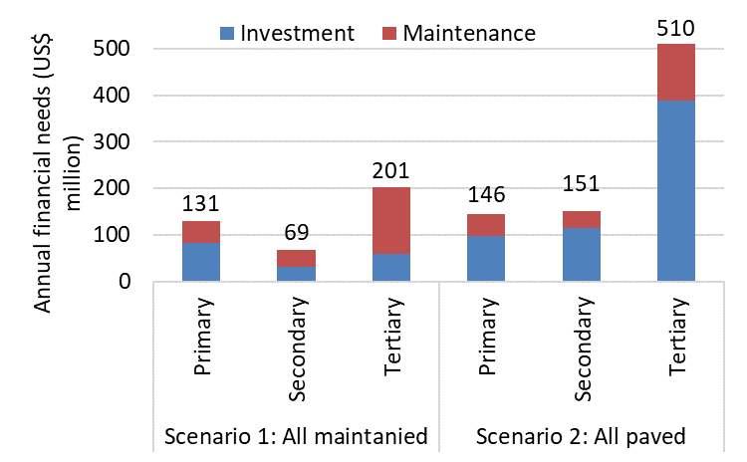
Alternative scenarios
Scenario 1
Maintain all roads in good condition
Scenario 2
Pave all and maintain in good condition

Slide 31
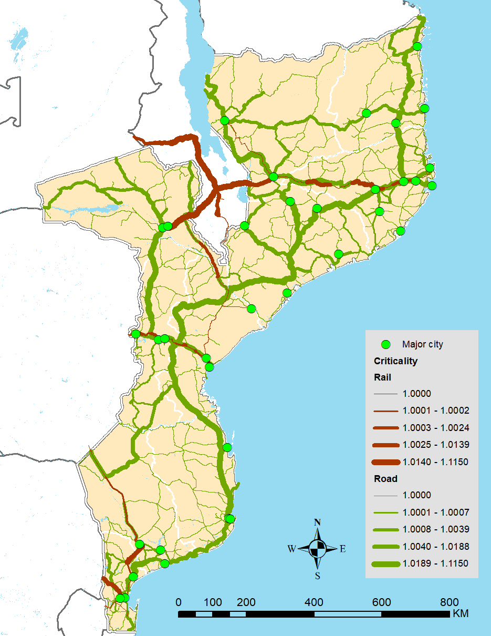
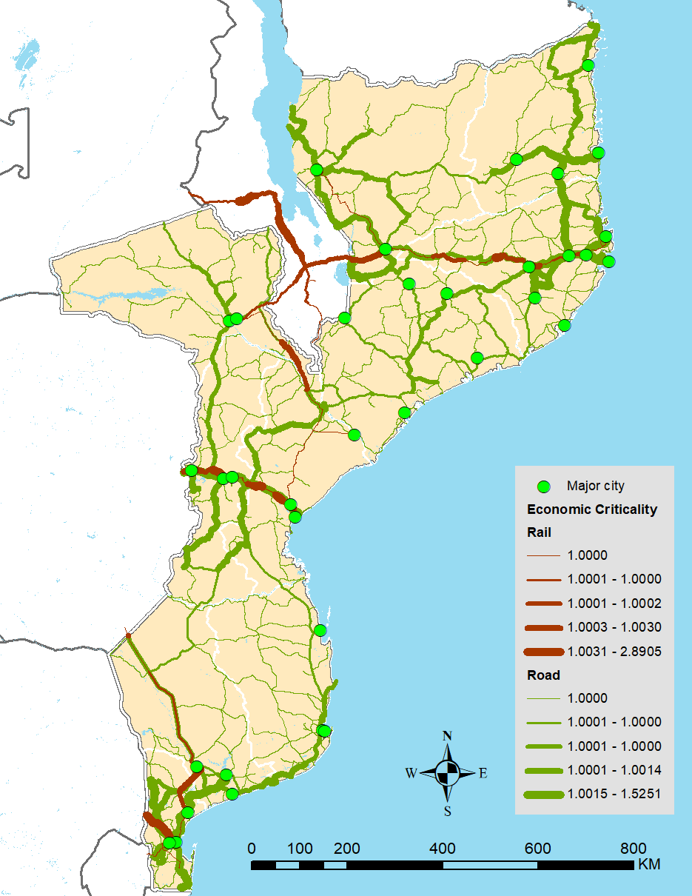
Alternative scenarios
Scenario 3: Connect rail and road networks seamlessly
Potential Economic Losses – Upper Bound
Potential Economic Losses – Upper Bound

Slide 32
Concluding Remarks
Incorporating uncertainty into decision making can improve road infrastructure investment strategies
  Many assumptions must be made, but all can be adjusted to better reflect reality
  Some options can be ruled out because the costs outweigh the benefits in all scenarios
Climate considerations are an imperative elements for public investment decisions
The criteria whereby critical corridors are defined is a policy decision
The choice of the “right” investment strategy should be left to policymakers, as context and political economy matters greatly
But empowering decision makings with tools that make explicit costs and tradeoff of their decisions is fundamental

Slide 33
Thank you for your attention!
Cecilia Briceño Garmendia
Lead Economist
cbricenogarmendi@worldbank.org
Based on Briceno-Garmendia and Rozenberg (2015) and Iimi and Blackwell (2024)

Slide 34
The Data
Road network
  Class, surface type, condition, traffic, number of lanes, vehicle fleet data
Geographic and topographic
  Elevation, terrain, administrative boundaries
  Locations of cities, ports, border crossings, and other important places
  Government-designated corridors (e.g. logistics corridors)
Economic and social
  Economic activities (industrial surveys and local GDP estimates and proxies), population density, and potential for development (e.g. IFPRI agricultural potential maps)
  Economic and population flows (though not always available)
Natural hazards
  Location of historical and potential shocks, particularly natural hazards

Slide 35
The Instruments
GIS and road management tools for calculation of user costs, economic costs and average speeds for individual road links based on a road segment’s network type, terrain, surface, condition, traffic class, and lanes
Optimal, least-cost routes are calculated between an origin and a destination
  Two sets of origins and destinations
    Existing corridors: defined by governments as strategically important
    Indicative corridors: optimal routes connecting places which serve some sort of function
A georeferenced network is key
  Brings financial and economic costs, the road network, geography, optimal routes, and land use together
  Allows for assessment of link importance
  Permits assessment of the impact of an investment project or other intervention
Notes:
Congestion: reduced speeds inputted into HDM-4 using Google’s Directions API

