Slide 1
Continental Climate Resilient and Smart Infrastructure Policy Framework
Nkululeko Leta Pr Eng
Climate Resilient and Smart Infrastructure Expert, African Capacity Building Foundation (ACBF)
Improvement of Road Network Resilience
“Strategies for Cost-Effective Climate Change Adaptation and Sustainable Development”
12-14 November 2025 / Maputo, Mozambique

Slide 2
Index
Why a Continental Perspective?
Prevailing Climate Resilient Infrastructure Policy Frameworks
Identification of Gap
Policy Development Methodology Applied
Objectives and Structure of the CR & SI Policy Framework

Slide 3
1. Why a Continental Perspective?
Climate disaster and challenges cut across countries and regions
Promote systems thinking
Unified proactive action for Climate Smart and Resilient Infrastructure
To provide a framework for MS and RECs to ensure that:
  infrastructure systems (Energy, Transport, Water, and ICT) on the African continent are designed, built, and operated to withstand the impacts of climate change,
  support sustainable development, and
  harness the benefits of smart technologies.

Slide 4
2. Prevailing Climate Resilient Infrastructure Frameworks
exist at the global, continental, regional, and national levels
their objectives and principles are relevant for this climate resilient and smart infrastructure policy framework.
reflect a concerted effort by African governments and regional organizations to enhance infrastructure development and support sustainable economic growth on the continent.
aim to address the continent’s infrastructure gaps, promote sustainable development, and improve regional integration.

Slide 5
3. Identification of Policy Gap
In 2019, the 2nd Ordinary Session of the AUC’s STC on Transport, Transcontinental and Inter-regional Infrastructure, Energy, and Tourism (STC TTIIET) identified the policy gap and recommended the development of a policy framework for Africa to promote climate resilient and smart infrastructure.

Slide 6
4. Methodology Applied
Key informant interviews
Key informant interviews were organized continentally, regionally and nationally with
Infrastructure experts
Climate resilience experts in the built environment
Continental Policy makers
Representatives of AU committees and related formations
Workshops
1-Day workshops were organized with AU committees and related formations to discuss findings from literature and key informants
The workshops were also a validation platform for proposed key issues such as the structure and contents of the proposed policy
Document analysis
Regional, National and related global policies on infrastructure
Documents on global best practice in climate smart and resilient infrastructure
Selection of AU committees and related bodies
This was purposive in accordance with influence in the infrastructure and climate change management space
Selection and data collection from key informants
Key informants were purposively selected —including by referral— based on the knowledge possessed and the influence held in issues climate smart and resilient infrastructure
Data were collected using physical and electronic key informant interviews supported by a key informant guide. Interviews were recorded and transcribed for analysis
Document selection
For national and regional policies: Referral by authorities and web based searches using key words
(National) infrastructure policy;
(Regional) infrastructure policy
African infrastructure policy
Climate smart, resilient infrastructure
For documents on global best practice: Academic; international development agency; regional institutional and multi-lateral agency database search for documents using key words
(National) infrastructure policy;
(Regional) infrastructure policy
African infrastructure policy
Climate smart, resilient infrastructure
Searches were also undertaken for specific infrastructure components —e.g., transport, energy, the built environment, etc.,—
Documents were restricted to those from 2020 to deal with the latest information
Analysis
Literature provided the key themes, definitions of concepts and basic structure of the report.
Key informant and workshop data were organized into the thematic areas developed through literature. Where considered necessary, new thematic areas emerging from key informant and workshop data were added
Ethical issues—Safeguarding policies; acknowledgement of source; necessary clearances—

Slide 7
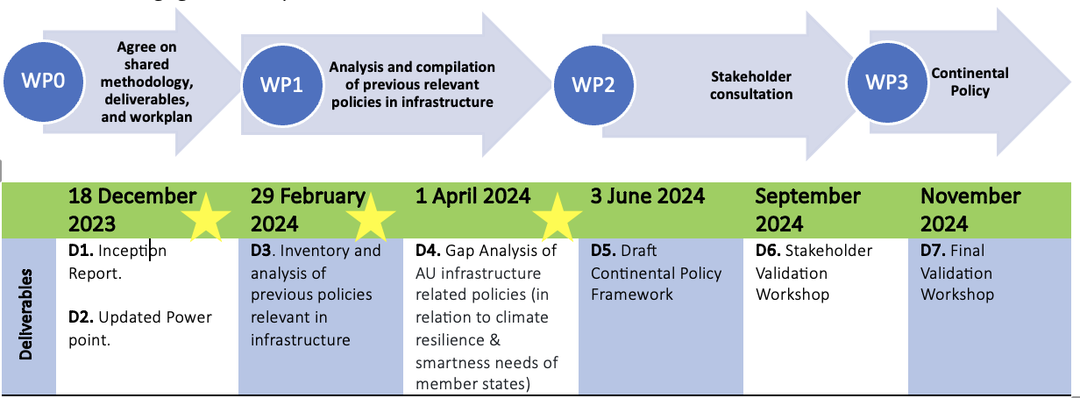
Process and delivery timelines for the CR & SI Policy FW

Slide 8
5. Objectives and Structure of the CR & SI Policy Framework
The Policy Framework intends to:
Enhance Climate Resilience of Infrastructure: To ensure that existing and new Energy, Transport, Water, and ICT infrastructure in member states and across RECs can withstand and adapt to climate related hazards and a changing climate.
Promote Climate Smart Infrastructure: To prioritise infrastructure designs, developments, and operations that reduce greenhouse gas emissions and support a low-carb economy.

Slide 9
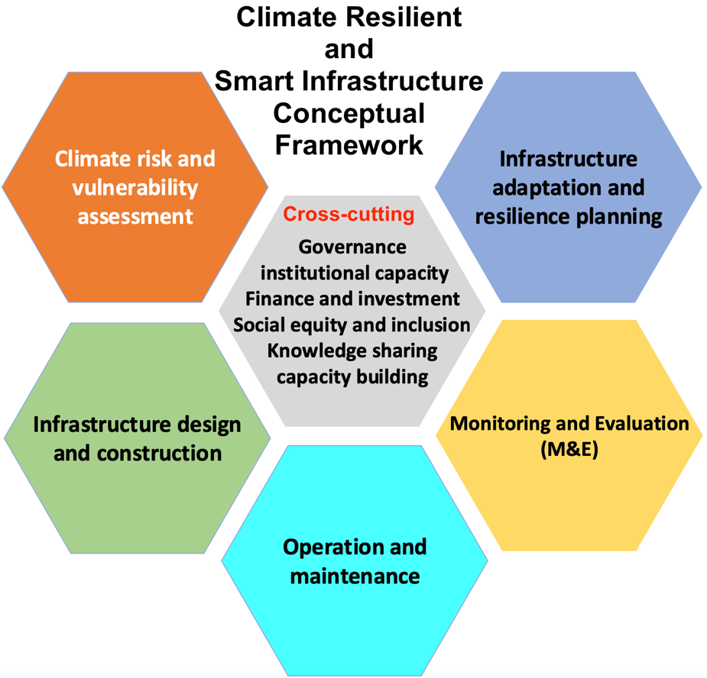
The structure of the Policy FW
The policy FW is split into 5 major chapters:
Chapter 1: Introduction and Rationale - covers the prevailing African infrastructure space from a climate resilient and smart perspective.
Chapter 2: Strategic Framing – outlines challenges facing the development of climate resilient and smart infrastructure and guiding principles addressing these challenges

Slide 10
Chapter 3: Strategic Policy Guiding Principles
The policy establishes eight 8 high level principles to guide the Member States
Principle 1: Gender and Inclusiveness – actively engage & involve people and communities, pvt, public
Principle 2: Climate-Science Informed Infrastructure – use best available climate science data in decision-making
Principle 3: Proactive Climate Resilient & Smart Infrastructure Planning – proactively plan, design, build and operate infrastructure that is resilient to current and future hazards
Principle 4: Nature-Based Climate Compatible Infrastructure – work in positively-integrated way with natural environment and ecosytems
Principle 5: Shared Accountability – share information and expertise for coordinated benefits
Principle 6: Continuous Innovation – continuously develop and update understanding of climate resilience
Principle 7: Accessible Climate Finance – improve ease of access to climate finance to support resilience
Principle 8: Harmonised Governance and Coordination – ensures policies and regulations are aligned enabling streamlined regional cooperation, transparency and accountability

Slide 11
Chapter 4: Policy Implementation for CR & SI
- outlines the essential steps, strategies, and stakeholders required for translating policy commitments into tangible results.
- Covers policy coordination, stakeholder engagement, project planning and design, climate finance, stakeholder roles in implementation, sector strategies
The policy has five 5 foundational policy intervention areas to support CR & SI implementation:
Strategic Area 1: Inclusivity and empowerment
Strategic Area 2: Policies, Regulations, and Standards
Strategic Area 3: Governance, Coordination, Capacity Building Tools
Strategic Area 4: Project Planning, Development and Delivery
Strategic Area 5: Climate Investments and Finance

Slide 12
Integration of the 5 strategic intervention areas and the 9 project lifecycle phases
The policy framework supports MS in directing the full lifecycle of infrastructure—from planning and procurement to construction, maintenance and evaluation—across energy, transport, water, and ICT sectors.

Slide 13
Chapter 5: Monitoring, Evaluation and Adaptive Management
– outlines the framework for tracking progress, assessing the effectiveness of the policy framework, and informing ongoing policy adjustments
- defines key performance metrics and indicators (input, output, outcome and impact)
Policy evaluation framework

Slide 14
Thank you for your attention!
Nkululeko Leta Pr Eng
Climate Resilient & Smart Infrastructure Expert
nkululeko.leta@gmail.com
@twitter

