Slide 1
Evaluation of the performance of Armoured base approach for low volume roads. Estudo de caso: N/C: Agostinho Neto - Mutamba
Cédrik Edson Namburete
Technician, ANE, IP
Improvement of Road Network Resilience
“Strategies for Cost-Effective Climate Change Adaptation and Sustainable Development”
12-14 November 2025 / Maputo, Mozambique

Slide 2
Index
Introduction
Objectives
Concept of Armoured Base
Case Study: N/C Agostinho Neto – Mutamba
  Contextualization
  Indicators and results
  Actual Conditions
Economic Viability
Conclusions

Slide 3
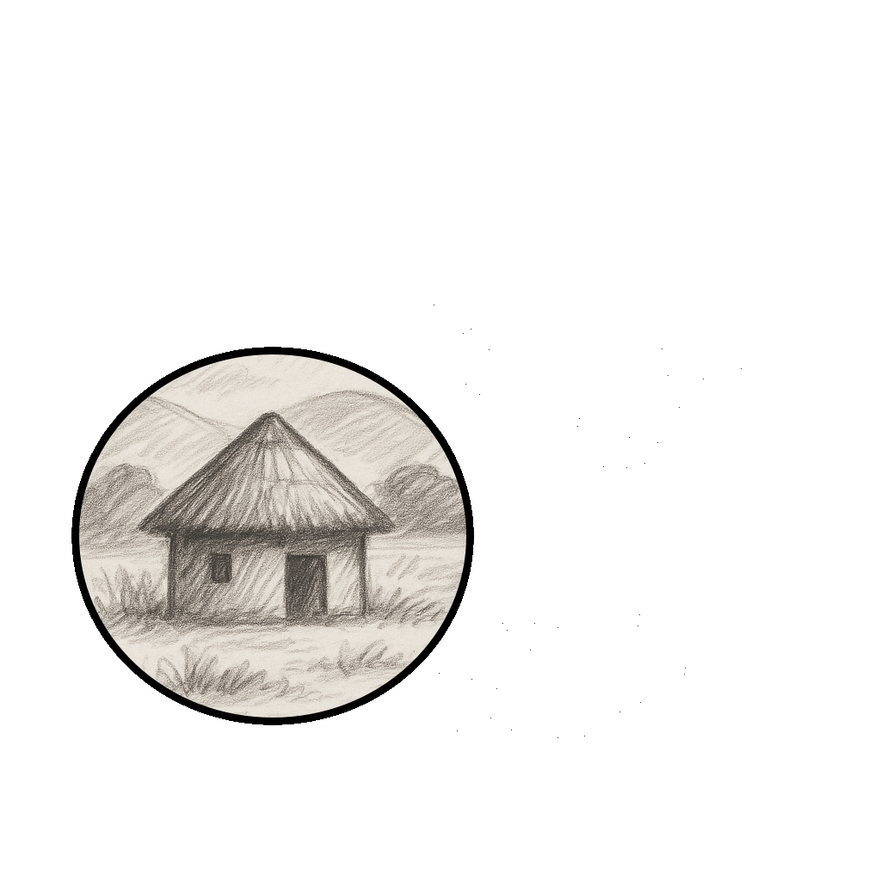




1. INTRODUCTION
36 000 km
LVR

Slide 4
2. OBJECTIVE
  Evaluate the performance of Armoured Base as technical and economic alternative to improve the durability and resilience of the LVR in Mozambique.
    Use of local materials;
    Low-cost coatings.

Slide 5
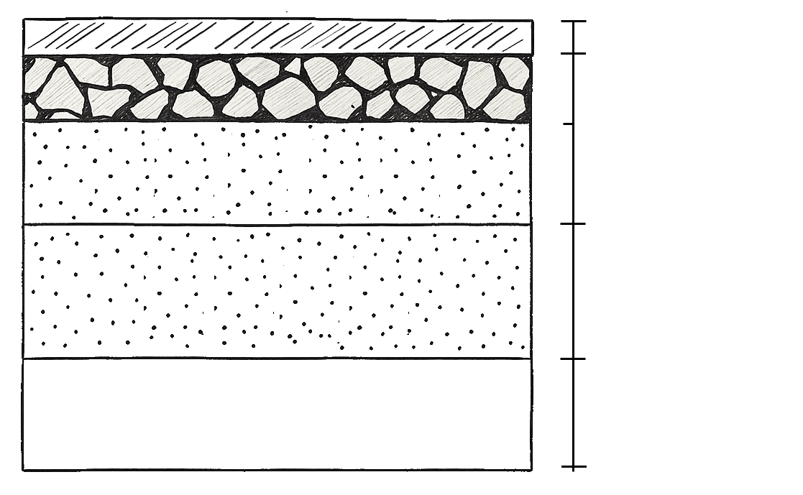
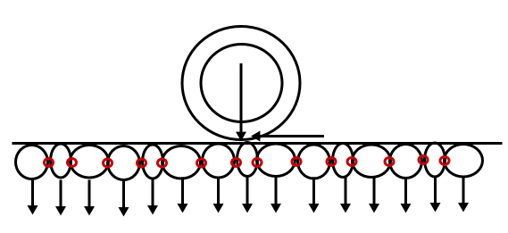
3. CONCEPT OF ARMOURED BASE
SURFACING LAYER
ARMOURING (50mm)
ARMOURED BASE (150mm)
GRANULAR BASE (100mm)
SUB-BASE (150mm)
FOUNDATION

Slide 6
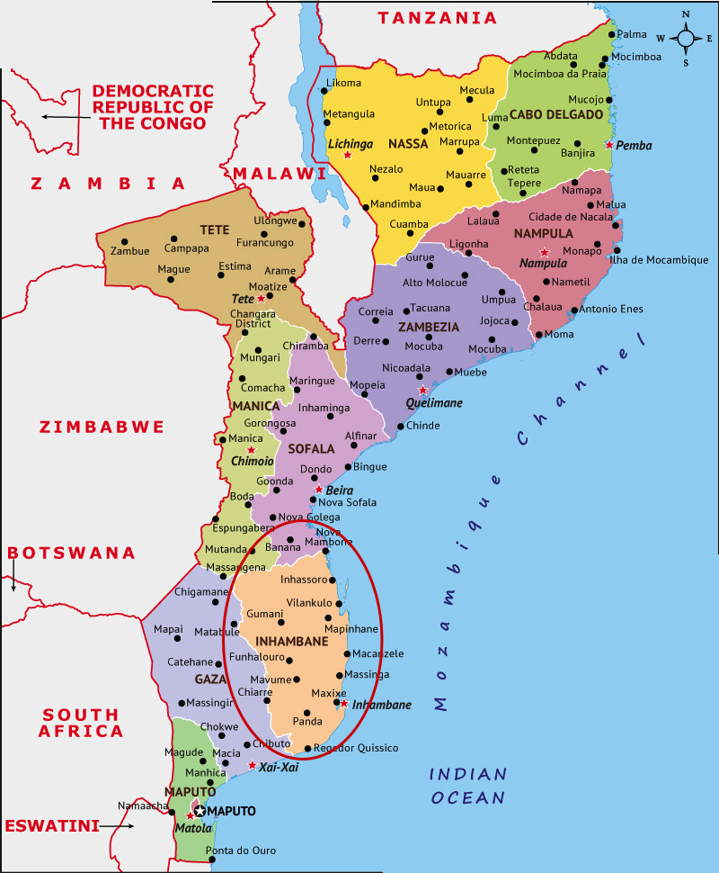
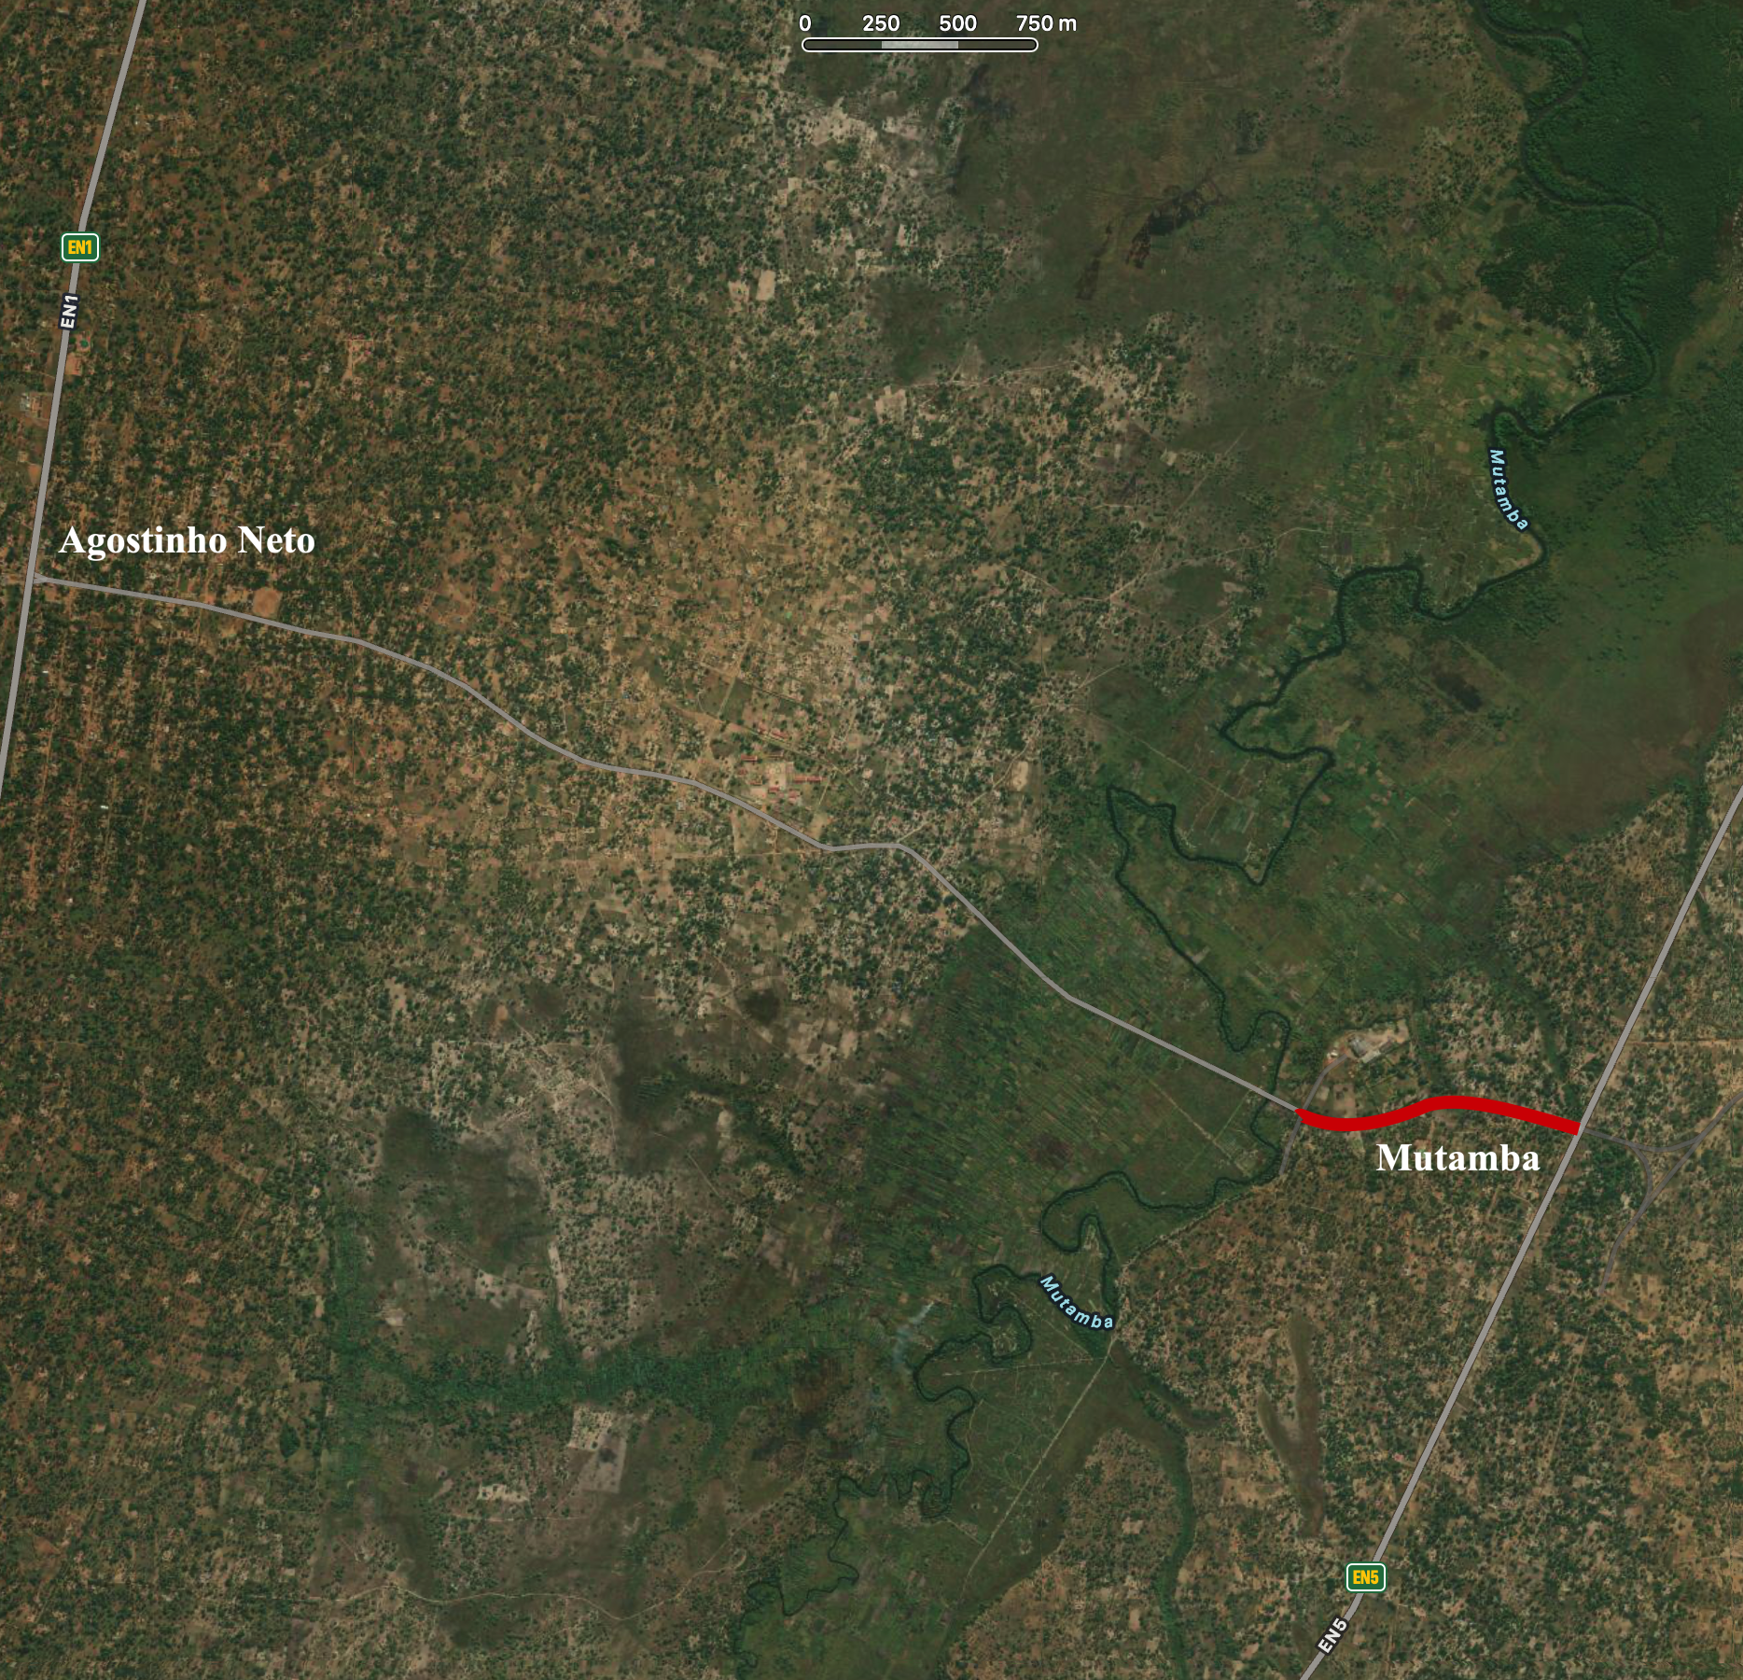
4. CASE STUDY: N/C Agostinho Neto – Mutamba (5,5Km - 900m)
4.1. CONTEXTUALIZATION
Classification | N/C
TMDA (vehic./day) | 690
MAR (mm) | 800 - 950
Total Length (km) | 5,5
Length of Section(m) | 900
Year of construction | 2013
Classification granular base (TMH 14) | G5
EVENTOS CLIMÁTICOS
Cyclone Dineo | 2017
Cyclone Freddy | 2023
Tropical Storm Filipo | 2024

Slide 7
4.2. INDICATORS AND RESULTS
4. CASE STUDY: N/C Agostinho Neto – Mutamba (5,5Km - 900m)
INDICATOR |  | CRITERIA | RESULT
Structural | Rutting ( mm / ano) | < 8 | 2
 | Rutting ( mm / after 3 years) | < 20 | 16
 | layer integrity (armoured Base) | >=90% | 100%
Functional | IRI (m/km) | <= 3,5 | 5
 | Transitability | >= 95% | 100%
 | Functional Availability (% of operating days/year) | >=90% | 100%
Economic | Corrective maintenance intervals | >=24 months | None
 | Annual maintenance cost | <=60% base cost | Yes
Visual | VCI | >=85% | 87

Slide 8
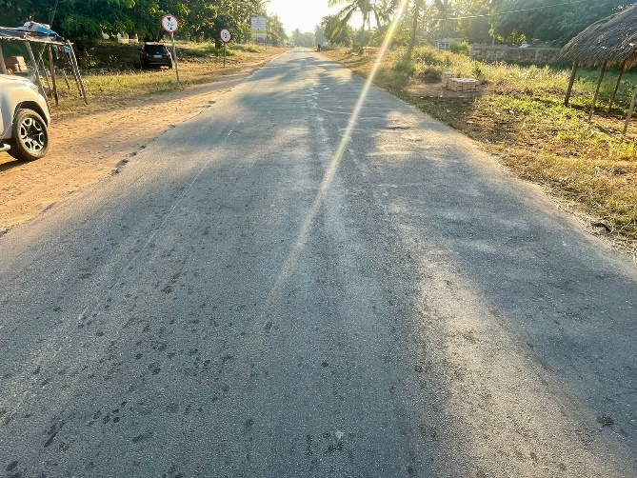
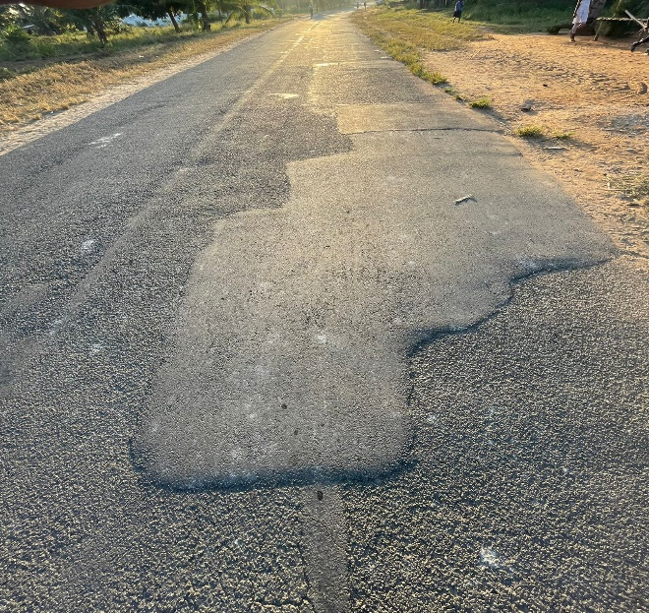
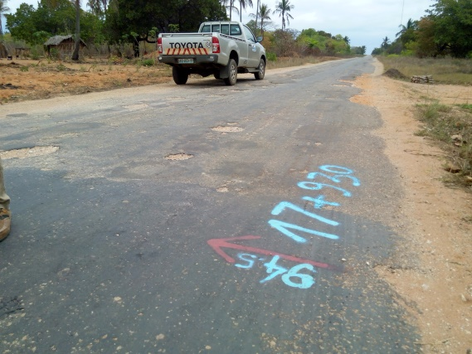
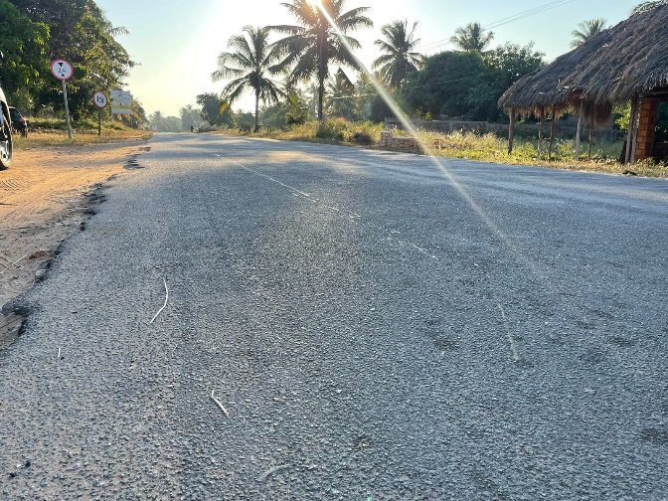
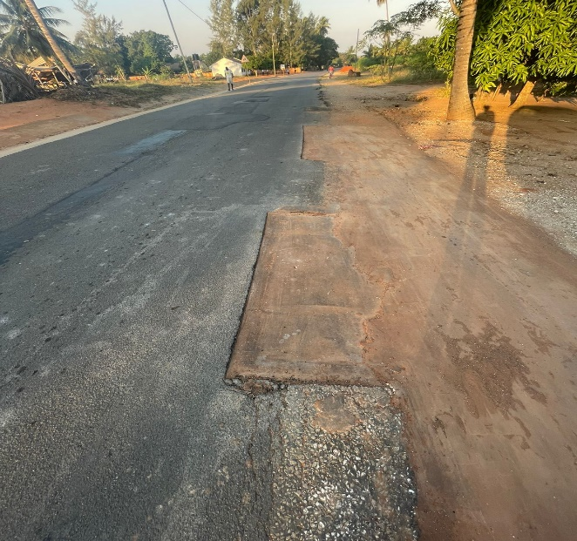
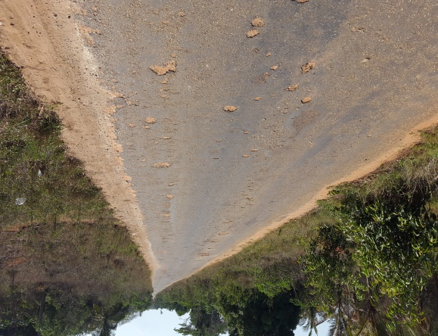
4.2. ACTUAL CONDITIONS
4. CASE STUDY: N/C Agostinho Neto – Mutamba (5,5Km - 900m)
Armoured base
Blended Base
Blended base

Slide 9
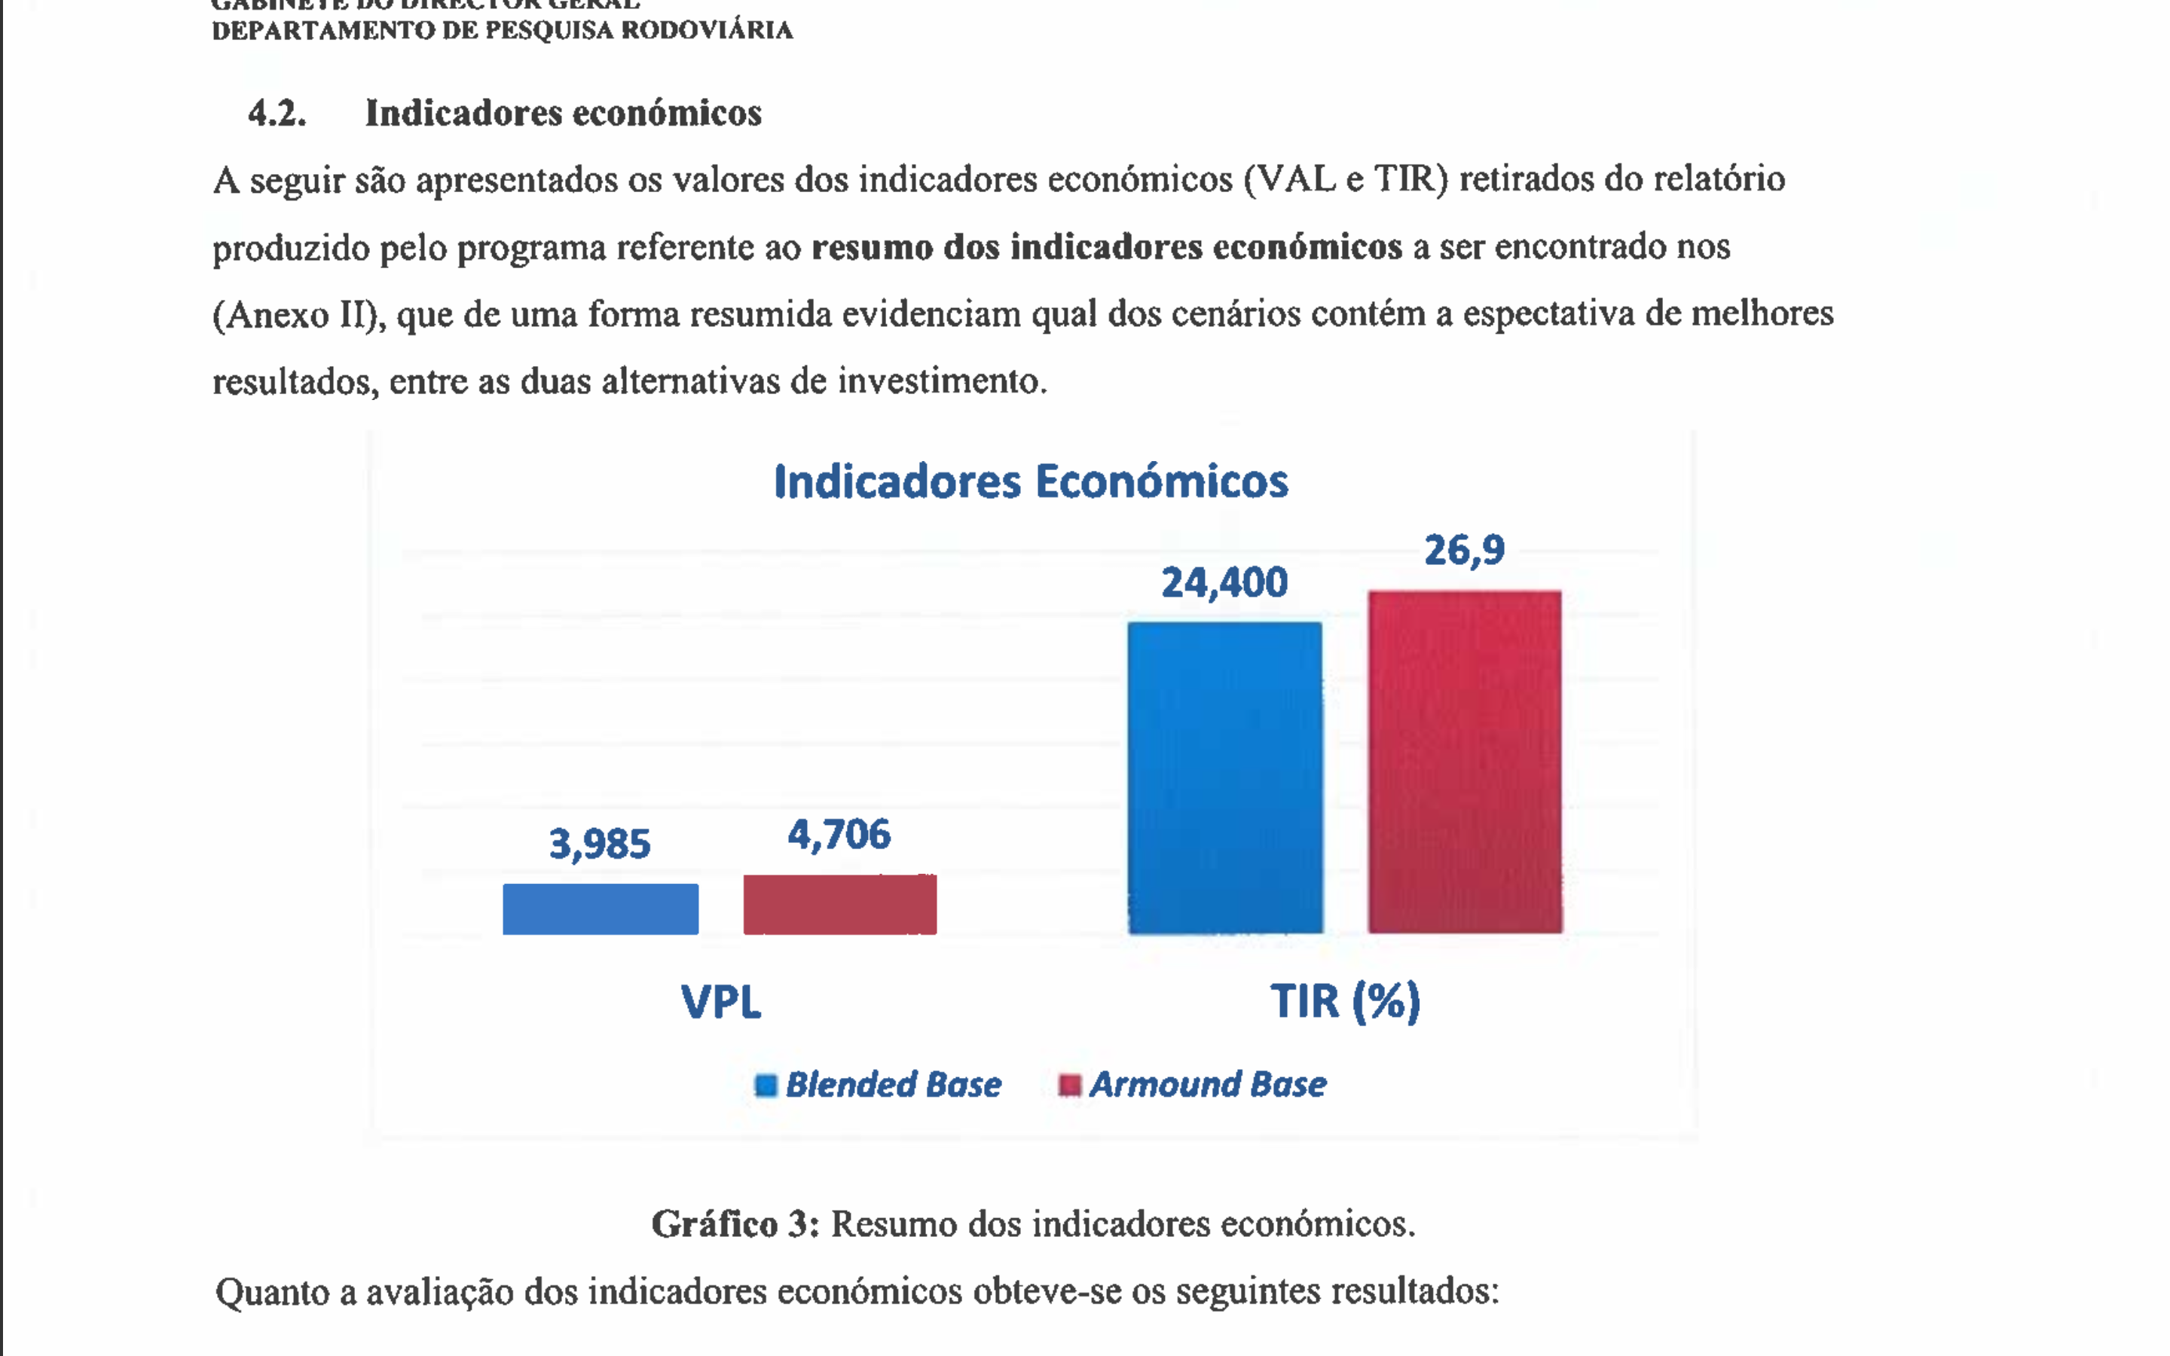
5. ECONOMIC VIABILITY
Road Agencies
Lower Costs (Maintenance and emergency repairs;
More budget available for new projects and network Expansion;
Reduction of extraordinary expenses after. Climatic events;
Better previsibility of the annual budget.
2. Road Users
Lower Costs for transport operations (fuel, tires, suspentions, …);

Slide 10
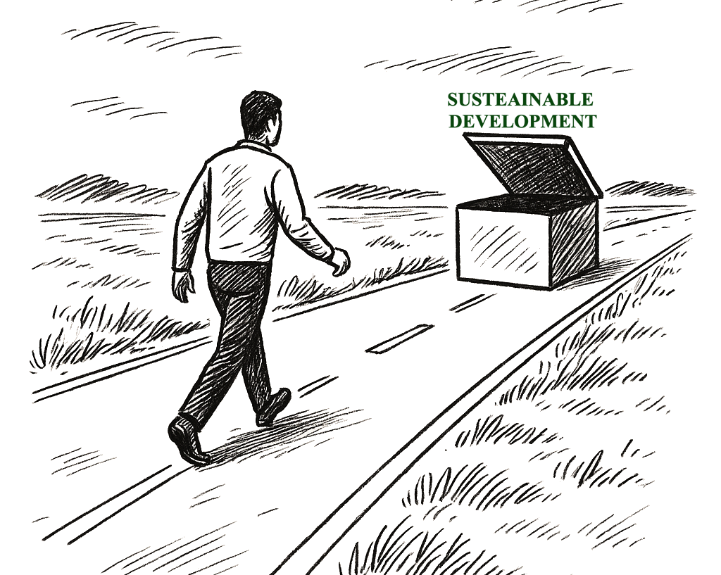
6. CONCLUSIONS
    Experience shows that an armoured base is a robust and economically viable technical solution.
    The solution should be replicated and its effectiveness tested under other conditions for validation.

Slide 11
Thank you for your attention!
Cédrik Edson Namburete
Technician, ANE, IP
cedrik.namburete@gmail.com
@twitter

