Slide 1
Planning the Resilience of Road Networks
Examples of Good Practices in France
Marie Colin
Technical advisor, Cerema (France)
Improvement of Road Network Resilience
“Strategies for Cost-Effective Climate Change Adaptation and Sustainable Development”
12-14 November 2025 / Maputo, Mozambique

Slide 2
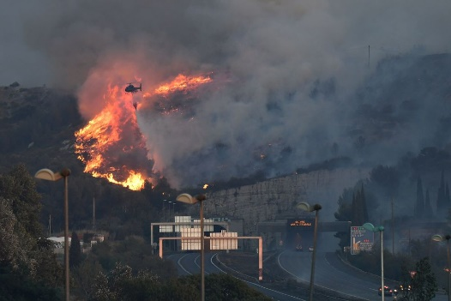
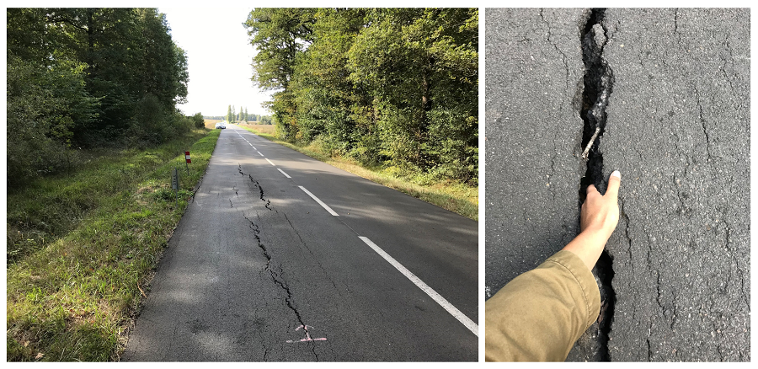
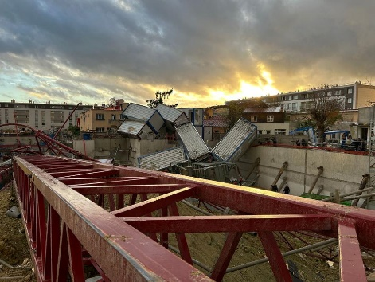

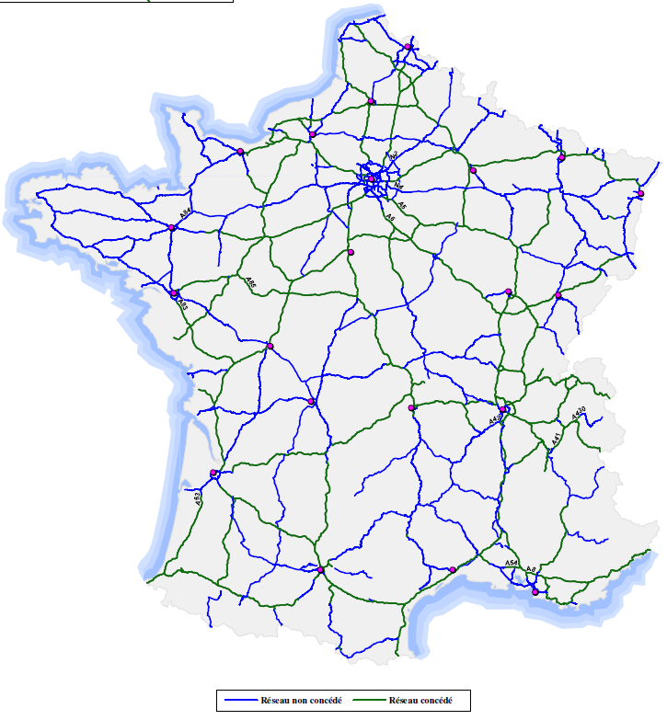
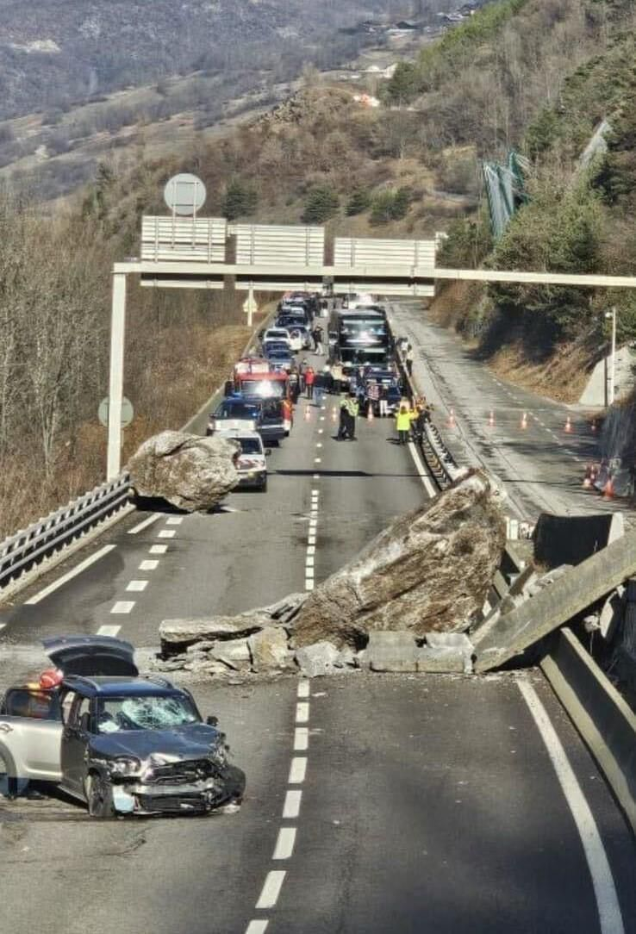
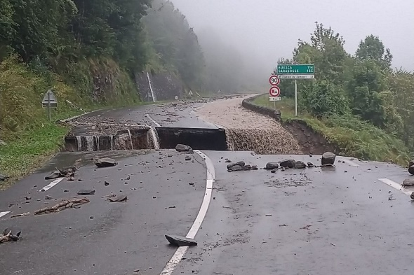
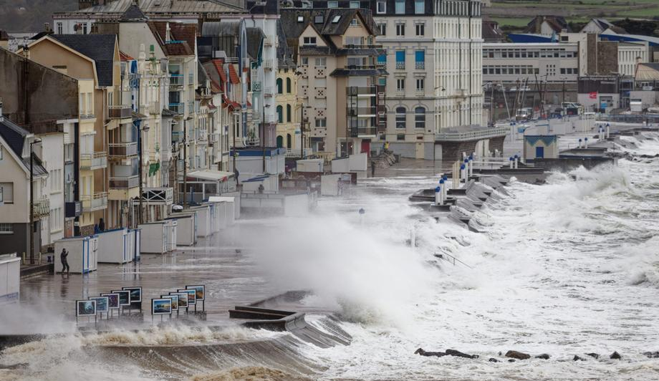
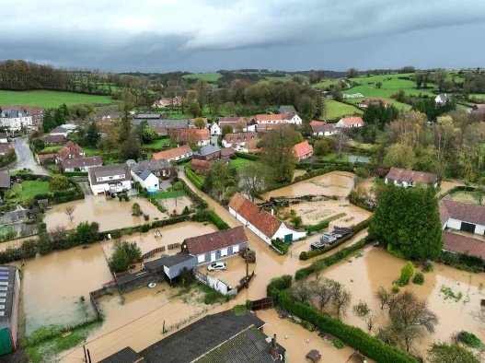
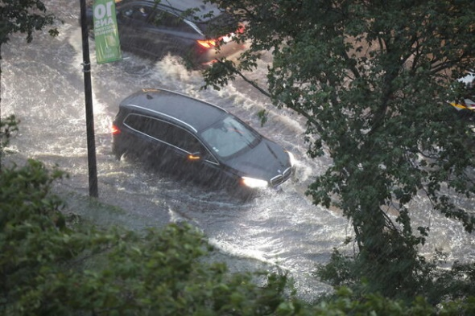
Why it is necessary to improve Road Resilience
In France:
1,101,810 millions km, the vast majority of which is secondary (1,080,586 km)
Road traffic routes account for 82% of transport networks

Slide 3
Why it is necessary to improve Road Resilience
The additional investment required to adapt transport infrastructures over the coming decades could amount to several hundred million to several billion euros per year
(I4CE, 2024)
Storm Alex in October 2020 caused extensive damage to over 70 km of road, costing 500 million € to repair
(CGEDD, IGA 2021)
Between 2009 and 2021, SNCF Réseau experienced five major climate events at a total cost of 38 million €, including 25 million € following the Alex storm
(Cour des Comptes, 2024)
The Savoie department spends 6 to 8 million euros a year to deal with natural hazards on its roads. This cost could rise to 10 to 15 million euros a year over the next few years
(La Gazette des communes, 2025)
The Nord-Pas-de-Calais department estimates that 10% of its roads were damaged by the 2023 floods
(La Gazette des communes, 2024)
A 30% to 50% reduction in infrastructure lifespan has already been observed in mountain areas as a result of climatic conditions
(Cour des comptes 2022)
Source : I4CE, 2024

Slide 4

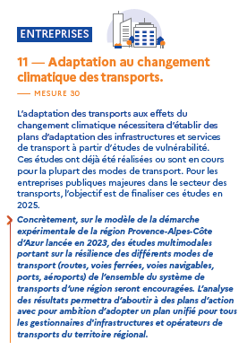
National policy: 3d French National Climate Change Adaptation Plan
Third French National Climate Change Adaptation Plan – PNACC 3
11 – Climate change adaptation of transport
A priority measures (52 measures)
Resilience studies and strategies for transport authorities
Adapt transport and mobility in territories
Adapt public transport services
Adapt technical guidelines used for the design, building & operation of roads

Slide 5

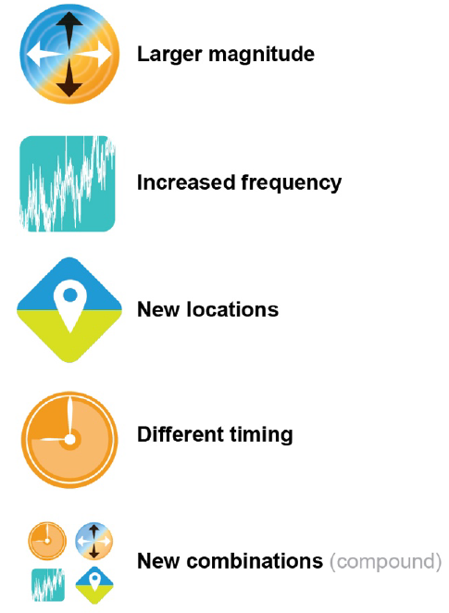


The French National Framework on Climate Change
Reference Warming Pathway for Climate Change Adaptation
Climate hazards
2030
2050
2100
Reference
… of greater intensity/amplitude
… more frequent
… in different geographical areas
+3°C
+4°C
+2°C
+2,7°C
… at different times of the year
+1,5°C
+2°C
… multiple / compound evolutions
+1,1°C
Compared to the pre-industrial area (1850-1900)
(0 °C x 9/5) + 32 = 32 °F

Slide 6
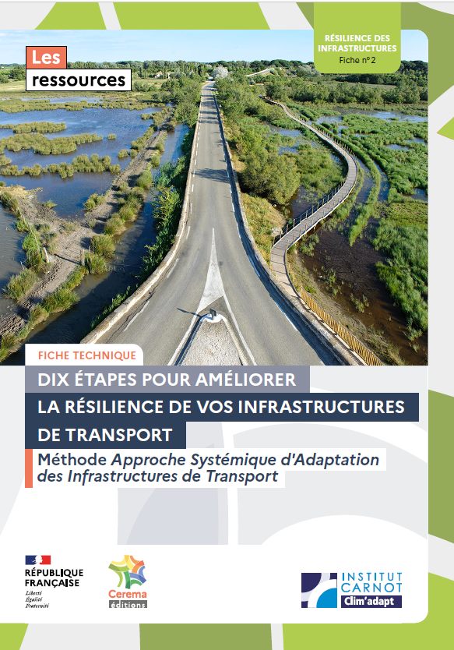
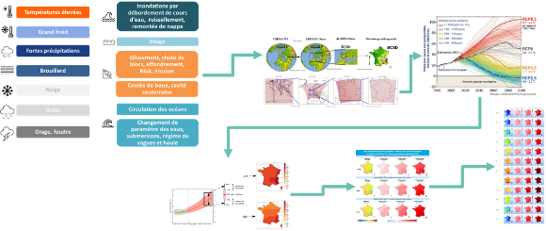
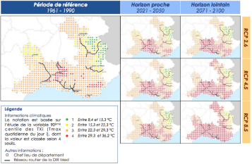
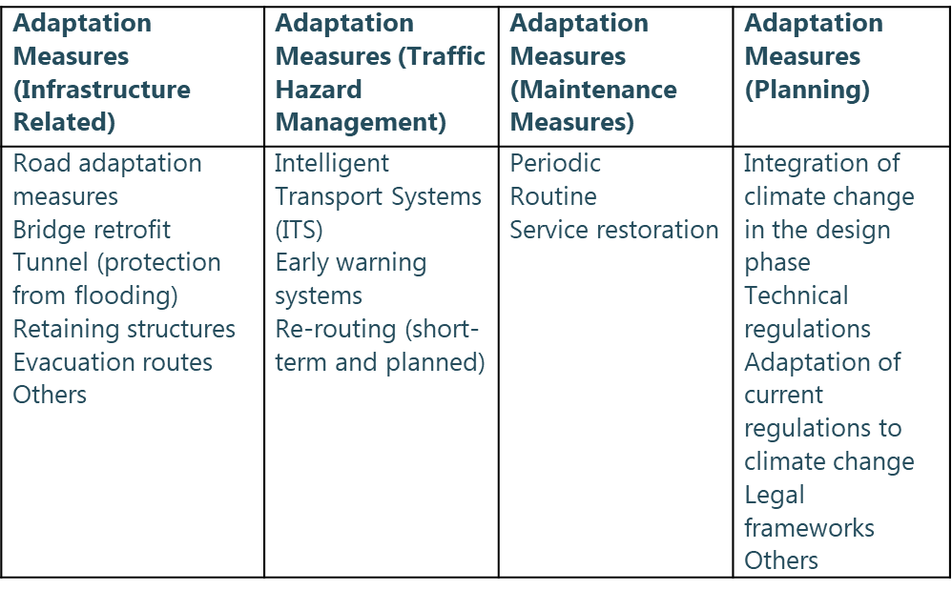
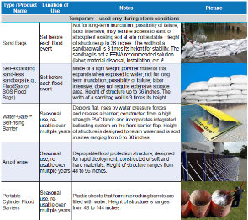
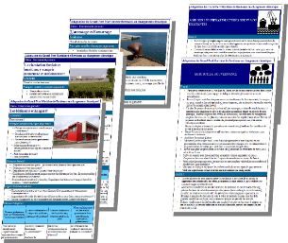
A Framework to Increase Road Resilience: ASAIT
Systemic Approach on Transport Infrastructures Adaptation - ASAIT
Define objectives, scopes and governance
Assess exposure to current and future hazards
Analyse sensitivities and risks evolutions
Identify adaptation solutions
Define a resilience strategy

Slide 7
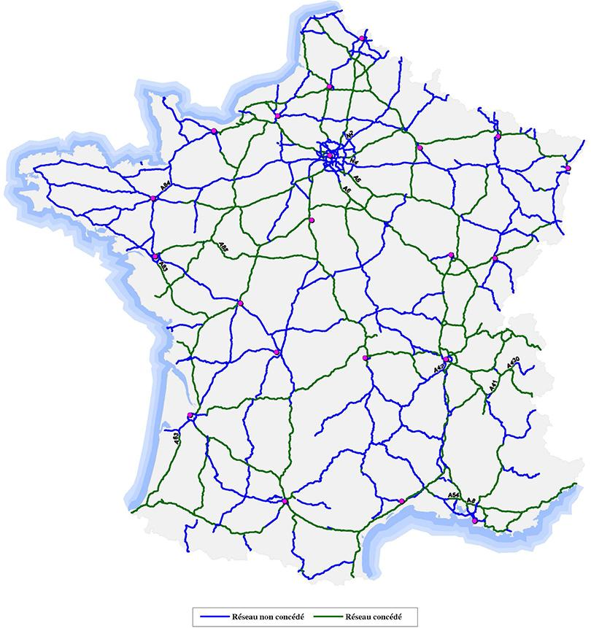
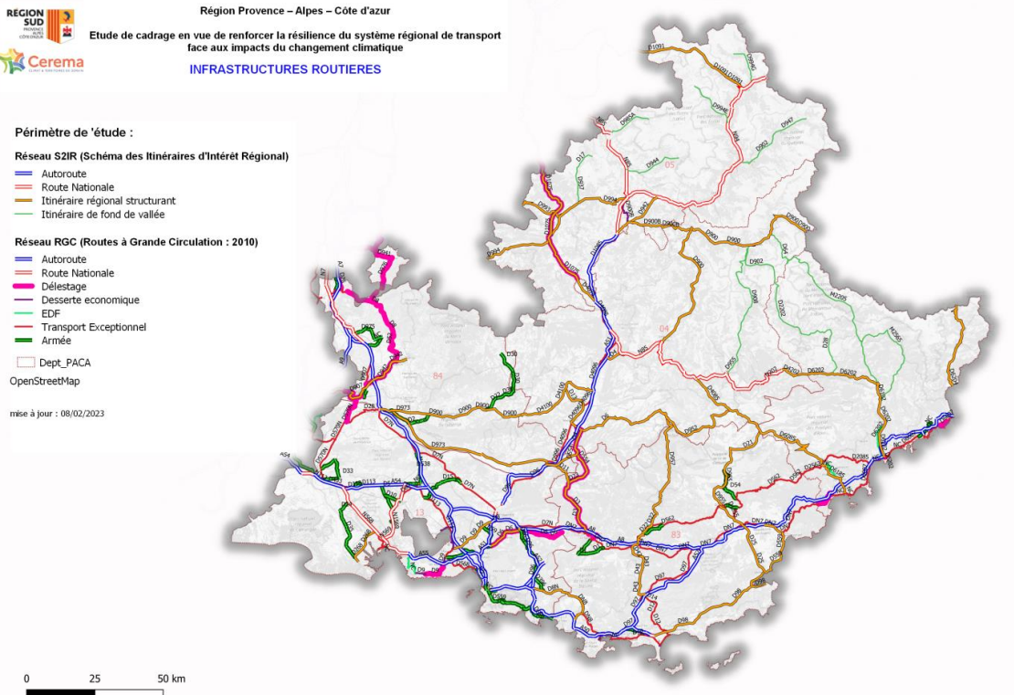
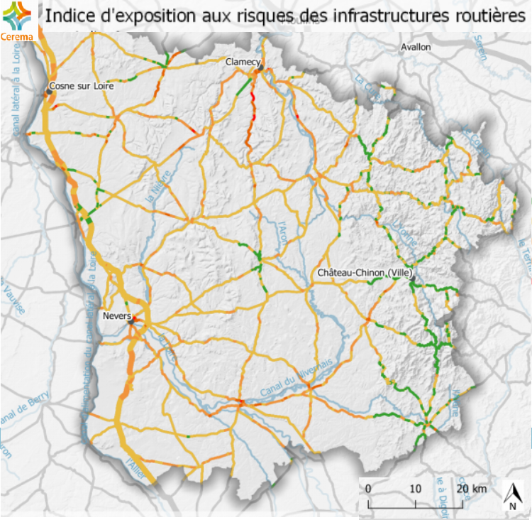

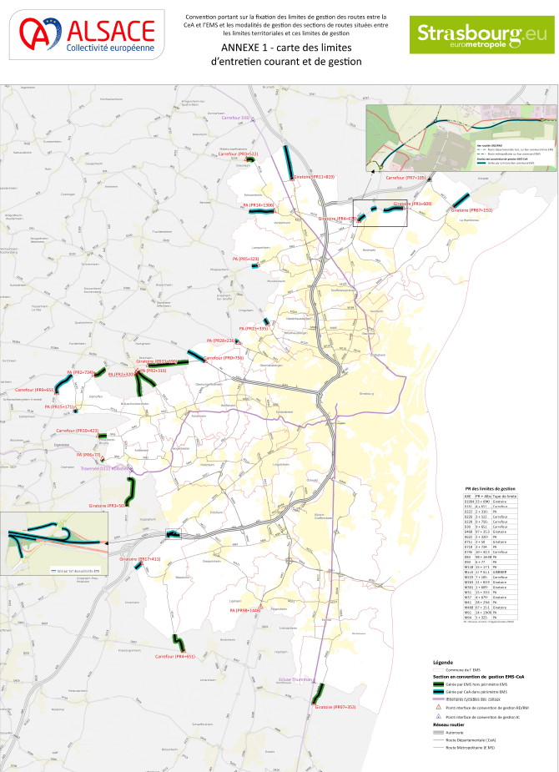
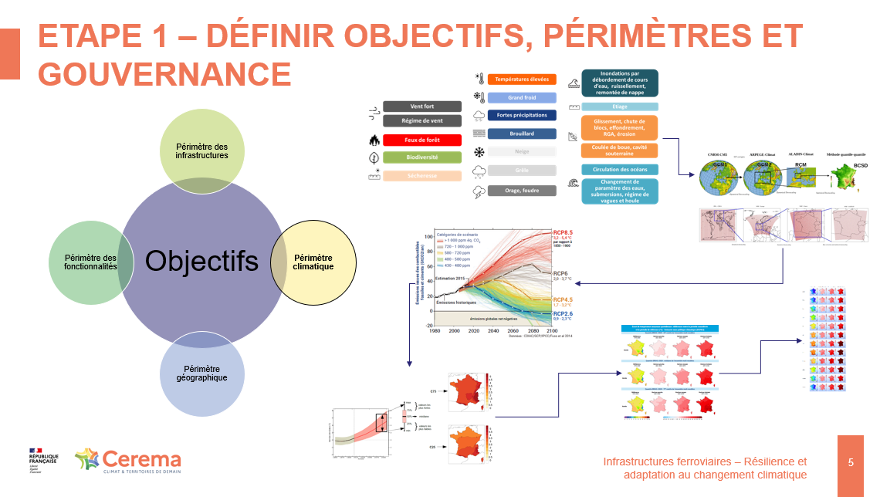
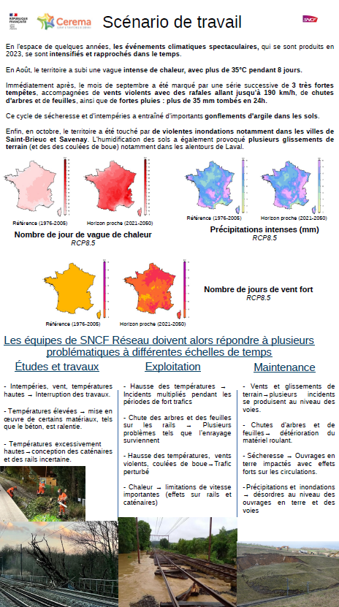
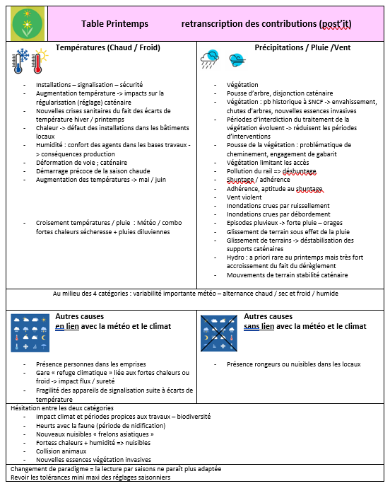
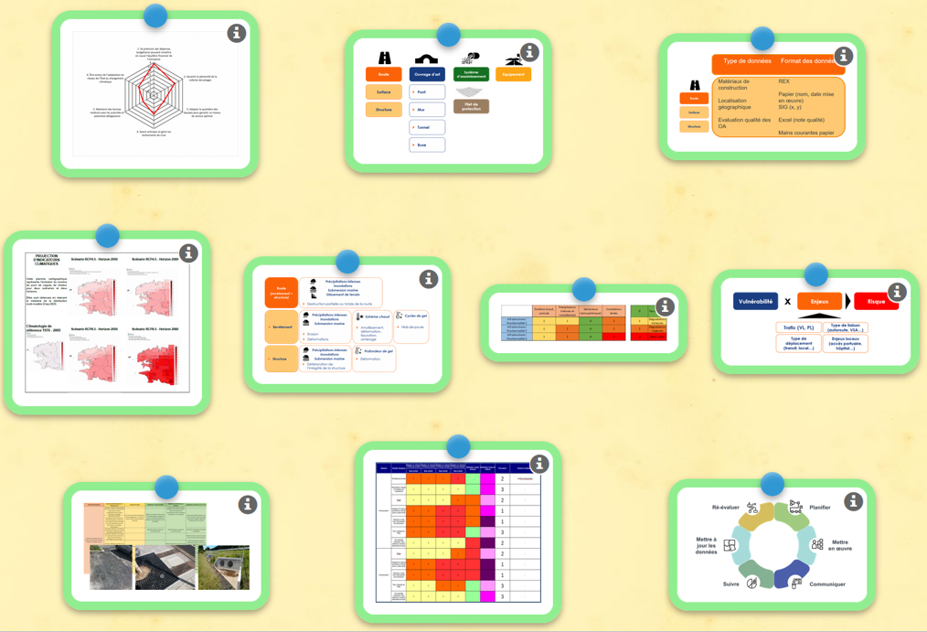
A Framework to Increase Road Resilience: ASAIT
Examples of studies
Resilience study of the national road network, both concessioned and non-concessioned, DGITM (2023 – 2025)
Analyses exposure, risks and challenges across the entire RRN, assesses the costs of inaction, identifies adaptation solutions
R&D project – Vulnerability assessment of regional infrastructure in the face of climate change in the South region, PACA region (2022 – ongoing)
Conducting a vulnerability assessment for all modes of transport, shared between the Region, the State and infrastructure managers
Vulnerability study of road networks in the Nièvre Department, Nièvre Prefecture (2019)
Conducting a macroscopic vulnerability analysis of road networks as part of the implementation of a PCAET (Climate Energy Air Plan)
Study on adapting the road network of the European Community of Alsace to climate change, CEA (2024 – ongoing)
Support to the ECA in framing a study on the resilience of their road network
Awareness-raising/training for employees on climate change resilience, SNCF Réseau (Strategy) - (2022)
Raise awareness among SNCF Réseau employees of the challenges and urgency of adaptation, help them develop their skills in the context of climate change vulnerability studies
Support in defining the scope of the rail resilience study for the Brittany and Pays-de-la-Loire network, SNCF Réseau (2023 – ongoing)
Precisely identify resilience objectives, conduct a resilience study on the Brittany and Loire network, identify adaptation solutions

Slide 8
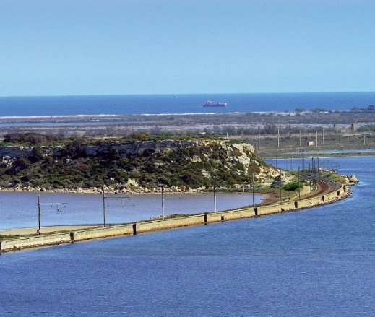
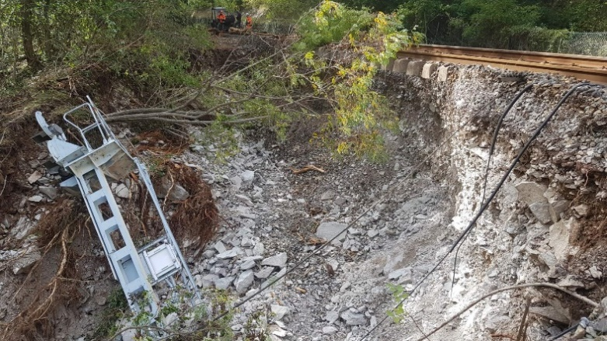
Some specific challenges in adapting road networks
Defining objectives
Improving resilience
Optimize expenditures
Preventing environmental impacts
Improve knowledge
Control costs
Improving the resilience of the territory served
Maintaining optimal service quality
Raise awareness
“Limit the increase in budgetary expenditure on maintenance work related to climate change to +1 point over 15 years”
“Limit average annual delays on the rail network to X min in 2035 during heatwaves in the densely populated Paris region”
“By 2035, adapt Earth structures on the structural network at risk of destruction or serious structural deterioration in the face of heavy precipitation in a TRACC +2°C context”

Slide 9
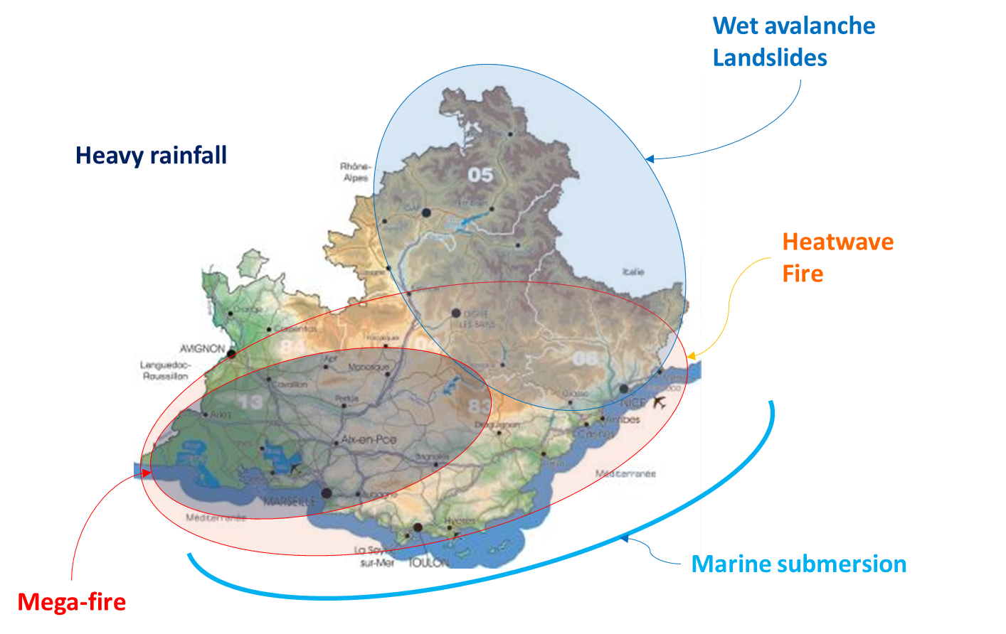
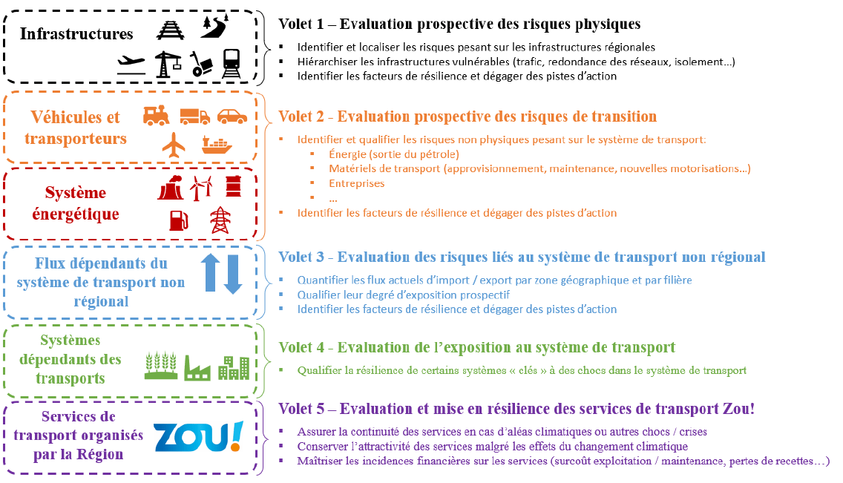
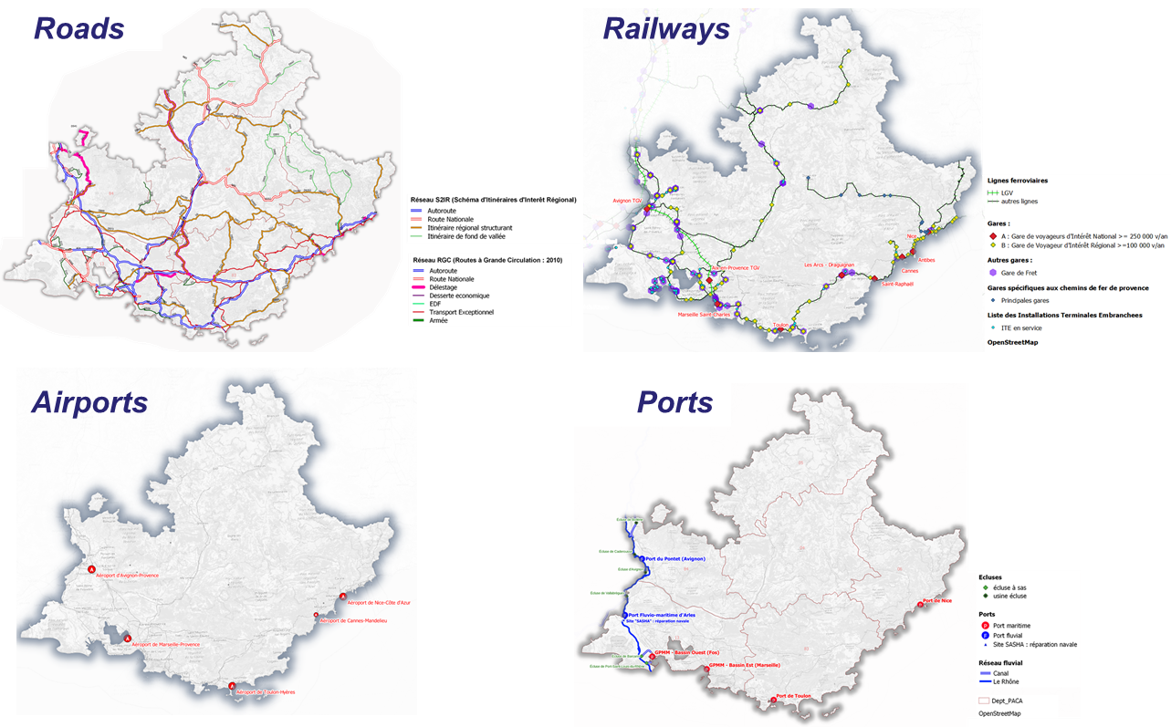
Some specific challenges in adapting road networks
Engaging stakeholder & sharing data
PACA resilience study:
Objective: adapt the regional transport system to make it resilient to crises
Launched as part of the PACA region's resilience strategy
Study leader: State-Region (50% of funding each)
Assets
Vehicles and carriers
Energy system
Flows dependent on the non-regional transport system
Transport-dependent systems
Transport services organized by the Region

Slide 10
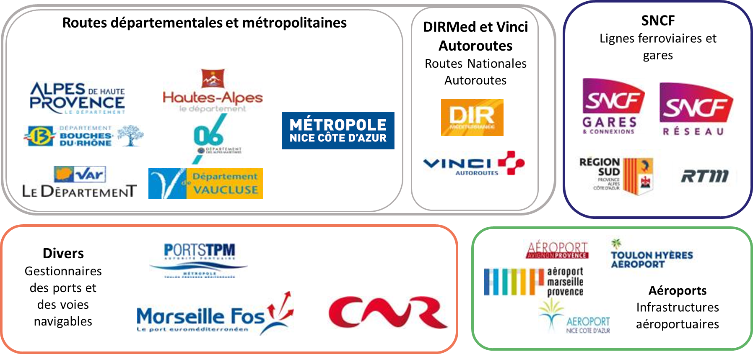
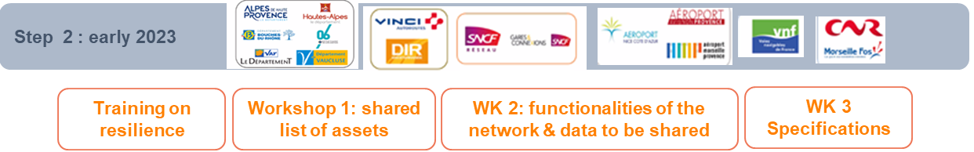
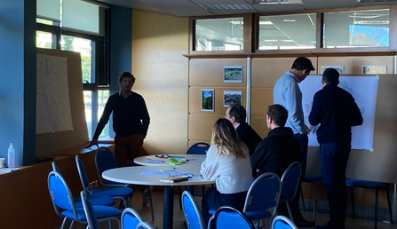
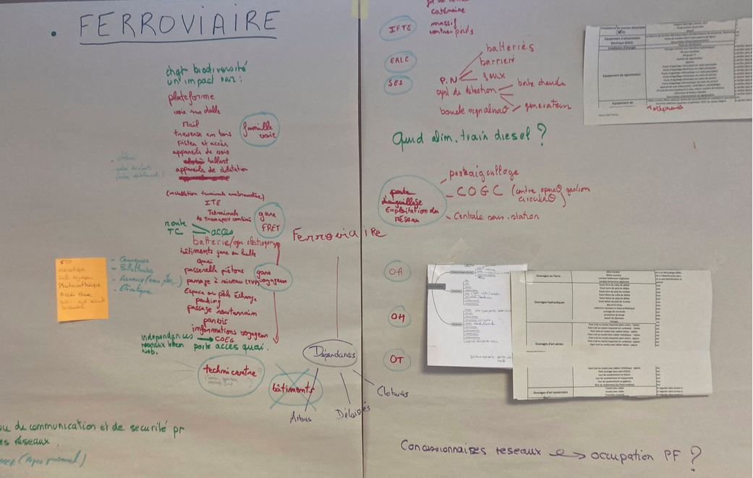
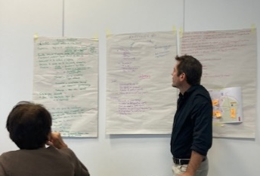
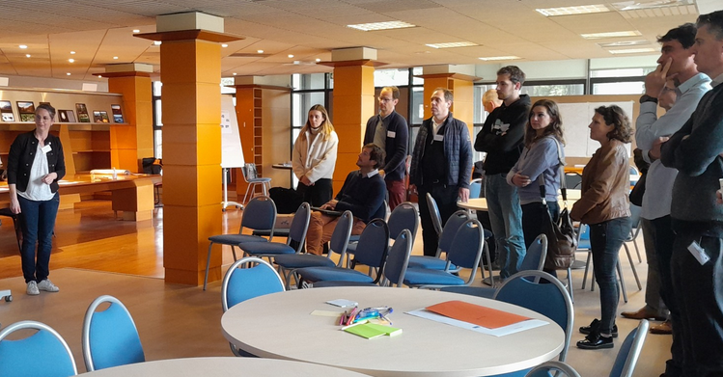
Some specific challenges in adapting road networks
Engaging stakeholder & sharing data
A Charter of Commitment, proposed by the State and the Region, signed by each asset manager:
    "The purpose of the Charter of Commitment is to bring together stakeholders in the region around the theme of adapting transport systems to the challenges of climate change. The signatories to the charter undertake to work collaboratively, both within their own organizations and in conjunction with other similar initiatives within their scope, on the vulnerability study of transport infrastructure and activities, and to work on the development of multi-partner action plans to improve their sustainability and resilience to the effects of climate change. They also commit to monitoring and evaluating progress. […] This charter is not intended to formalize a financial commitment on the part of the stakeholders.”
Common knowledge: training on resilience, regular workshops to share knowledge on impacts, sensitivity, etc.
Workshops to identify and collect data & discuss how to share it

Slide 11

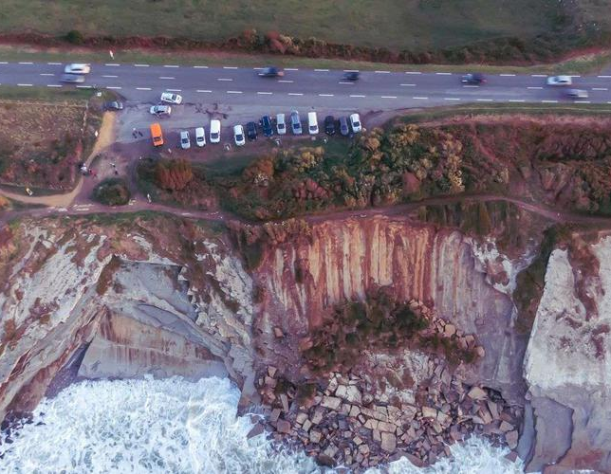
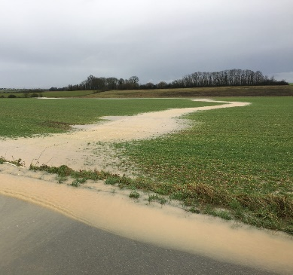
Some specific challenges in adapting road networks
Identifying & choosing adaptation measures
Technical engineering solutions
Rain tree
Grassed swale
Basin
Shotcrete protection of adjacent embankments around metal culverts (flooding)
Rockfall protection
Injection of expanding resin CD37 - RD48 (clay shrink-swell)
Nature-based solutions
Organisational solutions
Source : Cerema, MEL
Notes:
Landslide due to coastal erosion on the Route de la Corniche, Pays-Basque, France, 2021.
@Sud Ouest, Yannis Comte
Agricultural runoff
@Syndicat du SAGE de la Nonette

Slide 12
Some specific challenges in adapting road networks
Identifying & choosing adaptation measures
Design and construction of infrastructure | Maintenance | Operation, including management crisis | Planning, governance
Knowledge of assets | Work periods | Knowledge of hazards | Technical specification
Knowledge of vulnerabilities | Human resources | Crisis and post-crisis management & planning | Awareness-raising, training, internal communication
Asset databases | Frequency of tours inspection | Safety procedures (crisis) | Human resources
Design rules, sizing | … | Feedback on the impacts experienced | Budgetary resources
Protective infrastructures : dykes, etc. |  | Early warning systems | Knowledge of the costs of impacts vs repair costs
Choice of finishing materials design |  | Intelligent transport systems (ITS) | Standards, technical documents
Reinforcement of structures |  | Adaptation of traffic plans | Relocation of activities
… |  | Elevation of the spaces of storage | Improving service to strategic routes
 |  | … | …
Usefull to know:
Costs
Feasibility
Maintenance
Durability
Efficiency
Acceptability
Etc.
Example of a list of adaptation solutions - Cerema

Slide 13
Key take-away messages
Develop a national strategy that is consistent with other existing strategies (transport, environment, risks, etc.) and plan financing as far as possible
Create and disseminate knowledge about climate change. Proposing a national framework helps maintain a certain degree of consistency/comparability between studies
Develop tools and methods to assess vulnerabilities and define resilience strategies - surround yourself with the appropriate technical services
Raise awareness among stakeholders to mobilize them, encourage exchanges and knowledge & data sharing
Specific work to be planned on objectives: to be decided by managers, or set by the State?

Slide 14
Thank you for your attention!
Marie Colin
Technical advisor, Cerema (France)

Slide 15

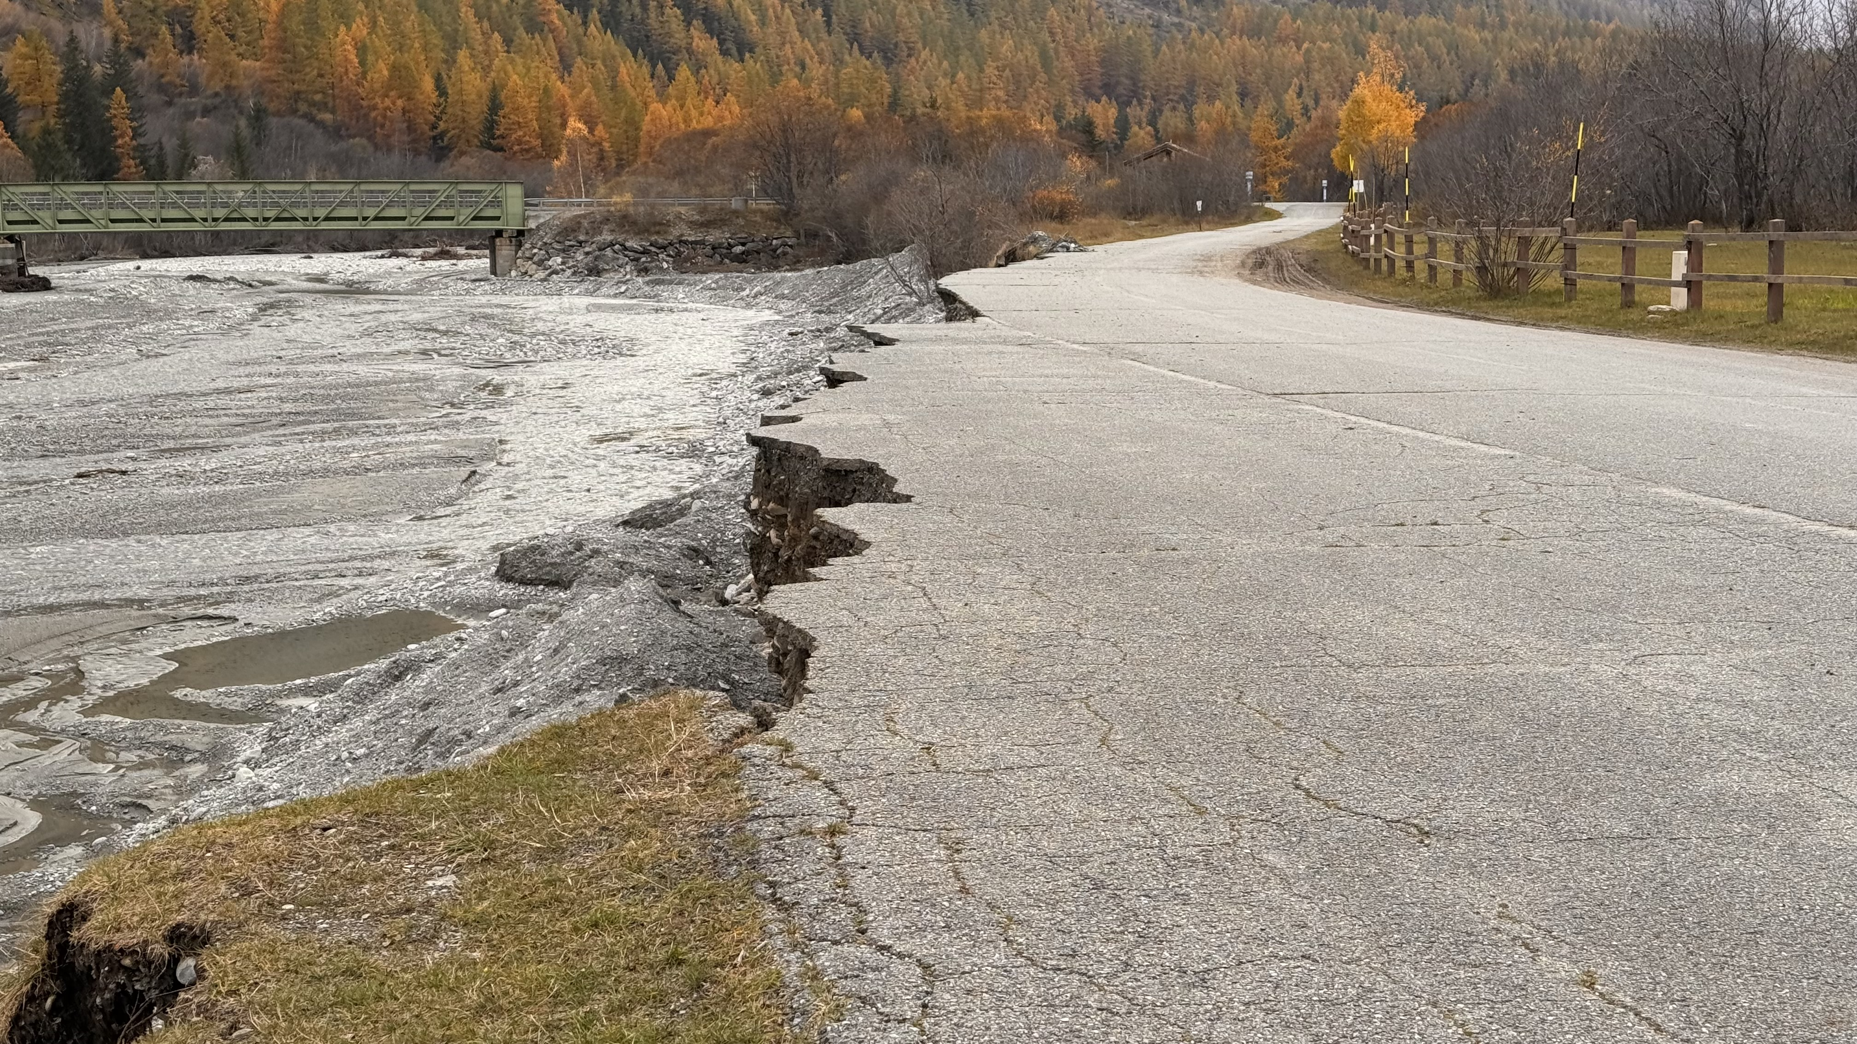
Why is it necessary to improve Road Resilience.
Third (French) National Climate Change Adaptation Plan (PNACC 3):
A climate projection framework based on the IPCC scenarios: TRACC - Reference Warming Trajectory for Climate Change Adaptation
  Climate projections, notably for rain events, available on a public website “Drias”
  Flood projections according to the TRACC hypothesis…
  … must be integrated into new local risk prevention plans
Adaptation of existing and future infrastructures is planned:
  Adaptation of the reference technical documents used to design, build, maintain and operate the network: adaptation of road culverts design to new rain patterns
  Vulnerability assessment of the national road network with identification of adaptation solution and assessment of inaction costs
  Request to the major road operators to carry out vulnerability assessments
  Request to the Regions to develop multimodal adaptation plans
Floods = €24.8 billion in insured damage between 1982 and 2022,
or 50% of the compensation paid out for natural disasters in France

