Slide 1
From Risk to Resilience: Rwanda's Journey Toward a Climate-Proof Road Network
Solange Mizero
Transport Specialist, World Bank
Improvement of Road Network Resilience
“Strategies for Cost-Effective Climate Change Adaptation and Sustainable Development”
12-14 November 2025 / Maputo, Mozambique

Slide 2
Index
Introduction and Context
Rwanda’s Climate Challenges
Vulnerability Mapping
Policy Framework for Resilience
Adaptability and Response Initiatives
Case Study: Rwanda Feeder Roads Development Project
Key Take Aways and Next Steps

Slide 3
Introduction and Context
  Rwanda is known for its hilly terrain (“Country of a thousand hills”) making it prone to floods and landslides.
Located in East Africa, Rwanda borders Tanzania, DRC, Uganda and Burundi.
Low-income country, with services, agriculture and industry being the major contributors to the GDP
Road transport is by far the most used mode of transport as it caters for more than 90% of the people and passenger traffic
The country’s road network is estimated at 38,000km:
  National roads: 2,735 km (of which 58% are paved)
  District roads-Class 1: 3,939 km (of which 5% are paved)
  District roads-Class 2: 9,763 km (of which 2% are paved)
  Others (Local/ Tertiary): 21,461 km (of which 2% are paved)
Topographic map of Rwanda
Source RTDA

Slide 4
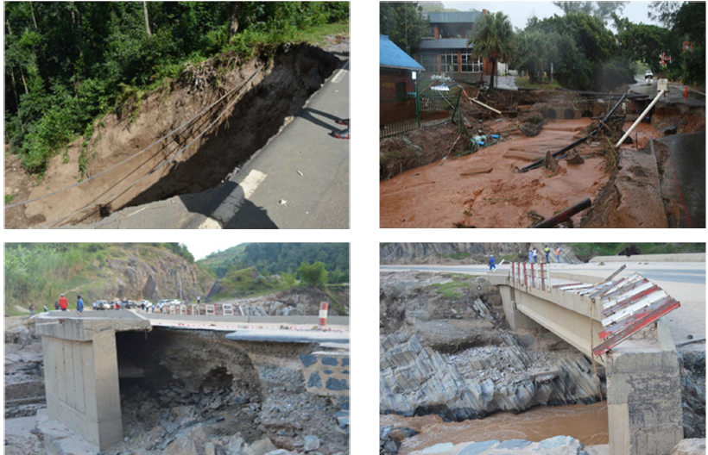
Rwanda’s Climate Challenges
Rwanda ranks 154th out of 185 countries in the Notre Dame Vulnerability Index, highlighting high exposure and low adaptive capacity.
Rwanda faces frequent floods, landslides, and soil erosion, especially during heavy rains.
Historically, climate change has posed significant risks to lives and infrastructure, making resilience a national priority.
Recent disasters of May 2023 floods claimed more than 130 lives and caused over $193 million in damages, with $115 million affecting the transport sector.
These risks threaten connectivity, safety, and economic stability
Illustration of damages of May 2023
Source: Rwanda Transport Development Agency

Slide 5
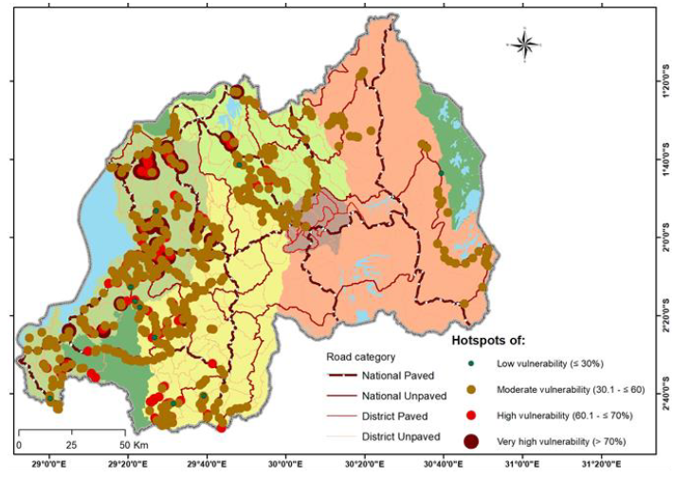
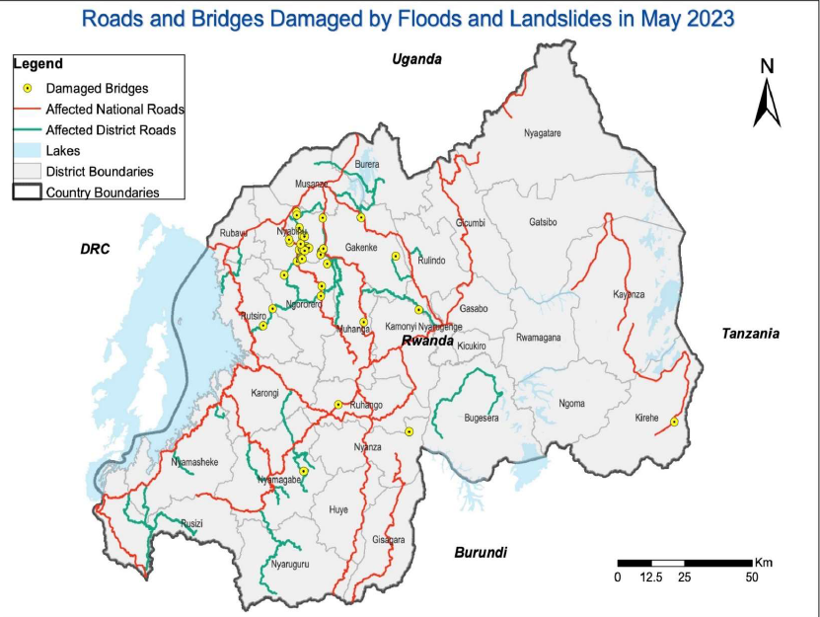
Spatial distribution of the vulnerability assessment on hotspots (February 2022)
Vulnerability Mapping
Roads and bridges damaged by floods and landslides of May 2023

Slide 6
Policy Framework for Resilience
Rwanda’s Green Growth and Climate Resilience Strategy guides national adaptation efforts.
The National Environment and Climate Change Policy and Nationally Determined Contributions (NDCs) set targets for resilient infrastructure.
National Disaster Risk Reduction and Management Policy (2023) provides a framework for effective disaster management focusing on prevention and preparedness for effective response, recovery and longer-term resilience.
The National Emergency Telecommunication Plan launched in October 2025 provides a clear framework for maintaining critical telecommunication infrastructure during natural disasters.
The Ministry in charge of Emergency Management is the leading institution in handling disaster preparedness and response management .
The Ministry of Infrastructure through its implementing arm, the Rwanda Transport Development Agency ensures design, construction and maintenance of a climate resilient road infrastructure.
Climate resilient road design, build back better guidelines and disaster risk monitoring are integrated into budget planning.
Mainstreaming through integrated national planning, strategic environmental assessments of policies and programs as well as sector strategic plans remains an important tool towards resilience.
Effective preparedness and prompt response continue to rely heavily on the collaboration among the government, development partners, and technical committees.

Slide 7
Adaptability and Response Initiatives
Systems Planning and Financing
A country-wide road network vulnerability assessment was completed in 2022
Climate change and adaptation at the center of budget planning
Engineering and Design
Guidelines on disaster and climate resilient road infrastructure & disaster management developed by the Ministry of Infrastructure.
Updating of the related design standards is at an advanced stage.
Nature-based solutions and other innovative solutions are encouraged to achieve cost-effective climate-proof designs.
Operations and Maintenance
A dedicated Road Maintenance Fund with designated sources of revenues is in place. The Fund is under gradual restructuring to cover the exponentially growing network.
Contingency Planning
With the recent introduction of OPBRC, a contingent budget is earmarked to ensure timely response to disasters/emergency
Technical “Climate Resilience” Committees at central and local levels established and regularly trained to support timely response
Institutional Capacity and Coordination
Roles and responsibilities clearly outlined with the Ministry in charge of Emergency Management as the lead agency.
Multi-year maintenance contracts in place for all the national paved roads (highest importance in hierarchy) and urban roads

Slide 8
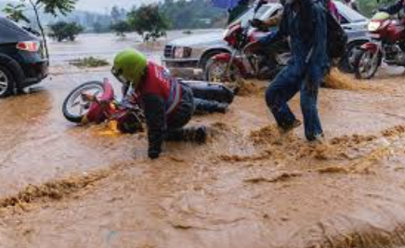
Ongoing World Bank Adaptation Initiatives
  Feeder Roads Development Project:
    Approved in March 2014, due closure in December 2025.
    Supports rural road connectivity in selected districts with an aspect of climate change adaptation as detailed in the next slides
  Rwanda Emergency Connectivity Restoration Project:
    Approved in April 2024
    Designed as a response to the recent floods and landslides of May 2023 to restore connectivity in the affected districts
    The project is supporting the rehabilitation/ repair of damaged roads and bridges
  Rwanda Disaster Risk Management Development Policy Credit with a Catastrophe Deferred Drawdown Option
    Approved in September 2025
    The development objective is to improve Rwanda’s preparedness and response to disaster and health emergencies, while strengthening resilience of its built environment and natural resources.
    The operation increases the resilience of the country by ensuring immediate drawdown of funds in case of an emergency.

Slide 9
Case study: Rwanda Feeder Roads Development Project
Project Development Objective: To enhance all season road connectivity to agricultural market centers in selected districts.
Financiers: World Bank, MTDF (USAID and KoN), CIF and GoR:
Key components:
  Rehabilitation, Upgrading and Maintenance of Selected Feeder Roads (720km)
  Strategy Development for Rural Access and Transport Mobility Improvement and Institutional Development Support
  Project Management Support
  Achievements to date:
  696km of roads completed, 1.5 million rural people and 150 market centers connected to an all-season road
  Strategic documents developed to guide rural roads transport sector (feeder roads strategy, feeder roads master plan and geohazard risk assessment)
Landslide susceptibility map
Source: RTDA

Slide 10
Case Study: Rwanda Feeder Roads Development Project
WHY?
73% of Rwandan population is rural
Agriculture represents about 25% of the country’s GDP
Six out of ten districts of intervention identified as vulnerable
Rural roads perceived as “agricultural roads”
HOW?
Introduction of Output Performance-based Road Contracts including emergency budget
Introduction of sealing technologies to increase the asset lifespan
Comprehensive geohazard risk assessment and resilient investment plan
Development of Standard Operating Procedures (SOPs) to support responsiveness

Slide 11
Case Study: Rwanda Feeder Roads Development Project
Preparedness
Needs estimation
Routine Inspections and Maintenance of the roads and bridges
Event Response
Issue public notices/advisories
Emergency structural rehabilitation or precautional closures
Relief
Identify and communicate possible deviations/alternatives
Stakeholders Engagement
Early anomaly detection and avoidance
Activation of emergency systems
Provide emergency/temporary accesses
Undertake repairs/restoration of damaged infrastructure

Slide 12

Case Study: Rwanda Feeder Roads Development Project
  The project made a major turning point with the approval of the first additional financing in 2017. Whereas the initial intent was to construct gravel roads, 54% of the roads envisaged under the additional financing were sealed. This brought significant benefits:
          Prolonged lifespan: Sealed sections in vulnerable areas can last on average 7 years compared to 2 years when unsealed, bringing value for money to the Government
          Better performance of the road asset: due to the introduction of OPRC types of contracts with a maintenance phase of about 3 years transferring risks to the contractors.
          Job creation: The long-term engagement of contractors and consultants led to higher numbers of jobs created compared to the traditional ways of contracting.
          Enhanced emergency responsiveness: a contingent budget was provided for under the contracts to allow timely response to disasters (mainly floods and landslides)

Slide 13
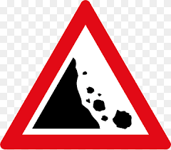
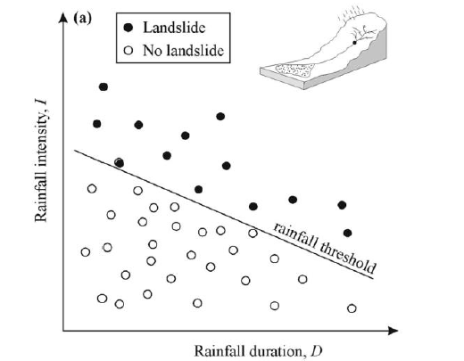
Case Study: Rwanda Feeder Roads Development Project

Slide 14

Disasters are inevitable and induce direct socio-economic impacts. Preparedness matters!
Rethink Infrastructure designs and maintenance towards sustainable infrastructure
Resilience financing: an integral part of the asset lifecycle, not optional
Institutional strengthening and capacity building: a sure way of achieving resilience

Slide 15

IMMEDIATE
Institutional framework to support collaboration for effective preparedness and response
SHORT TO MEDIUM-TERM
Simplified Standard Operating Procedures can significantly help reduce the impacts
IN THE LONG RUN
Invest in risk knowledge: development of functional Road Asset Management and Early Warning Systems.

Slide 16
Thank you for your attention!
Solange Mizero
Transport Specialist, World Bank
smizero@worldbank.org
@solange_mizero

